Slide 1
Protein Sequence Analysis - Overview
Raja Mazumder
Senior Protein Scientist, PIR
Assistant Professor, Department of Biochemistry and Molecular Biology
Georgetown University Medical Center
NIH Proteomics Workshop 2004

Slide 2
Overview
Proteomics and protein bioinformatics (protein sequence analysis)
Why do protein sequence analysis?
Searching sequence databases
Post-processing search results
Detecting remote homologs

Slide 3
Clinical Proteomics
From Petricoin et al., Nature Reviews Drug Discovery (2002) 1, 683-695
From Petricoin et al., Nature Reviews Drug Discovery (2002) 1, 683-695

Slide 4
Single protein and shotgun analysis
Mixture of proteins
Single protein analysis
Shotgun analysis
Digestion of
protein mixture
Gel based seperation
Spot excision
and digestion
Peptides from
many proteins
Peptides from a
single protein
LC or
LC/LC separation
MS analysis
MS/MS analysis
Protein Bioinformatics
Adapted from: McDonald et al. 2002. Disease Markers 18 99-105

Slide 5
Protein Bioinformatics: Protein sequence analysis
Helps characterize protein sequences in silico and allows prediction of protein structure and function
Statistically significant BLAST hits usually signifies sequence homology
Homologous sequences may or may not have the same function but would always (very few exceptions) have the same structural fold
Protein sequence analysis allows protein classification

Slide 6
Development of protein sequence databases
Atlas of protein sequence and structure – Dayhoff (1966) first sequence database (pre-bioinformatics). Currently known as Protein Information Resource (PIR)
Protein data bank (PDB) – structural database (1972) remains most widely used database of structures
UniProt – The United Protein Databases (UniProt, 2003) is a central database of protein sequence and function created by joining the forces of the SWISS-PROT, TrEMBL and PIR protein database activities

Slide 7
Comparative protein sequence analysis and evolution
Patterns of conservation in sequences allows us to determine which residues are under selective constraints (are important for protein function)
Comparative analysis of proteins more sensitive than comparing DNA
Homologous proteins have a common ancestor
Different proteins evolve at different rates
Protein classification systems based on evolution: PIRSF and COG

Slide 8
PIRSF and large-scale functional annotation of proteins
PIRSF structure is in the form of a network classification system based on the evolutionary relationships of whole proteins and domains
As part of the UniProt project, PIR has developed this classification strategy to assist in the propagation and standardization of protein annotation

Slide 9
Comparing proteins
Amino acid sequence of protein generated from proteomics experiment
e.g. protein fragment DTIKDLLPNVCAFPMEKGPCQTYMTRWFFNFETGECELFAYGGCGGNSNNFLRKEKCEKFCKFT
Amino-acids of two sequences can be aligned and we can easily count the number of identical residues (or use an index of similarity) to find the % similarity.
Proteins structures can be compared by superimposition

Slide 10
Protein sequence alignment
Pairwise alignment
a b a c d
a b _ c d
Multiple sequence alignment usually provides more information
a b a c d
a b _ c d
x b a c e
Multiple alignment difficult to do for distantly related proteins

Slide 11
Protein sequence analysis overview
Protein databases
PIR and UniProt
Searching databases
Peptide search, BLAST search, Text search
Information retrieval and analysis
Protein records at UniProt and PIR
Multiple sequence alignment
Secondary structure prediction
Homology modeling

Slide 12
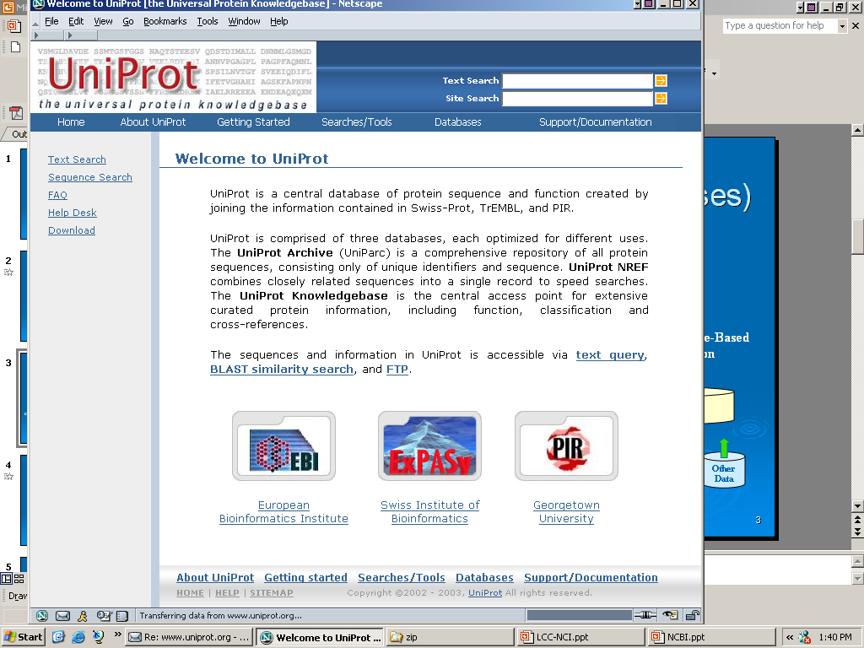
Universal Protein Knowledgebase (UniProt)
PIR (Protein Information Resource) has recently joined forces with EBI (European Bioinformatics Institute) and SIB (Swiss Institute of Bioinformatics) to establish the UniProt
http://www.uniprot.org/

Slide 13
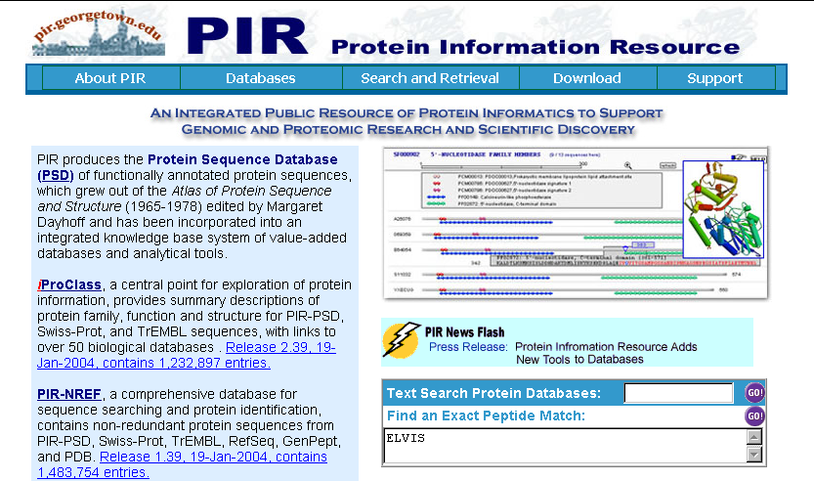
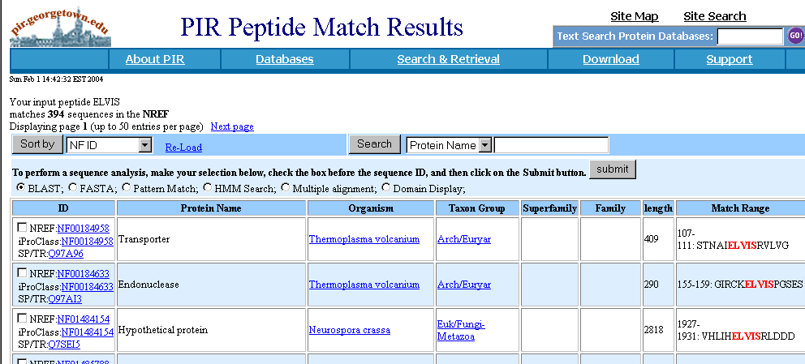
Peptide Search

Slide 14
Query Sequence
Unknown sequence is Q9I7I7
BLAST Q9I7I7 against the UniProt knowledgebase (http://www.pir.uniprot.org/search/blast.shtml)
Analyze results

Slide 15
BLAST results

Slide 16
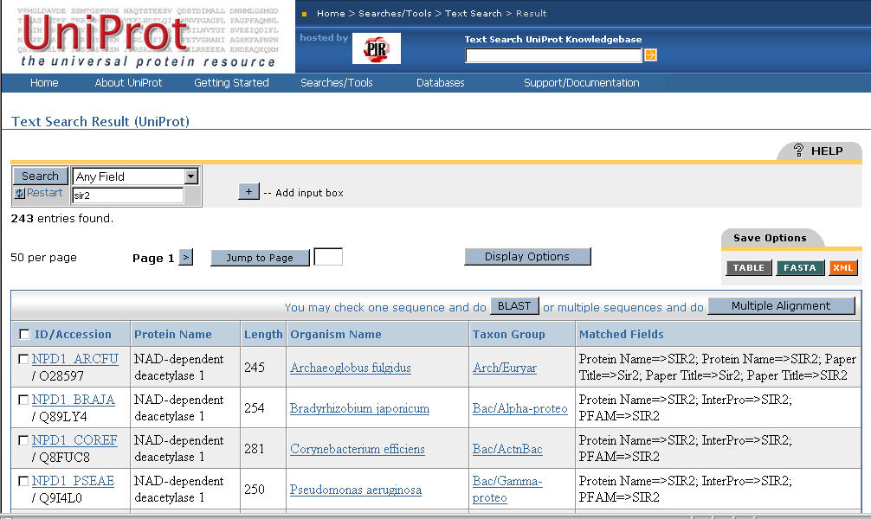
Text Search

Slide 17
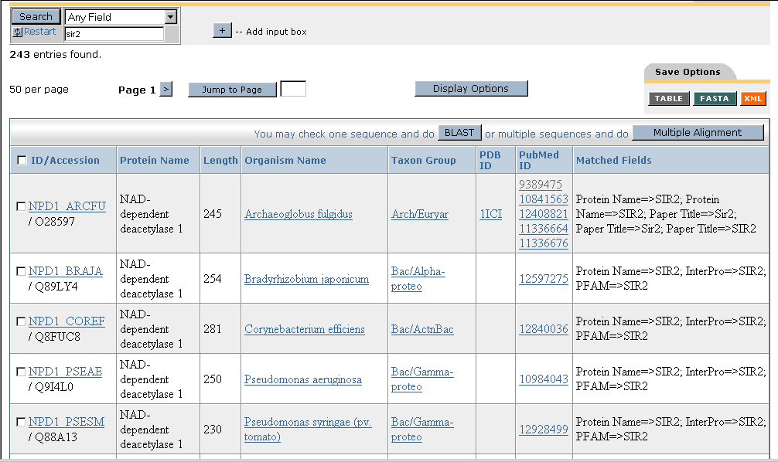
Text search results: display options
Moving Pubmed ID and PDB ID into “Columns in Display”

Slide 18
Text search results: add input box

Slide 19
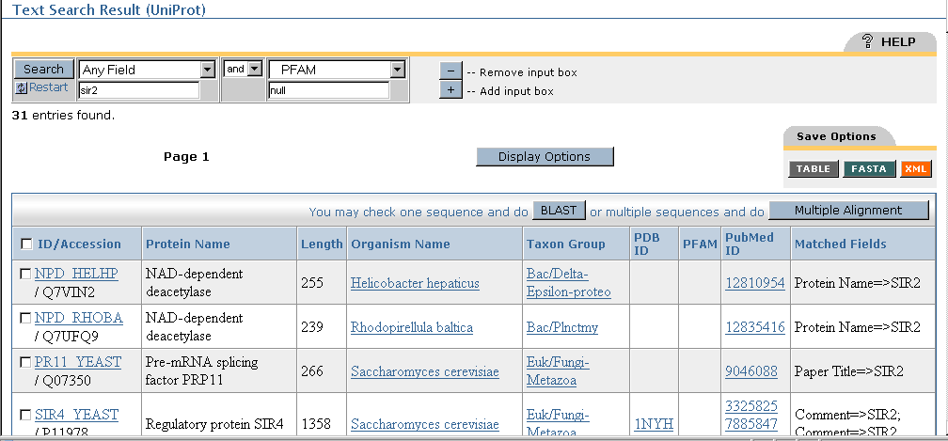
Text Search Result with NULL/NOT NULL

Slide 20
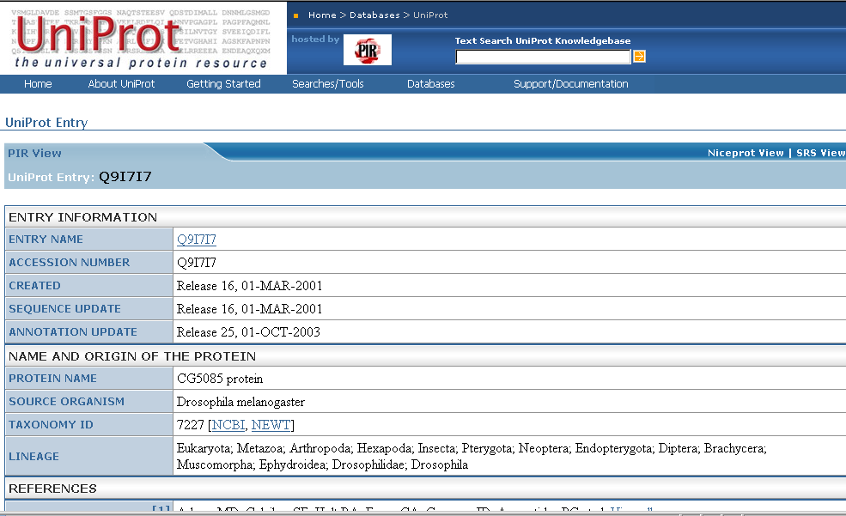
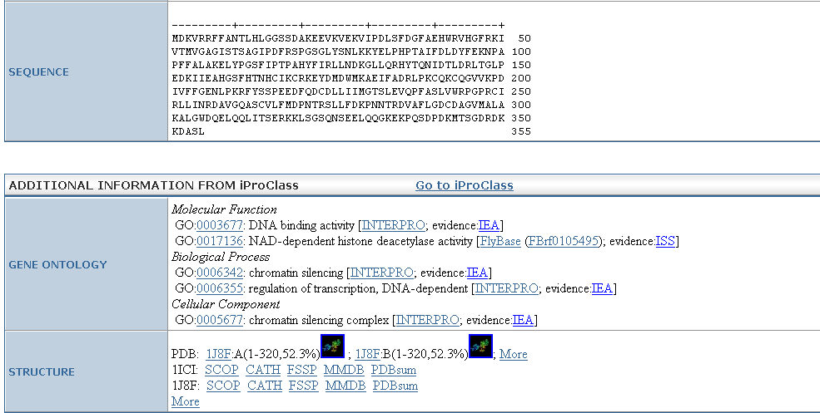
UniProt protein record:

Slide 21
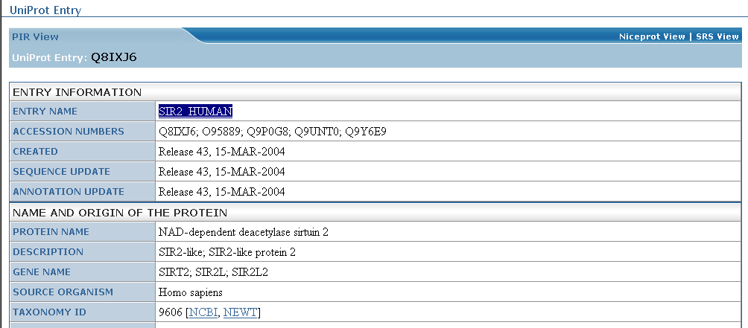
SIR2_HUMAN protein record

Slide 22
Are Q9I7I7 and SIR2_HUMAN close homologs?
Check BLAST results
Check pairwise alignment

Slide 23
Protein structure prediction
Programs can predict secondary structure information with 70% accuracy
Homology modeling - prediction of ‘target structure from closely related ‘template’ structure

Slide 24
Secondary structure prediction http://bioinf.cs.ucl.ac.uk/psipred/

Slide 25
Secondary structure prediction results

Slide 26
Sir2 Homolog-Nad Complex

Slide 27
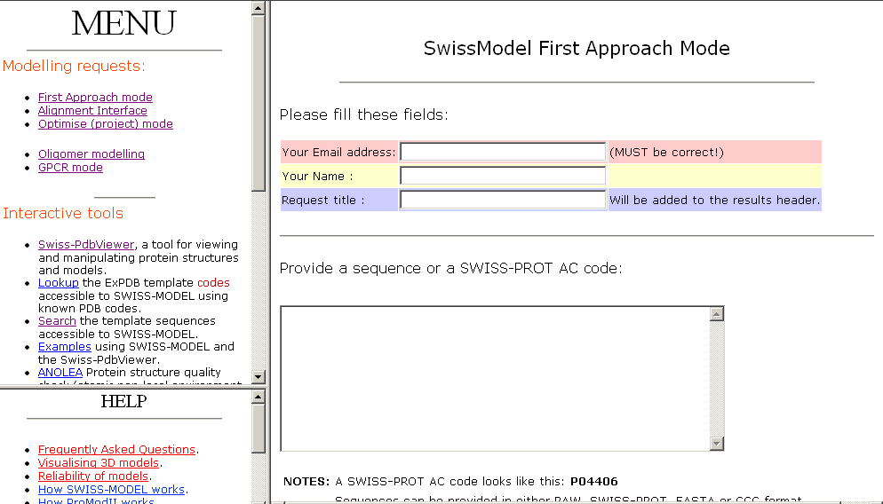
Homology modeling http://www.expasy.org/swissmod/SWISS-MODEL.html

Slide 28
Homology model of Q9I7I7
Blue - excellent
Green - so so
Red - not good
Yellow - beta sheet
Red - alpha helix
Grey - loop

Slide 29
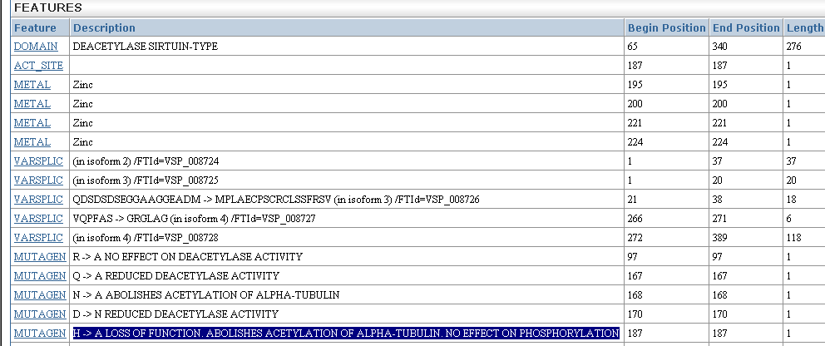
Sequence features: SIR2_HUMAN

Slide 30
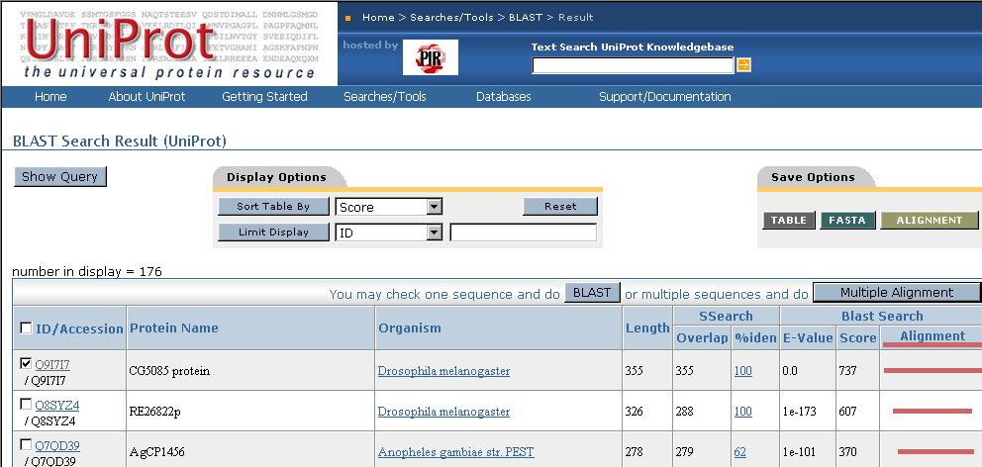
Multiple sequence alignment

Slide 31
Multiple sequence alignment
Q9I7I7, Q82QG9, SIR2_HUMAN

Slide 32
Sequence features: CRAA_RABIT

Slide 33
Identifying remote homologs

Slide 34
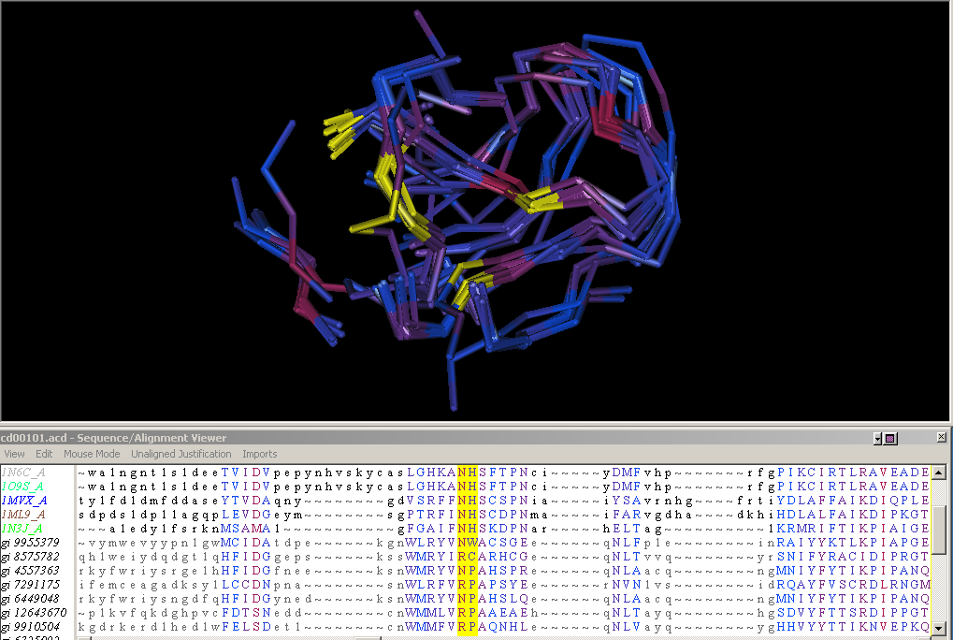
Structure guided sequence alignment

