Slide 1
Water Movement

Slide 2
Gradient
The driving force for water flow.
The difference in potential divided by the
Distance between the two points considered
total potential at point A – total potential at point B
distance between points A and B
The stronger the gradient,
the greater the driving force
for water movement.

Slide 3
Gradient
Height (cm)
50
a
Ψ_{Ta} = -20 cm
20
10
b
Ψ_{Tb} =-100 cm
Ψ_{g} = 0
Reference level
Difference in potential energy = -20 cm – (-100 cm) = 80 cm
Distance between points A and B = 40 cm
=
Gradient =
Difference in total potential = 80 cm = 2
Distance between the points 40 cm

Slide 4
Height (cm)
50
Ψma = -100 cm
Ψga = 0 cm
a
b
20
Ψmb = -200 cm
Ref.
Ψgb = 0 cm
10
0
Distance (cm)
5
25
=
Difference in total potential -100 - (-200) = 100 cm = 5
Distance between the points 20 cm 20 cm
Notes:
Which way will water flow?

Slide 5
The stronger the gradient,
the greater the driving force
for water movement.

Slide 6
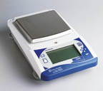
Soil Water Content
Water content by weight
Moist weight – Dry weight
Water weight
=
Dry soil weight
Dry soil weight
Multiply by 100 to yield % water by weight
V = Πr²h
Water content by Volume
Volume Water
Volume Soil
Multiply by 100 to yield % water by volume

Slide 7
Example:
You collect a 200 cm³ soil sample. Its moist weight is
150 g. After drying, the dry weight is 100 g.
Gravimetric water content:
Moist weight – Dry weight
Water weight
=
Dry weight
Dry weight
150 g - 100g
100g
=
50 g = 0.5 or 50%
100g

Slide 8
Example:
You collect a 200 cm³ soil sample. Its moist weight is
150 g. After drying the dry weight is 100 g.
Volumetric water content:
Volume Water
Density of water
1 g/cm³
Volume Soil
150 g - 100g
200 cm³
=
50 g
200 cm³
= 50 cm³ water = 0.25 or 25%
200 cm³ soil

Slide 9
Characterizing Soil Moisture Status
Energy-Based
Relating water content and matric potential (suction)
Notes:
Obvious relationship between water content and suction.

Slide 10
Characterizing Soil Water
Soil Core
porous plate
suction

Slide 11
Characterizing Soil Water
Soil Core
Moisture Release Curve
saturated
One soil
*
Water
Remaining
In soil
Suction applied in
discrete increments.
0
Suction applied (cm)
10,000

Slide 12
Texture, Density
Two Soils
saturated
A
*
Water
Remaining
In soil
coarser
B
finer
0
Suction applied (cm)
10,000

Slide 13
Pore Size Distribution
saturated
*
Water
Remaining
In soil
Suction applied (cm)
10,000

Slide 14
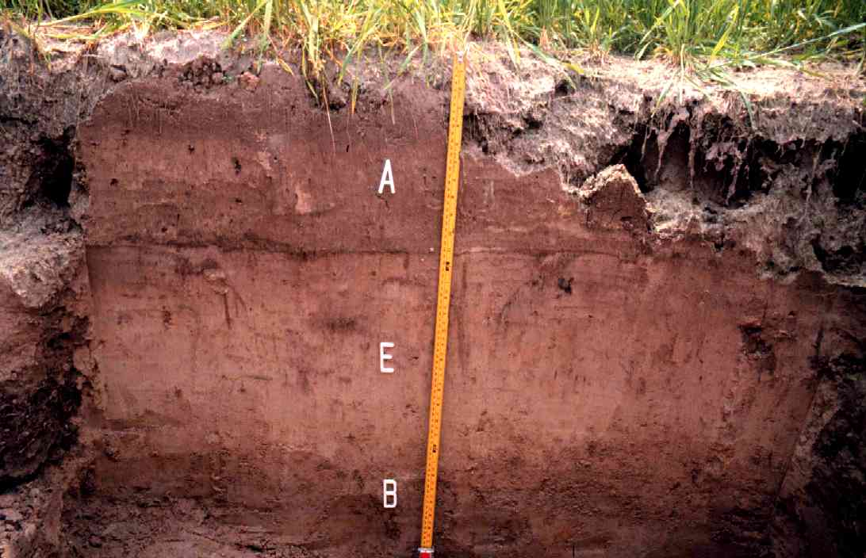
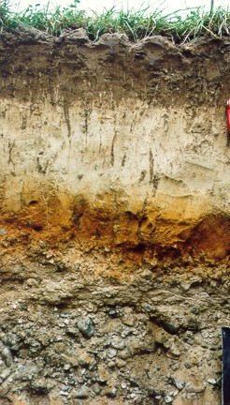

Slide 15
Soil Moisture Status

Slide 16
Soil Moisture Status
Saturation: Water content of soil when all pores are filled
Suction equivalent: 0 bars
0 KPa
0 cm water
Field Capacity: Water content of soil after drainage from saturation by gravity
Suction equivalent: -0.33 bars (or –0.10 bars)
- 33 KPa
- 330 cm water
Permanent: Water can no longer be accessed by plants
Wilting point Suction equivalent: -15 bars
-1500 KPa
- 15,000 cm water
Plant Available water: Field Capacity - PWP

Slide 17
Energy and Texture
Water Content (%) at
Texture | Field Capacity | Perm. Wilting Point
Sandy Loam | 17 | 9
Loam | 24 | 11
Clay | 36 | 20
Heavy Clay | 57 | 28
Smaller
particles
and pores

Slide 18
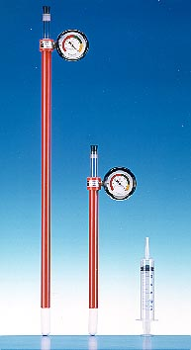
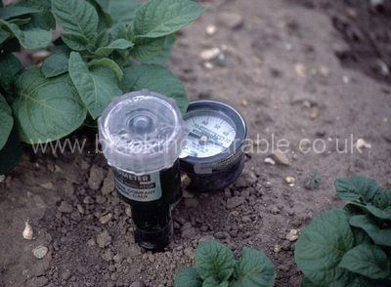
Practical Measures
saturated
*
Water
Remaining
In soil
0
Suction applied (cm)
10,000
Notes:
Imagine growing tomatoes

Slide 19
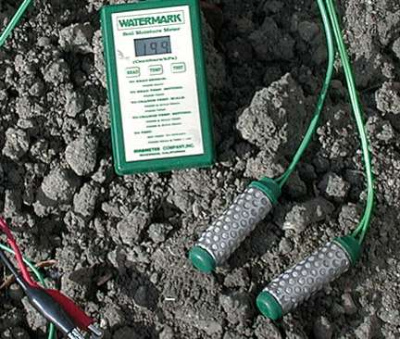
Direct Methods
Time Domain Reflectometry
Soil Resistance Blocks

Slide 20
The Rate of Water Movement

Slide 21
Hydraulic Conductivity
The ease with which water moves through soils
Strongly responsible for water distribution
within the soil volume.
Determines the rate of water movement in soil.
Texture
Density
Structure
Water content

Slide 22
Hydraulic Conductivity
Coarse
uncompacted
Fine
compacted

Slide 23
Determining Saturated Hydraulic Conductivity
Volume
time
⃗
h * A
L
W
A
T
E
R
h
Volume
time
=
K
h * A
A
L
L
Soil
K = V * L
h * A * t

Slide 24
Approximate Ksat and Uses
Ksat (cm/h) | Comments
36 | Beach sand/Golf Course Greens
18 | Very sandy soils, cannot filter pollutants
1.8 | Suitable for most agricultural, recreational, and urban uses
0.18 | Too slow for most uses
<3.6 x 10⁻⁵ | Extremely slow; good if compacted material is needed
Saturated hydraulic conductivity

Slide 25
Determining Saturated Flow

Slide 26
Determining Saturated Flow
Darcy’s Equation
Volume flow
Area * time
= Q
= Ksat * gradient
A

Slide 27
Gradient
Height (cm)
50
a
Ψ_{Ta} = -20 cm
20
10
b
Ψ_{Tb} =-100 cm
Ψ_{g} = 0
Reference level
Difference in potential energy = -20 cm – (-100 cm) = 80 cm
Distance between points A and B = 40 cm
Gradient =
Difference in total potential 80 cm = 2
Distance between the points 40 cm
=

Slide 28
Darcy’s Equation
=
Gradient =
Difference in total potential = 80 cm = 2
Distance between the points 40 cm
Volume flow
Area * time
= Q
= Ksat * gradient
(Q) = 5 cm/hr * 2
= 10 cm/hr

Slide 29
Height (cm)
50
Ψma = -100 cm
Ψga = 0 cm
a
b
20
Ψmb = -200 cm
Ref.
Ψgb = 0 cm
10
0
Distance (cm)
5
25
=
Difference in total potential -100 - (-200) = 100 cm = 5
Distance between the points 20 cm 20 cm
If Ksat = 5 cm/hr, then the flow (Q) = 5 cm/hr * 5 = 25 cm/hr
Notes:
Which way will water flow?

