Slide 1
List of important diseases of wheat
SL. No. | Disease | Causal organism
1. | Blast | Magnaporthe oryzae triticum pathotype (MoT)
2. | Fusarium head blight | Fusarium graminearum (Imperfect stage) Gibberella zeae (Perfect stage)
3. | Leaf blight or Black point | Bipolaris sorokinina Alternaria triticiana
4. | Rusts
 | Stem rust | Puccinia graminis f. sp. tritici
 | Leaf rust | Puccinia triticina (formally Puccinia recondita)
 | Stripe rust | Puccinia striiformis
5. | Foot and root rot | Fusarium graminearum/F. cilmorum Rhizoctonia solani Pythium spp.
6. | Loose smut | Ustilago tritici (Syn. U. nuda var. tritici)
7. | Powdery mildew | Blumeria graminis f. sp. tritici

Slide 2
Disease: Wheat blast
Causal organism: Magnaporthe oryzae Triticum pathotype (MoT)
Small dark brown spots without light centers (type 1) lesions represent an enlarged resistance reaction and fail to produce spores.
Blast infected bleached spikelets
Larger, eye-shaped lesions with light tan centers and dark brown margins (Type 5 lesions) produces thousands of spores per night over a 20-day period.
Head symptoms showing blackened rachis with entire wheat head bleached out symptoms

Slide 3
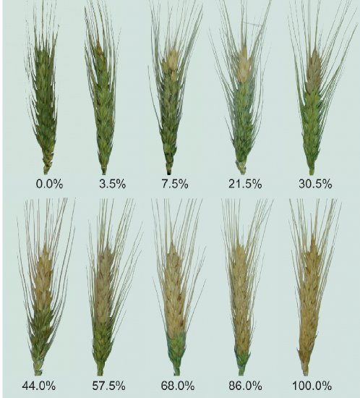
Blast infected wheat heads showing blackened rachis with entire head bleached out

Slide 4
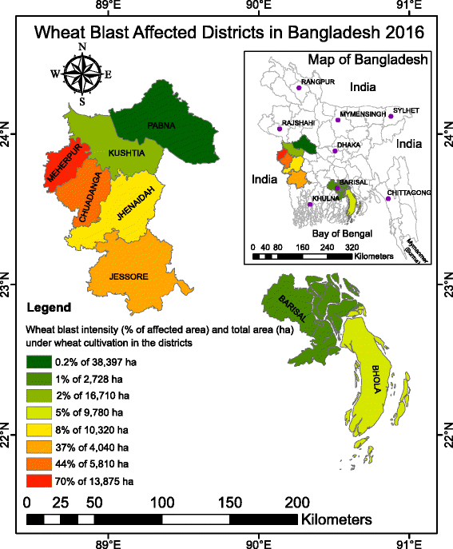
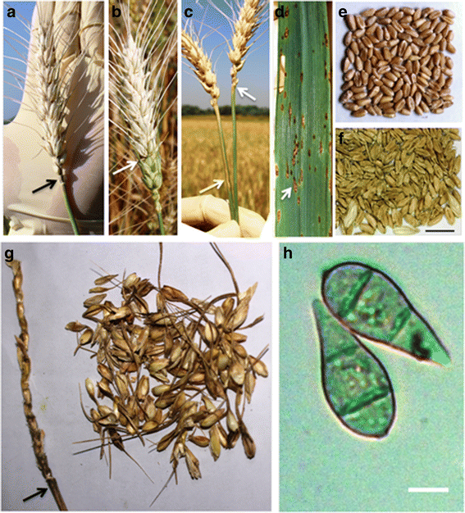

Slide 5
Favourable conditions
Environmental Conditions such as warm and wet weather
Several days of continuous rains and temperatures from 18-25 °C
during flowering, followed by hot, sunny and humid days
Minimum temperature for infection is 10°C and the maximum is 32°C,
with optimum between 25 and 30°C
High nitrogen fertilization and aerobic soils and drought stress
Global climate change, one report suggests that rising CO2levels
enhances rice blast disease.
High relative humidity which is required for sporulation.
Rain and/or heavy dew are required for appressorium function and
spore release.
High humidity promotes lesion expansion.

Slide 6
Symptoms of wheat blast
The wheat blast pathogen can infect all above ground parts of the wheat plant, but head infection is the most common symptom in the field. Highly susceptible cultivars can be infected at the seedling stage. The predominance of wheat head blast symptoms without leaf lesions in the field represents a major difference between wheat blast and rice blast.
Infected heads become bleached with blackened rachis and either produce shriveled seeds or no seed at all.
Wheat leaf lesions in the field vary:
Type 1 Lesion: Small dark brown spots without light centers,
Type 2 lesion:Round or eye-shaped lesions with small light centers
Type 5 lesion: Larger, eye-shaped lesions with light tan centers and
dark brown margins
Sporulating leaf lesions appear gray from the color of the spores. The potential for individual lesions to sporulate depends on the relative area of the light tan region (the sporulating region) inside the darker brown margins.
Uniformly dark brown Type 1 lesions represent an enlarged resistance reaction and fail to produce spores.

Slide 7
Small dark brown spots without light centers (Type1), round or eye-shaped lesions with small light centers (Type 2), continuing through increasingly larger, eye-shaped lesions with light tan centers and dark brown margins (Type 5 lesions).
??
Warm and wet weather.
Continuous rains and temperatures from 18-25°C during flowering, followed by hot, sunny and humid days.
Minimum temperature for infection is 10°C and the maximum is 32°C, with optimum between 25 and 30 °C .
High relative humidity
Native grass species, infected seeds and crop residues
Bleached
out spikelets
Disease cycle of wheat blast
?
Secondary cycles:
Conidial dispersal by air and rain splash
Infected heads become bleached
?

Slide 8
Control or management of wheat blast
Wheat blast disease can be managed through a combination of
Short term strategies:
Use blast resistant wheat varieties such as BARIgom 33.
Crop rotation with alternative crops such as oil seed crops and pulses in stead of wheat is one of the important cultural practices which can reduce the pathogen inoculums from the field.
Eliminating crop residues through burning immediately after harvesting of wheat.
Keeping crop fields weed-free will destroy the alternative hosts of the blast pathogen because inoculums can also survive on weeds and in crop residues.
Spray Trooper(Tricyclazole) /Nativo (Tebuconazole+ Trifloxystrobine) at 7-10 days interval starting at early flowering stage.

Slide 9
Early planting can reduce the wheat blast incidence because delaying the planting date significantly reduced yield losses due to wheat blast where the disease was previously endemic.
Application Silicon (Monosilicic acid (H₄SiO₄), 250-1000kg/ha) in the soil enhances resistance to wheat blast by making the epidermis harder.
Long term strategies:
Conventional and molecular breeding (CRISPR Cas9 techniques) to develop blast resistant wheat varieties.
Genetic approaches (pathogen population analyses) and epidemiological research (mode of pathogen overwintering, transmission, environmental factors and hosts) to strengthen knowledge on the fungus and its interactions with wheat and other host plants.
Monitoring of disease appearances, movement, and evolution, in coordination with international (CIMMYT), Universities (BAU) and local extension agencies (DAE, NGOs) and research agencies (WRC), as well as predictive models.

Slide 10
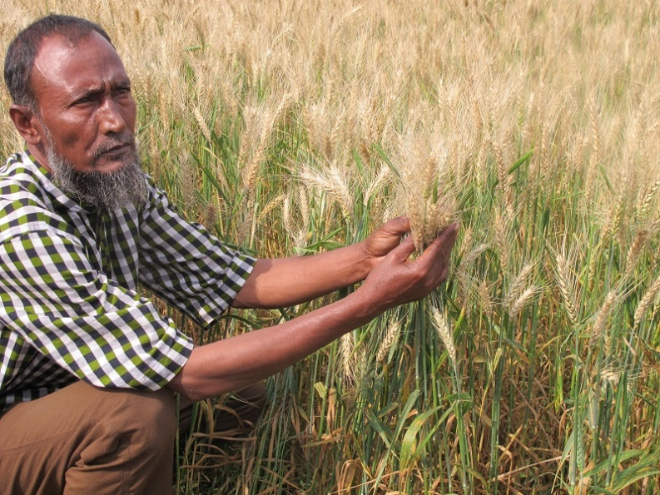
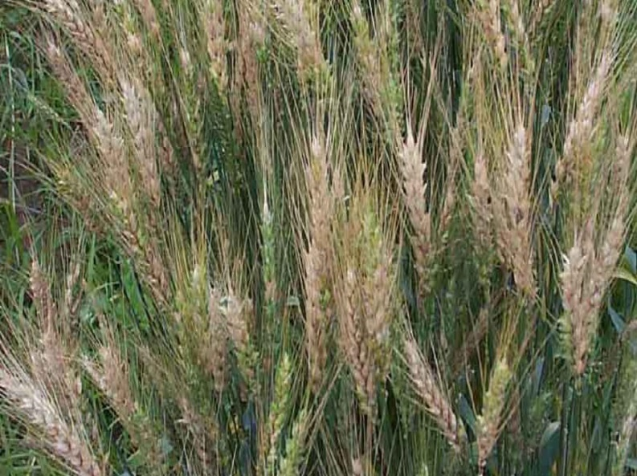
??

Slide 11
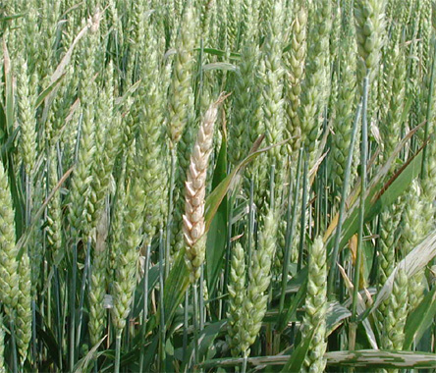
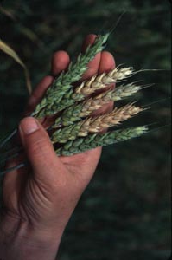
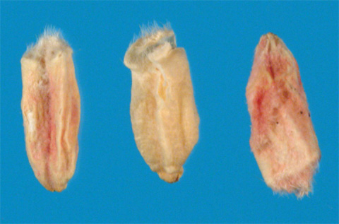
Disease: Fusarium head blight (FHB)
Causal organisms : Fusarium graminearum (Imperfect stage)
Gibberella zeae (Perfect stage)
Shriveled and wrinkled grains of pink, soft-grayto light-brown color
Diseased spikelets exhibit premature bleaching with one or more spikelets located in the top, middle, or bottom of the head may be bleached.
Environment and FHB
FHB infection is favored by extended periods of high moisture or relative humidity (>90%) and moderately warm temperatures (between 15 to 30°C).
These conditions present before, during, and after flowering favor inoculum production, floret infection, and colonization of developing grains.

Slide 12
Symptoms of Fusarium head blight
The first symptoms of Fusarium head blight occur shortly after flowering. Diseased spikelets exhibit symptoms of premature bleaching as the pathogen grows and spreads within the head shortly after infection .
One or more spikelets located in the top, middle, or bottom of the head may be bleached.
Over time, the premature bleaching of the spikelets may progress throughout the entire head.
Bleached spikelets usually are sterile or contain shriveled and/or discoloured seed.

Slide 13
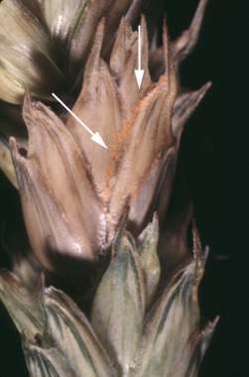
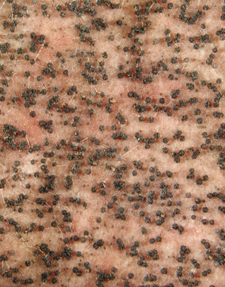
Salmon-colored sporodochia on wheat spike
Perithecia of Gibberella zeae on carrot agar medium
If the environment is warm and moist, aggregations of light pink/salmon colored spores (sporodochia) may appear on the rachis and glumes of individual spikelets.
Later in the season, bluish- black spherical bodies may appear on the surface of affected spikelets. These bodies are sexual structures of the fungus known as perithecia, and can be seen readily in laboratory cultures on carrot agar medium.
Note: The fungus produces a mycotoxin known as deoxynivalenol that poses a
significant threat to the health of domestic animals and humans.

Slide 14
Shriveled and wrinkled grains of pink, soft-gray to light-brown color
As symptoms progress, the fungus colonizes the developing grain causing it to shrink and wrinkle inside the head.
Often, the infected kernels have a rough, shriveled appearance, ranging in color from pink, soft-gray, to light-brown.

Slide 15
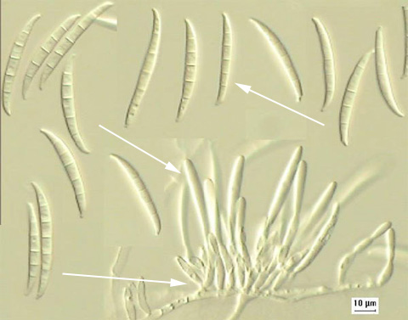
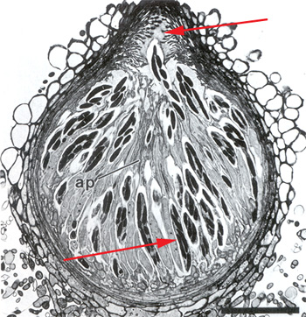
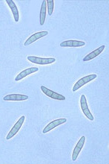
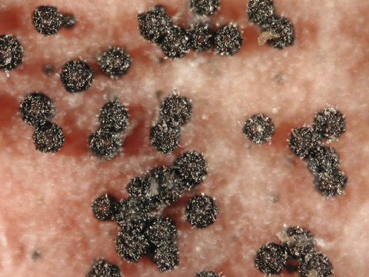
Macroconidia (top arrow), phialides (middle arrow), and sporodochium (bottom arrow) of Fusarium graminearum
Cross-section of a perithecium of Gibberella zeae showing the ostiole (top arrow) and asci bearing ascospores(bottom arrow)
Ascospores of Gibberella zeae are slightly curved with rounded ends
Bluish-black perithecia of Gibberella zeae

Slide 16
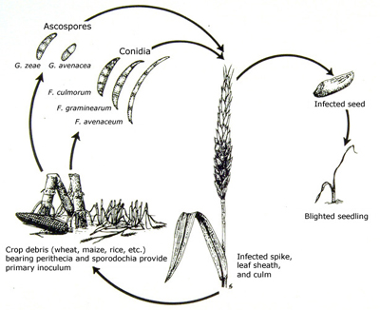
Chlamydospores
Disease cycle of Fusarium head blight

Slide 17
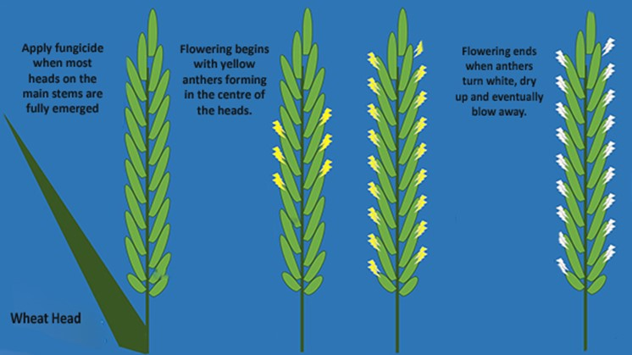

Slide 18
Control or management of Fusarium head blight
Cultural practices
Crop rotation with oil seed or pulse crops and soil incorporation of crop residues
by tillage have been shown to reduce the incidence of FHB.
Burning of the crop debris on the soil surface can reduce the impact the level of
FHB.
Spray prothioconazole + tebuconazole/propiconazole + trifloxystrobin/ propiconazole/ prothioconazole @ 0.2% (60L/ha) when most heads are fully emerged.
Biological Control
Biocontrol agents could play an important role in organic cereal production.
Certain strains of spore- producing bacteria (such as Bacillus species) and yeasts (such as Cryptococcus flavescens) show some promise for the control of FHB and the reduction of mycotoxin contamination.
Resistant cultivars such as BARIgom 33 should be used.
Integrated disease management (IDM)
Integrated management of FHB may one day be achieved by the combined application of biocontrol agents and fungicides at the time of flowering of wheat.

Slide 19
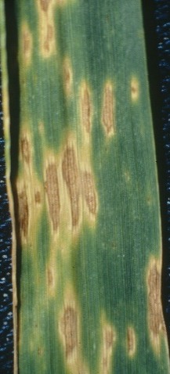
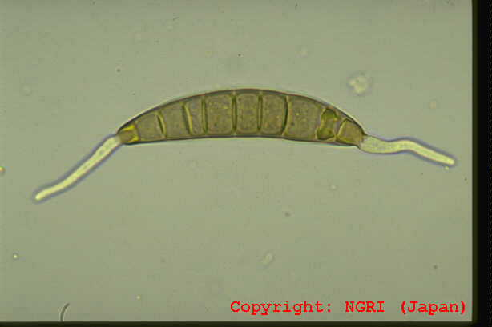
Disease name: Leaf blight of wheat Pathogen name: Bipolaris sorokiniana
Alternaria triticina
Small, oval, chlorotic lesions that are irregularly scattered on the leaves
Black pointed shrived grains
Black powdery symptoms on the leaf awns and glumes

Slide 20
Symptoms
Early symptoms are small, oval, chlorotic lesions that are irregularly scattered on the lower leaves. The lesions enlarge, become irregular in shape, and develop into dark brown or grey sunken.
Lesions may have a bright-yellow marginal zone, and can grow up to 1 cm or more in diameter. Lesions progressively develop from lower to upper leaves, and blighting may extend to whole leaf and head due to coalesce of several lesions.
Under moist conditions, lesions may be covered by black powdery conidia. Under severe conditions the symptoms can also be seen on the leaf sheath, awns and glumes.
At the dough stage of wheat development, heavily infected fields appear dull and bronzed with a burnt appearance when seen from a distance

Slide 21
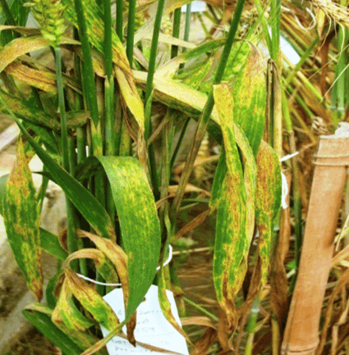
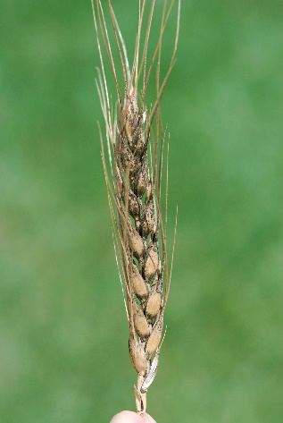
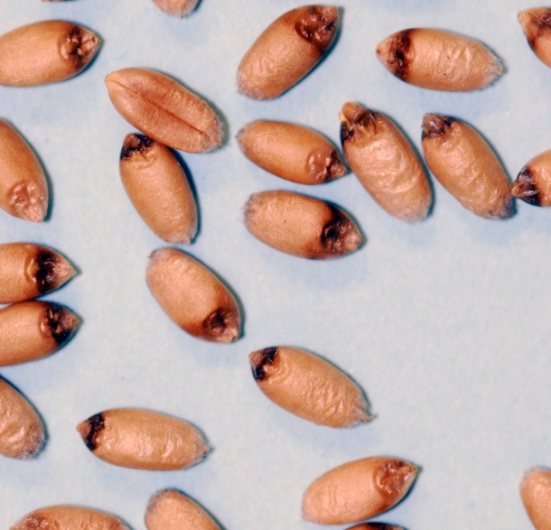
Primary cycles
Small, oval, chlorotic lesions that are irregularly scattered on the lower leaves.
Temperature: 20-25C
Continuous leaf wetness (10 hrs)
High doses of nitrogen
Disease cycle of leaf blight
Perennating organs in diseased seeds, infected stubbles and in soil
Secondary cycles:
Conidial dispersal by air and rain splash
Conidia

Slide 22
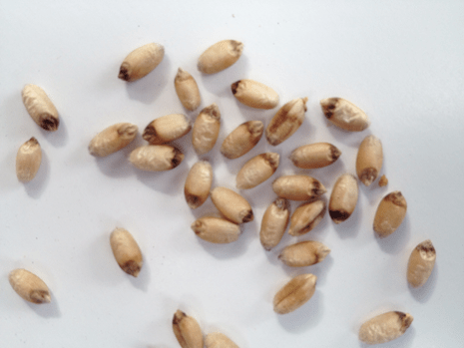
Disease name: Black point of wheat Pathogen name: Bipolaris sorokiniana
Alternaria spp.
Fusarium
Aspergillus
Penicillium
Curvularia
Chaetomium
Gloeosporium
Nigrosp[ora
Rhizopus
Stemphylium
Black necrotic lesion developed at the embryonic site of the wheat grain and grain becomes shriveled.

Slide 23
Symptoms
Diseased kernals are discolored and appear weathered, black- pointed, or smudged.
Black point associated with the darkened pericarp and sometimes shriveled embryo end of the seed.
When embryos are invaded, germinability of the seeds decreases.

Slide 24
Control or management of leaf blight or black point of wheat
Spray Propiconazole/Hexaconazole at the time of maturing heads for two times at 7-10 days interval is found effective.
Spray Trichosuspension or BAU Biofungicide (Trichoderma harzianum) or Trichoderma viride @ 0.2% or Pseudomonas fluorescens (0.5%) and neem leaf extract (73.57%) aTilt @ 0.2%
Seed treatment with Provax @ 2.5 g/kg seed can improve the germinability and decrease infection of seedlings grown from diseased kernals.
Store the seeds in well ventilated dry places to reduce the storage molds development.
Use cultivars which are resistant or tolerant to black point infection
Black point can be partially controlled by reducing irrigation frequency after heading and by reducing nitrogen rates, without sacrificing either yield or quality.

Slide 25
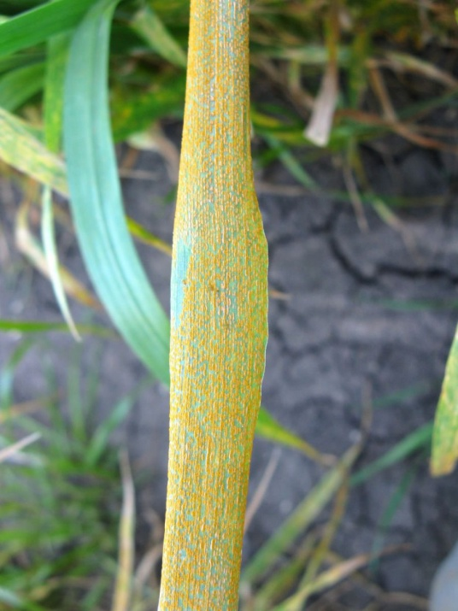
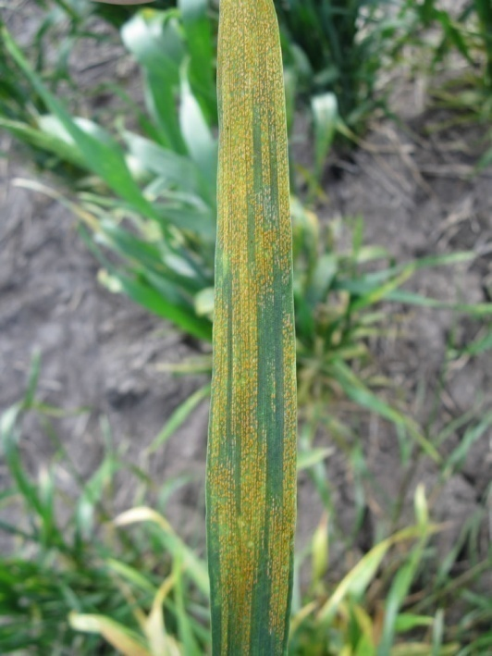
Disease: Stripe rust (Yellow rust)
Causal organism: Puccinia striiformis
Yellow stripes, raised pustules appear on the leaves, especially on the older leaves lying low in the canopy and can be easily wiped off onto a white cloth or tissue leaving a yellow stain.
Favourable conditions:
Temperatures of less than 18°C (optimum 6-12°C) with a minimum of three hours of leaf-wetness (for example, dew).
Once an infection is established within the leaf the fungus can survive short periods of temperatures as high as 40°C.
Alternate hosts:
Agropyron
Bromus

Slide 27
Symptoms
Yellow stripes of pustules appear on the leaves, especially on the older leaves lying low in the canopy.
These pustules are raised above the leaf surface and can be easily wiped off onto a white cloth or tissue leaving a yellow stain.
Hot spots are 1-10 meters in diameter and are generally well developed just before the disease becomes widespread in the crop.

Slide 28
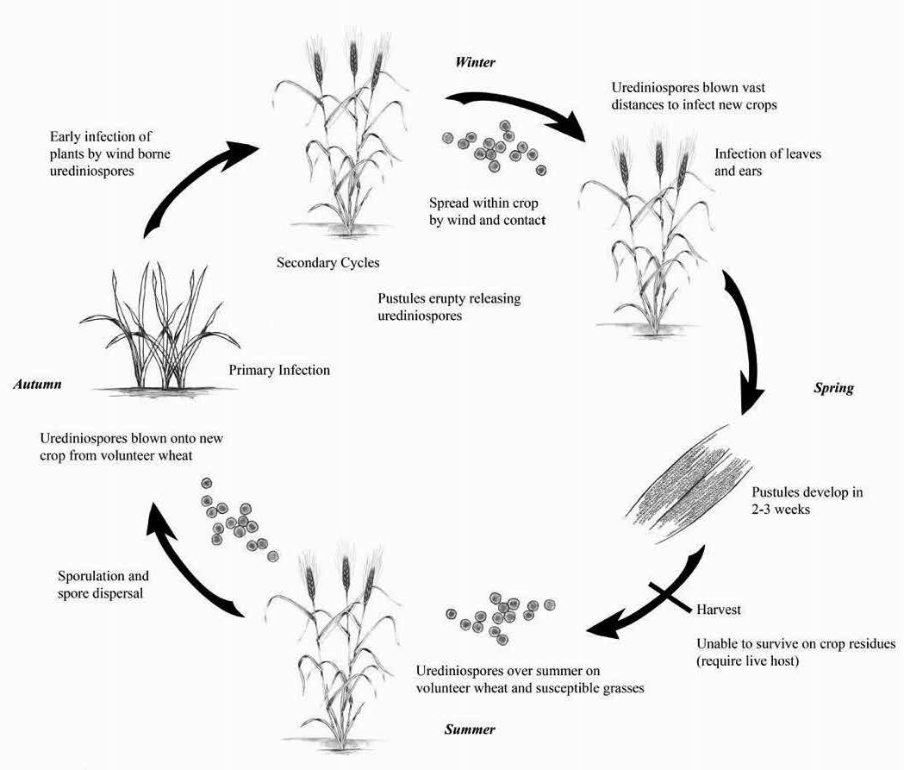
Disease cycle of stripe rust

Slide 29
Stripe rust is caused by the fungus Puccinia striiformis. Stripe rust survives from one season to the next predominantly on volunteer self-sown cereals, but can also survive to a lesser extent on other cereal and grass weeds that grow over summer.
Stripe rust epidemics are usually more severe in seasons following wet summers that have supported the ‘green bridge.
During the season, conditions suitable for epidemic and stripe rust can be expected in crops by January to April in the years. For an infection of a plant to occur the spore requires temperatures of less than 18°C (optimum 6-12°C) with a minimum of three hours of leaf-wetness (for example, dew).
Once an infection is established within the leaf the fungus can survive short periods of temperatures as high as 40°C.
Following infection of the leaf the fungus grows within the leaf for 14 to 28 days (or longer depending on temperature) until the spores appear on the leaf surface as pustules.
The time between infection and symptom development is known as the latent period, with the time reducing as temperatures warm during the spring.
The spores are then dispersed by wind, allowing the cycle to repeat multiple times during the season.

Slide 30
The Green Bridge
Stripe rust can only survive from one season to the next on living plants; mostly wheat and to a lesser extent barley, triticale, barley grass, brome grass and phalaris. This is called the ‘green bridge’.
Stripe rust does not survive on seed, stubble or soil. Therefore, the greater the number of susceptible volunteer wheat plants growing during summer/ autumn the greater the risk of a stripe rust epidemic and the reason that stripe rust is often more severe following wet summers.
The susceptibility of the volunteer wheat plants over summer influences the quantity of inoculum generated by the green bridge. If most varieties in a district are resistant there will be considerably less inoculum than if the majority of plants are susceptible or very susceptible.

Slide 31
Management Strategies to Minimise the Impact of Stripe Rust
The following management strategies are recommended to minimise the impact of stripe rust:
Remove volunteer wheat plants (the ‘green bridge’) that will support stripe rust inoculum in the 6 weeks prior to sowing
Avoid Very Susceptible (VS) and Susceptible (S) varieties by selecting more resistant varieties
Use a seed or fertilizer treatment to suppress early infection
Monitor crops during the growing season and apply a foliar fungicide early in the epidemic, if required.
Spray (azoxystrobin + propiconazole)/(Tebuconazole + Trifloxystrobin)/azoxystrobin/(azoxystrobin + tebuconazole) @ 0.2% at 7 to 10 days from flag leaf emergence to early dough grain development stage or at earliest sign of rust pustules development.

Slide 32
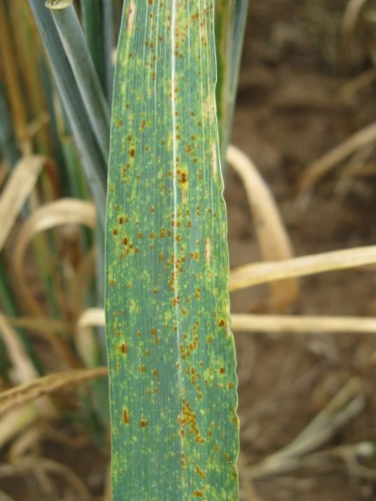
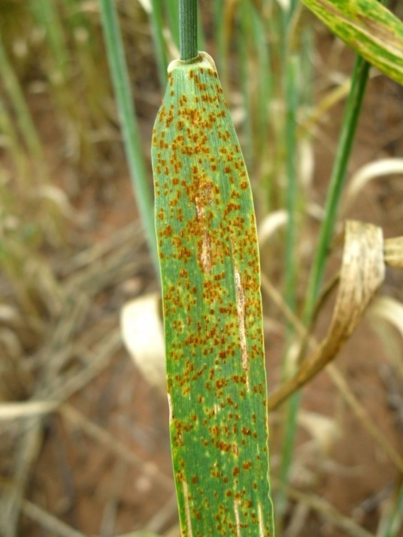
Disease: leaf rust (Brown or orange rust)
Causal organism: Puccinia triticina (formally Puccinia recondita)
Circular to oval, orange-brown pustules appear scattered across the leaf surface that are raised above the leaf surface and these pustules are confined chiefly to the upper surface of the leaf.
Favourable conditions:
Wet conditions and
Temperatures of approximately 15-22°C

Slide 34
Symptoms of leaf rust
Circular to oval, orange-brown pustules appear scattered across the leaf surface that are raised above the leaf surface and these pustules are confined chiefly to the upper surface of the leaf.
Later in the season, black teliospores develop on mature plants, usually on the under surface of the leaf or on the leaf sheath.

Slide 35
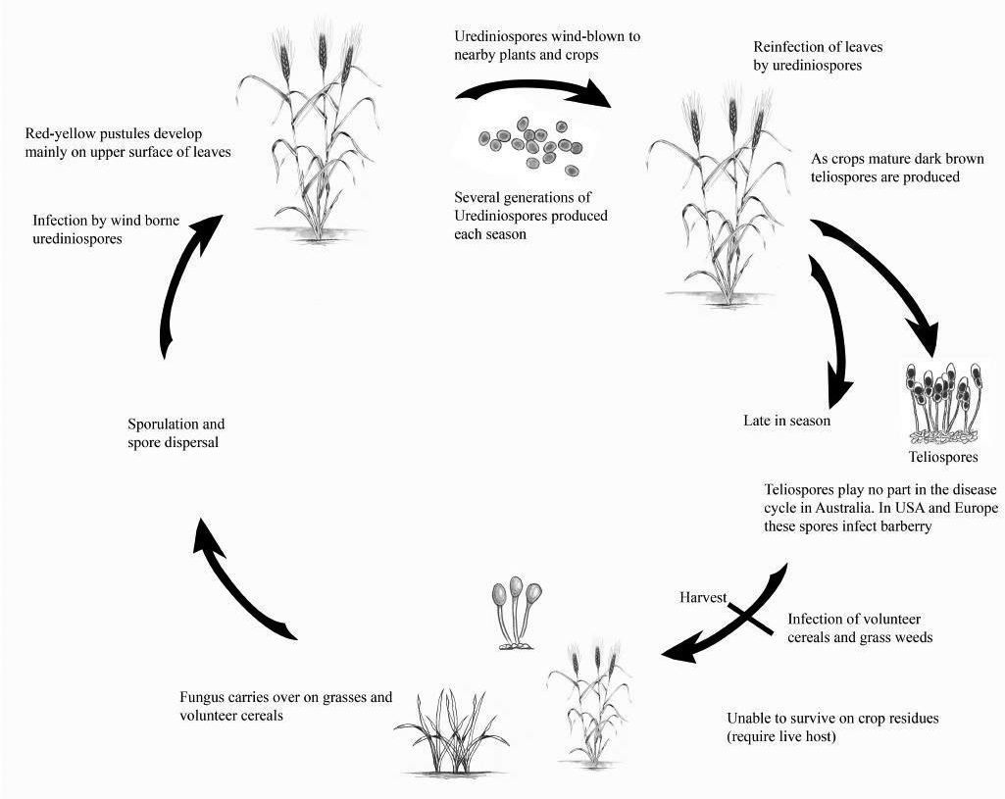
Secondary cycles
Disease cycle of leaf rust
Teliospores play an important role by either infecting volunteer wheat plants or barberry plants

Slide 36
Leaf rust is caused by the fungus Puccinia triticina (formally Puccinia recondita ). Leaf rust, like other cereal rusts, requires a living host to survive from one season to the next.
The most important hosts for rusts are susceptible volunteer plants such as weeds, wheat plants growing during the summer/autumn. Rust cannot carry over from one season to the next on seed, stubble or soil.
Wheat varieties susceptible to leaf rust enable inoculum levels to build up on volunteers during the summer and autumn. This can be a problem in seasons following wet summers that favour the growth of self-sown wheat. The plants that become heavily infected with rust in the autumn provide a source of rust for the new season’s wheat crop.
If these conditions are followed by a mild winter and a warm wet spring, then the chances of a leaf rust epidemic are high. Therefore, the chances of a rust epidemic are greatest following a wet summer.
Due to the absence of the alternate host, leaf rust reproduces asexually. This reduces the variability of the rusts in the field and therefore increases the likelihood that resistant varieties will be effective for a long period of time.
Rust spores are wind-blown and can be spread over large areas in a short time. The establishment of leaf rust epidemics within a crop is favoured by wet conditions and temperatures of approximately 15-22°C.

Slide 37
Control or Management of leaf rust
Resistant Varieties
The best way to control leaf rust is to grow resistant varieties. Widespread cultivation of resistant varieties minimises the levels of rust in the environment and reduces the occurrence of new races.
Cultural Practices
Heavy grazing or the use of herbicides during autumn to remove self-sown susceptible wheat will reduce the amount of rust in following crops.
Seed Treatments
There are seed treatments available which will suppress early infections of leaf rust. Seed treatments are important in susceptible varieties, especially if they are sown early or following a wet summer favouring growth of volunteers.
Monitoring and fungicide spray
Spray (azoxystrobin + propiconazole)/(Tebuconazole + Trifloxystrobin)/azoxystrobin/(azoxystrobin + tebuconazole) @ 0.2% at 7 to 10 days from flag leaf emergence to early dough grain development stage or at earliest sign of rust pustules development.

Slide 38
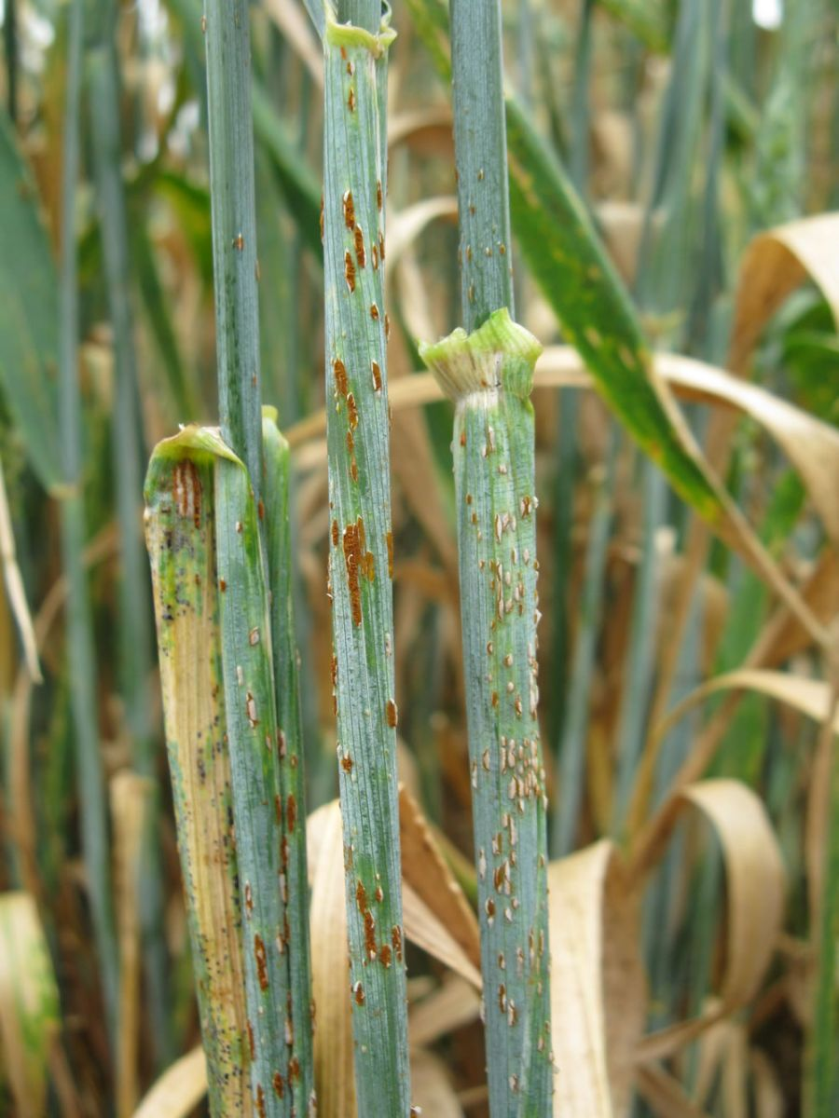
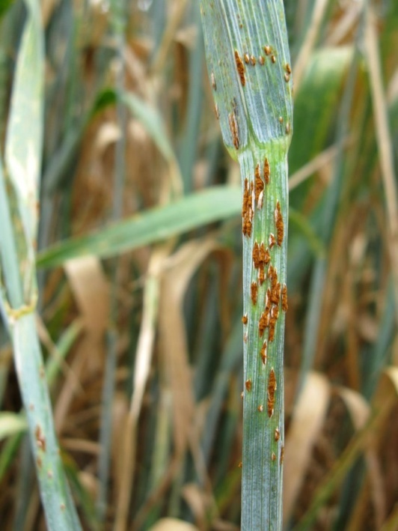
Disease: Stem rust (Black rust)
Causal organism: Puccinia graminis f.sp. tritici
Reddish-brown, darker, powdery, oblong pustules having a characteristic torn margin that can occur on both sides of the leaves, on the stems and the glumes.
Alternate hosts:
Berberis
Mahonia
Mahoberberis
Favourable conditions:
Wet conditions and
Temperatures of approximately 15-30°C
http://www.croppro.com.au/crop_disease_manual/ch02s07.php

Slide 40
Symptoms
Reddish-brown, powdery, oblong pustules having a characteristic torn margin that can occur on both sides of the leaves, on the stems and the glumes.
Stem rust spores are much darker in colour than leaf or stripe rust spores.
As the plant matures, the pustules produce black spores known as teliospores. They occur mainly on the leaf sheaths and stem.

Slide 41
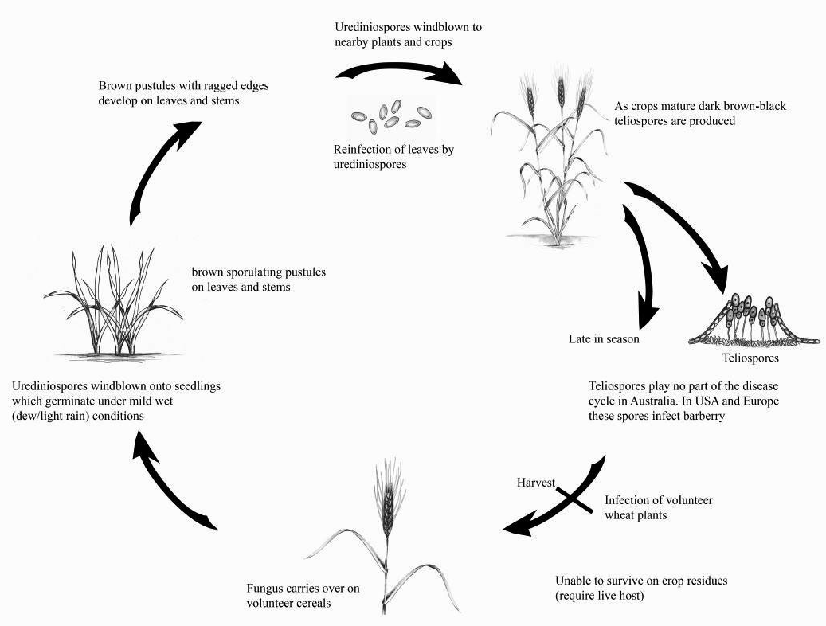
Fungus carries over on volunteer cereals or barberry plant
Secondary cycles
Disease cycle of Stem rust
Teliospores play an important role by either infecting volunteer wheat plants or barberry plants
Wet conditions and
Temperatures of approximately 15-30°C
Fungus carries over on volunteer cereals or barberry plant

Slide 42
Management of stem rust
Stem rust can be managed using an integrated approach that includes managing the green bridge, avoiding susceptible cultivars and close monitoring to enable timely fungicide sprays.
Removal of the Green Bridge
Rust can only survive from one season to the next on living plant material (mainly self sown cereals). Therefore, the removal of the green bridge is essential to reduce the amount of inoculum present to infect a new crop.
Variety Selection
Sowing resistant varieties provides the best protection against stem rust by reducing the chance of new pathotypes occurence.
Monitoring and fungicide spray
Spray (azoxystrobin + propiconazole)/(Tebuconazole + Trifloxystrobin)/azoxystrobin/(azoxystrobin + tebuconazole) @ 0.2% at 7 to 10 days from flag leaf emergence to early dough grain development stage or at earliest sign of rust pustules development.

Slide 43
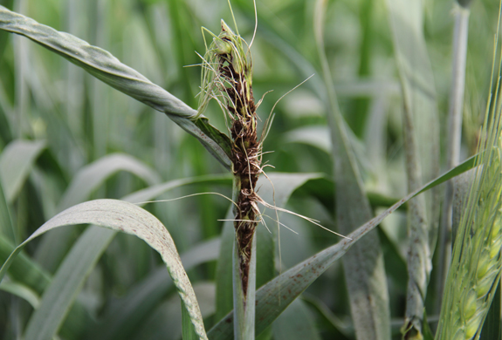
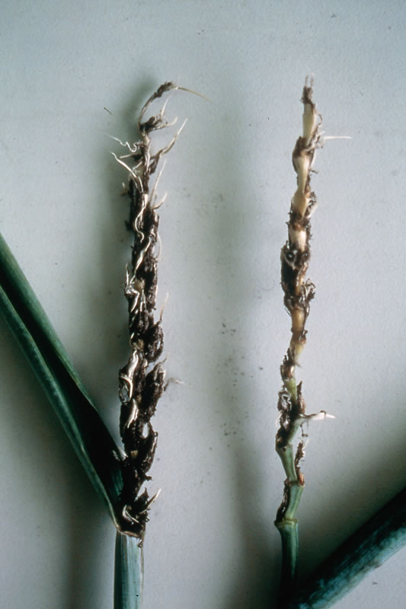
Disease name: Loose smut Pathogen name: Ustilago tritici (Pers.) Rostr.
The fragile membrane that covers the spores breaks off soon after heading and the spores become airborne or are washed off by rain, eventually leaving only the empty rachis as evidence of the disease.
Smutted heads, in which grain and glume structures are replaced by masses of black teliospores covered by a gray membrane, emerge several days earlier than contrasting green healthy heads
Favourable conditions:
Wind and moderate rain
Cool temperatures (16–22 °C)

Slide 45
Smutted head, where all the structures except the rachis are replaced by spores
Bare rachis after blown off the spores by wind and water

Slide 46
Symptoms
Loose smut is a fungal disease in which full heads are replaced by smut spores (teliospores). Conspicuous loose smut symptoms are evident at early heading.
Smutted heads, in which grain and glume structures are replaced by masses of black teliospores covered by a gray membrane, emerge several days earlier than contrasting green healthy heads.
The fragile membrane that covers the spores breaks off soon after heading and the spores become airborne or are washed off by rain, eventually leaving only the empty rachis as evidence of the disease.
The loose smut symptoms can only be seen at the time of flowering though the plants are infected right after seed germination.
The heads of the infected plants emerge earlier than the healthy one. symptoms of the disease
Yield lost in the infected heads is total. Diseased heads produce no grain at all.

Slide 48
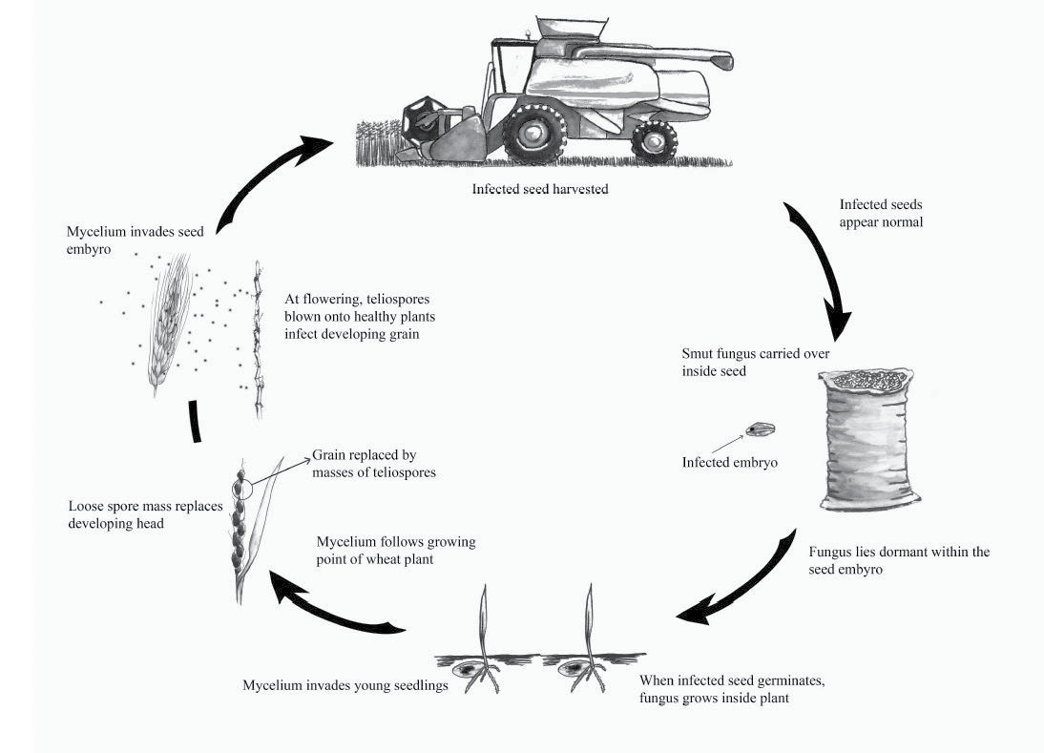

Slide 49
Management or Control
Planting high-quality pathogen-free seed will eliminate the inoculum source.
Seeds should be treated with Propvax (Carboxin + Thiram) /Tebuconazole (2.5g/kg seed) to eliminate seed borne infection.
Spray (azoxystrobin + propiconazole)/ Folicur 25EC (Tebuconazole) + Trifloxystrobin)/azoxystrobin/(azoxystrobin + tebuconazole) @ 0.05 to 0.075% at 7 to 10 days from seedling to flag leaf emergence stage or at earliest sign of loose smut development.
Using resistant cultivars helps reduce final symptoms.
Placing seed production fields away from commercial fields helps avoid infection of the seed from air-born spores, which can be carried long distances by winds.

Slide 50
Disease: Powder mildew
Causal organism: Blumeria graminis f. sp. tritici
White powdery cottony masses of the fungal growth
Mature lesions may have dark, reproductive structures with black speckles mixed with the white, cottony growth of the fungus
Favorable conditions:
Mild temperatures (15–22°C) and high humidity (in excess of 70%),
Dense crop canopies, where air circulation is poor and in damp, shaded areas,
dense canopies are closely correlated to high seeding rate and/or high
nitrogen nutrition
Good soil moisture profile which promotes canopy humidity
Extended periods of humid and damp canopy

Slide 51
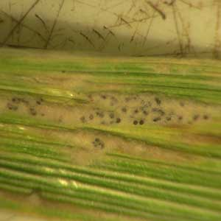
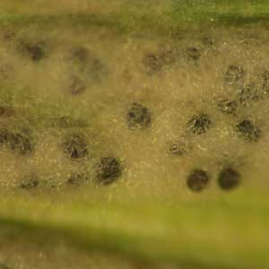
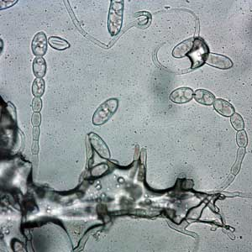
Small black fungal fruiting bodies (cleistothecia) immersed in the gray fungal tissue can be observed later in the season
Fungus produces septate , superficial hyaline mycelium on the leaf surface with short conidiophores and single celled, elliptical, hyaline conidia

Slide 52
Symptoms:
Powdery mildew is characterized by a powdery white to gray fungal growth on leaves, stems and heads. The fluffy white pustules are first detected on the lowest leaves of plants.
As the plant matures, the white powdery growth changes to a grey-brown color. The leaf tissue on the opposite side of the leaf from the white mold growth becomes yellow, later turning tan or brown.
Small, black fruiting bodies (cleistothecia) develop on leaves as plants mature. Cleistothecia are recognized as distinct round, black dots within older, grey colonies of powdery mildew.
Cleistothecia contain spores (ascospores) that serve to infect in the fall and early spring.

Slide 53
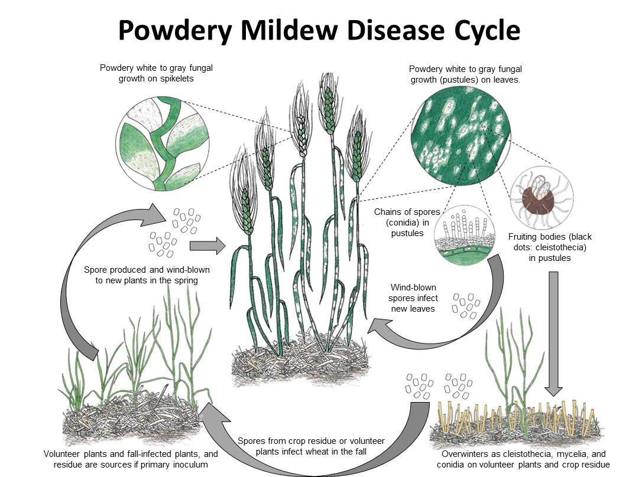

Slide 54
Control or management:
Spray Propiconazole + Tebuconazole or Propiconazole + Azoxystrobin or Propiconazole @ 0.2 to 0.3% as soon as the symptoms appear in few plants
Use resistant varieties
Cultural practices:
Do not over-fertilize with nitrogen since this encourages heavy, succulent, susceptible growth.
Lighter seeding rates improve air circulation and decrease disease.
Crop rotation and clean plowing reduce the amount of overwintering pathogen structures in the field, although air-borne inoculum can negate these practices.

Slide 55
Disease: Foot rot
Causal organisms: Fusarium graminearum
Fusarium culmorum
Pythium graminicolum
P. arrhenomanes
Favourable conditions:
High humidity
Wet weather
Warm, moist and poorly drained soils

Slide 56
Yellowing of the seedlings due to root rot
Common root rots with black discolouration with sub-crown internodes (arrows)
Common root rots with black discolouration (arrow)
Symptoms:
The first visible symptoms of common root rot are the appearance of stunted seedlings with chlorotic symptoms in the field as irregular patches.
The symptoms of common root rot include dark brown to black lesions in roots, subcrown internodes and stem bases.
The primary and secondary roots may appear brown or blackened.
The diagnostic symptoms of the Fusarium foot rot is cottony pink mycelium that may appear on the stem bases.

Slide 57
Control or management
Maintain balanced fertilization particularly by reducing the application of nitrogenous fertilizer.
Proper weeding to eliminate the alternate hosts and weeds may predispose the plant roots to infection.
Use certified or fungicides treated seeds.
Rotate crops to reduce the Fusarium inoculum by avowing the planting wheat following corn or wheat.
Seeds treatment with Provax (Carboxin + Thiram) or Tebuconazole or Mancozeb + copper oxychloride @ 2.5 g/Kg seeds.
Soil can be drenched with 0.2-0.3% solution of Mancozeb + Carbendazim at the seedling stage.

Slide 58
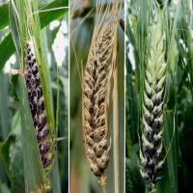
Disease: Covered smut of barley
Causal organism: Ustilago hordei
Dark grey to black ears/heads due to the masses of teliospores of the fungus that are covered by a thin membrane of tissue.
Favourable conditions:
Infection of seedlings is favored by earlier sowing
Drier and acidic soils
Temperature (15-21°C)

Slide 59
Symptoms
The presence of the disease is first noticed at ear emergence when the ears appear dark grey due to the masses of teliospores covered by a thin membrane of tissue.
The membrane splits at maturity, or during threshing, releasing the spore mass into the atmosphere.
The spores are not readily wind-dispersed if the membrane ruptures before harvest as they stick together due to the presence of an oily coating.
Infected plants may be slightly shorter than their healthy neighbors.
Affected ears may emerge later than the surrounding crop and in some cases remain trapped within the sheath of the flag leaf.
Infected ears are readily identified by their dark color and shriveled awns.
Sori can occasionally be found in stripes on leaves and stem galling has also been reported.

Slide 60
Control or Management of covered smut of barley
Spray Mancozeb/Tebuconazole @ 0.2 t0 0.3% starting just before emergence of the heads continue for two or three times if the disease is severe.
Treatment of barley seeds with Provax @ 2.5 g/kg seeds successfully
controls the disease.
Use of disease resistant varieties also helps to reduce losses.
Sowing seeds in a moderately dry soil will reduce the disease incidence,
since moist soils are favourable for infection.
The rate of covered smut infection can be reduced when barley is raised in a neutral or alkaline soil than in an acid soil.

