Slide 1
PLANT TRANSFORMATION VECTORS AND THEIR TYPES

Slide 2


Plant Transformation
”Transformation is the genetic alteration of a cell resulting from the direct uptake and incorporation of exogenous genetic material from its surroundings.”
or
“Integration of gene into genome by means other than
fusion of gametes”

Slide 3

Steps of Plant Transformation

Slide 4
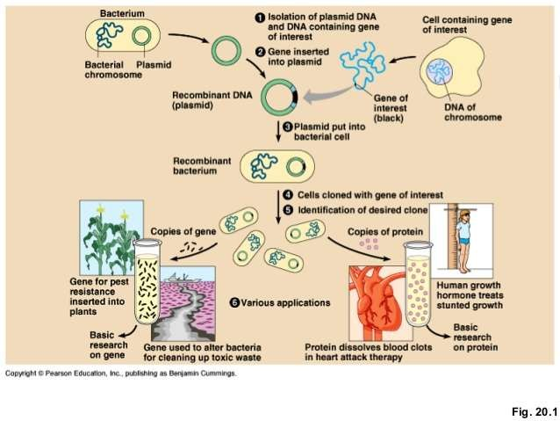

Slide 5



Plant Transformation Methods
01.method or vectored methods
oAgro bacterium-mediated transformation.
oVirus mediate.
Direct method.
  Protoplast electroporation.
  Protoplast polyethylene glycol method.
  Gene gun method.

Slide 6


Vector
“A DNA molecule used as a vehicle to carry foreign genetic material into another cell.”
Types Of Vector:
-Plasmids.
-Cosmids.
-Viral vectors.
-Artificial chromosome.

Slide 7

Characteristics of vectors
Origin of replication
Self-replicating
Bacterial selectable markers
Gene constructs of interest

Slide 8



Vector classification
Cloning vectors
“Small piece of DNA into which a foreign DNA fragment is inserted for cloning purposes.”
Expression vectors
“Also known as an expression construct, is usually a plasmid or virus designed for protein expression in cells.”

Slide 9







In plants
Plasmids
Viruses
Bacteriophages
Cosmids

Slide 10

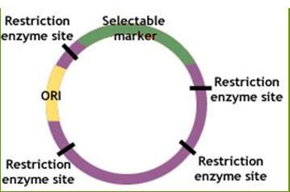
Plasmid
Extra chromosomal DNA molecules.
Self-replicating.
Circular & Double stranded.
Short sequence of DNA.
Found in prokaryotes.

Slide 11
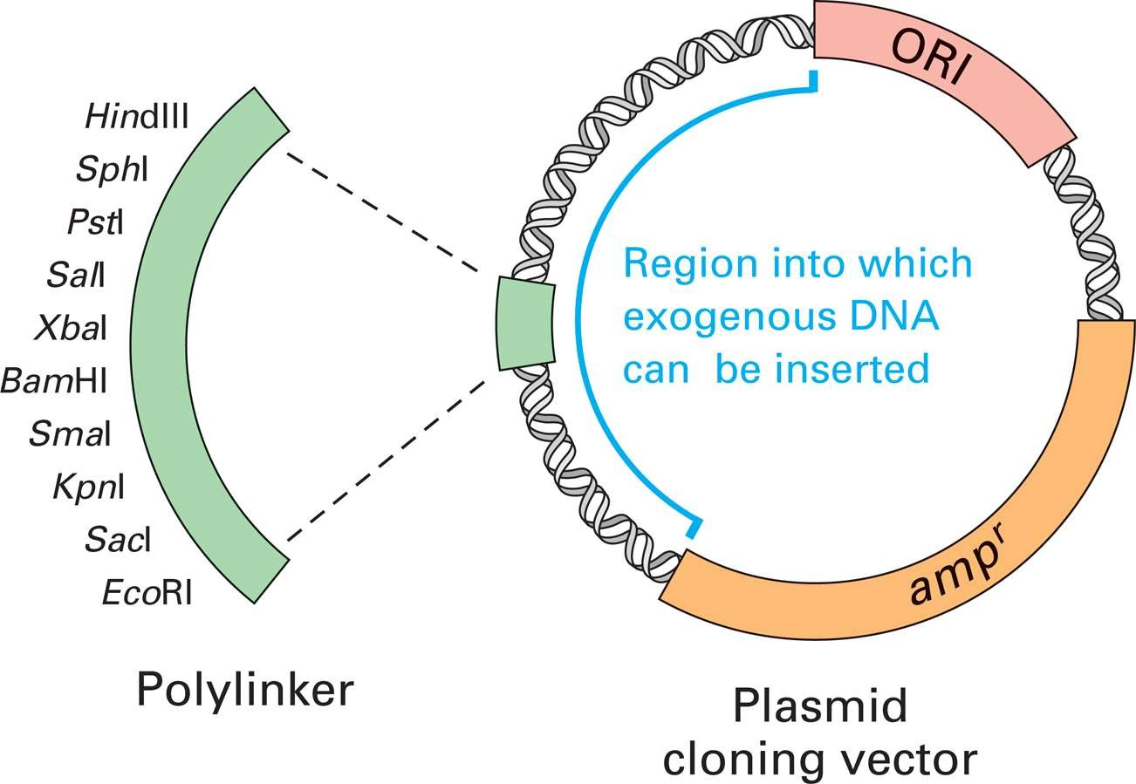

Slide 12



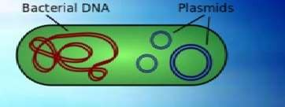



Classification of plasmids
o Fertility plasmid
e.g. F plasmid of E. coli
o Col plasmid
e.g. ColE1 of E. coli
o Resistance plasmid
e.g. RP4 in Pseudomonas
o Degradative plasmid
e.g. TOL of P. putida
o Virulence plasmid
e.g. Ti plasmids of A. tumefaciens

Slide 13


Based on the origin or source of plasmids
Two major classes :
Natural plasmids:
They occur naturally in prokaryotes Example: ColE1.
Artificial plasmids:
They are constructed in-vitro by re-combining selected segments of two or more plasmids.
Example: pBR322.

Slide 14
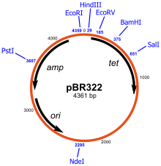
Nomenclature of Plasmid
pBR322
Plasmid Boliver Rodriguez
Number given to distinguish
p B R
322

Slide 15

Advantages
Occur naturally in bacteria
Have different restriction sites.
Replicate completely independent of bacteria
Genes are easily inserted into plasmids
Easily transformed into bacteria

Slide 16

Disadvantages
Cannot accept large fragments
Sizes range from 10-20 kb
Standard methods of transformation are inefficient

Slide 17



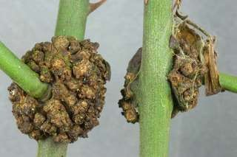
Agrobacterium-mediated transformation
Gram negative bacteria.
Found in soil.
Causes crown-gall disease.
Ability to introduce DNA into plant.
Contains
  Ti-plasmid.
  Ri-plasmid

Slide 18
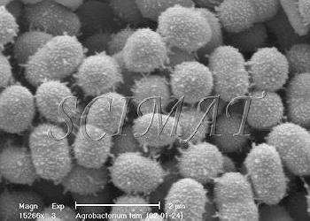
Agrobacterium tumefaciens

Slide 19



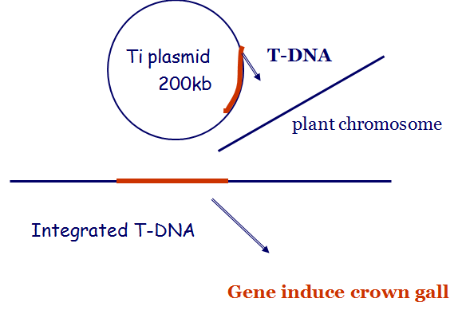
Recombinant Ti-plasmid
Place target gene in T-DNA region.
Recombinant T-DNA introduced into plants

Slide 20
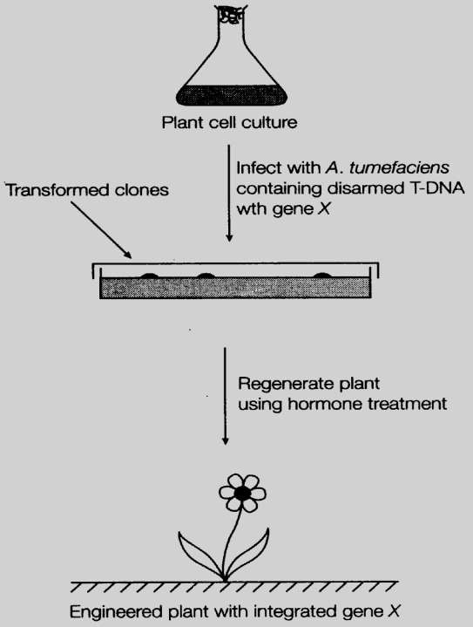
Plant genetic engineering using T- DNA vector

Slide 21

Method of screening

Slide 22


White-Blue screening
Colonies with recombinant plasmid are white
Colonies with non-recombinant plasmids are blue.
For example: pUC19
Resistance to ampicilline.
Contains portion of the lacZ which codes for beta-galactosidase.

Slide 23
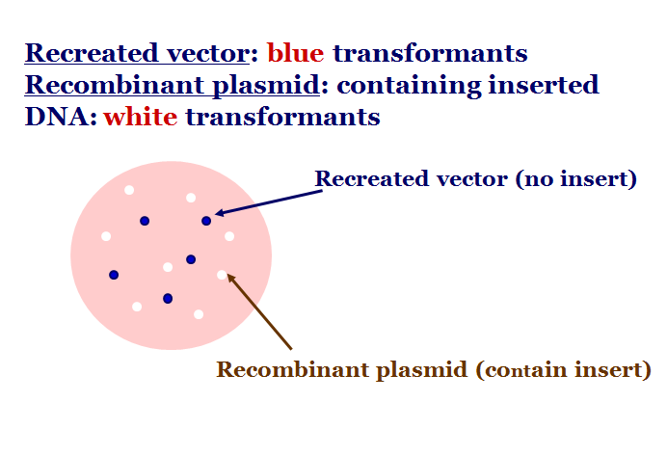
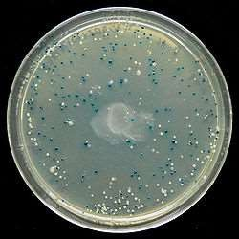

Slide 24
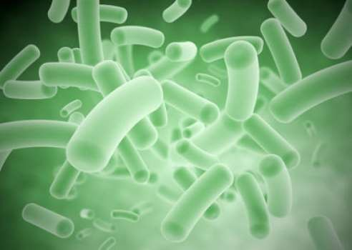


Viral vectors
“Viruses which are used as gizmo by molecular biologists to carry genetic
material into cells” are called viral vectors.
Viral vectors are non-integrative as compared to bacterial vectors

Slide 25

Examples
Cauliflower mosaic virus based vectors.
Cowpea mosaic virus
Bean pod mottle virus (BPMV)
TMV based vectors.
Potato virus X (PVX)
Bean yellow dwarf virus
Bacteriophage Lambda Vectors

Slide 26

Characteristics of viral vectors
Safety
Low toxicity
Stability
Cell type specificity

Slide 27

Viruses are used in two ways
–Virus directly inserted into plant
–Virus indirectly inserted (bacteria)

Slide 28
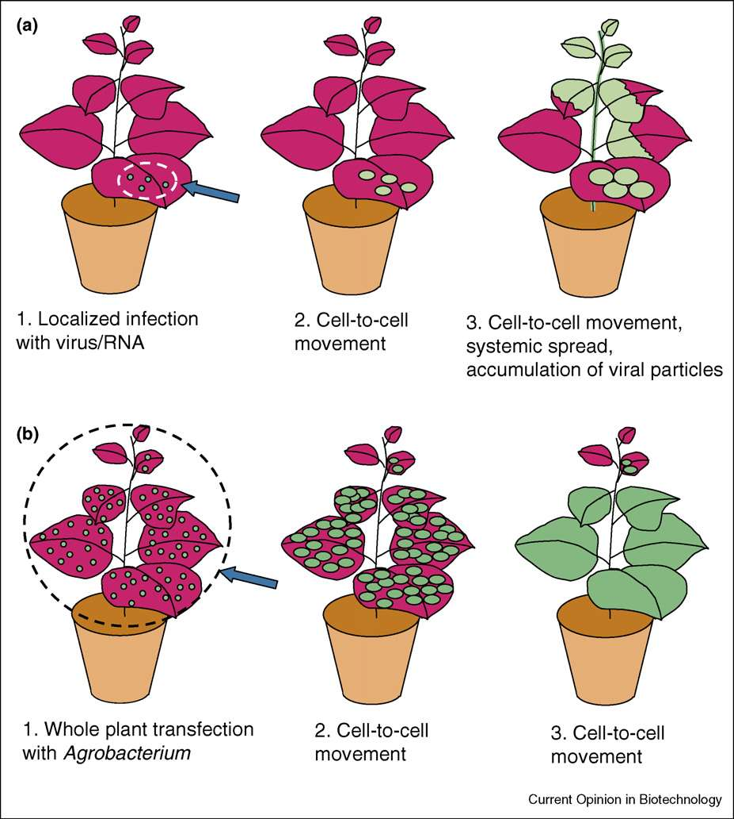

Slide 29

Cauliflower mosaic virus
DNA virus
Infectious when simply rubbed on leaves
Mechanical and aphid mediated transmission
Up to 10⁶ copies per cell within 3-4 weeks of infection in plant.

Slide 30
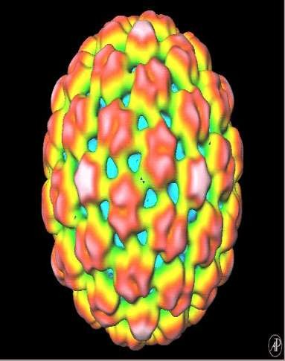
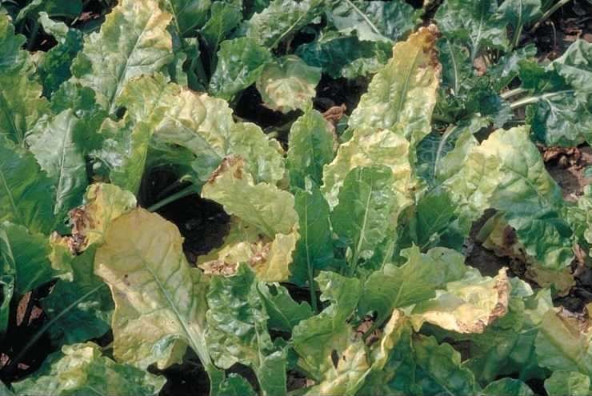
Small insertions (10-30 bp) in various sites abolished infectivity
The largest insert is 256-531 bp
CaMV genome can be inserted into Ti vector

Slide 31



CaMV activity in plant cell
Gene I
uncoating
nucleus
Inclusion body (gene VI)
Gene III/IV
transcription
assembly
Reverse transcription
Gene V
35S RNA
19S RNA
Gene IV
translation

Slide 32


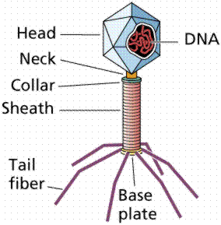
Bacteriophage Lambda Vectors
Viruses that can infect bacteria
1000 times more efficient than plasmid vectors
Clone DNA fragments in range of 10,000 - 20,000 bps

Slide 33

Steps

Slide 34
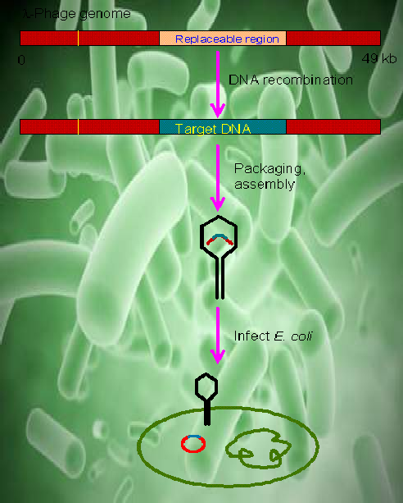

Slide 35
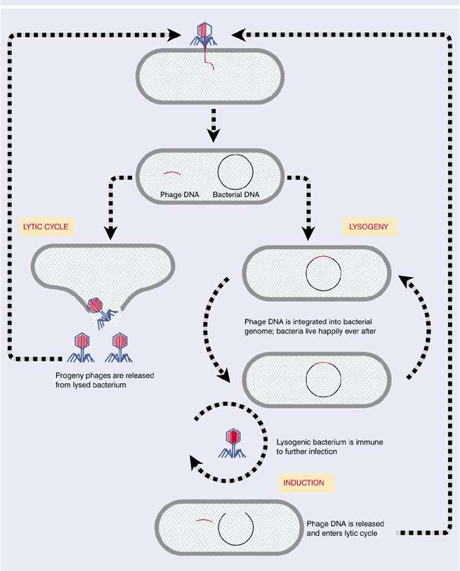

Slide 36

Advantages
Fast processing ,low cost, high yield
Good at targeting and entering cells
Mostly target specific types of cells
Used as virus-induced gene silencing (VIGS) in reverse genetic studies

Slide 37
Express proteins in plants for the
  Study of gene function
  Production of vaccines
  Study of metabolic engineering
  Analysis of plant-microbe interactions

Slide 38

Disadvantages
Worst effects to plants by
  Producing severe disease
  Giving undesired products
  Affecting the plant adversely
(due to highest mutation rate)

Slide 39



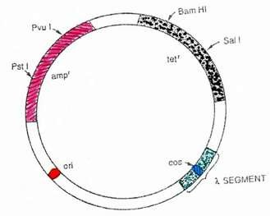
Cosmid:-
Derived from bacteriophage & plasmid
Cohesive sites + plasmid = cosmid
Less used for plant transformation
Carry DNA fragments of about 40 kb
E.g. US 8298819 B2

Slide 40




Cohesive ends or sticky ends
A single-stranded end of a linear duplex DNA molecule which can form hydrogen-bond with a complementary single-strand base sequence from the end of the same or another DNA molecule

Slide 41
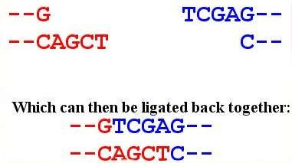

Slide 42
Conclusion
Plant transformation vectors are plasmids that have been specifically designed to facilitate the
generation of transgenic plants. The most commonly used plant transformation vectors are termed binary vectors because of their ability to replicate in both E. coli, a common lab bacterium, and Agrobacteri tumefaciens, a bacterium used to insert the recombinant (customized) DNA into plants

