Slide 1
Brassinosteroids

Slide 2
Introduction
Brassinosteroids or brassins are a recently discovered group of steroids that have dis­tinct growth promoting activity in some plants especially in stems. These compounds were first isolated in 1979 from bee collected pollen grains of rape (Brassica napus), a mustard (hence the name brassins). Brassinosteroids are now known to be widely distributed through­out the plant kingdom. In chemical structure, brassinosteroids resemble steroid hormones of animals.

Slide 3
More than 60 brassinosteroids have so far been identified from different parts of plants such as pollens, seeds, leaves, stems, roots and flowers.
They cause marked biological effects on plant growth at very low concentrations (micro-molar concentrations).
One of the very common, well known and biologically active brassinosteroids in plants is brassinolide whose structure is given in Fig. Interestingly, it is chemically similar to insect moulting hormones, ecdysones.

Slide 4
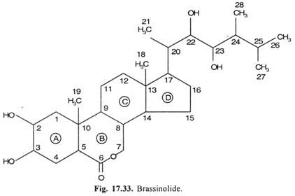
Structure

Slide 5
functions
Physiological studies have established that exogenous brassinosteroid causes
cell elon­gation and cell division in excised stem sections.
Brassinosteroids also inhibit root growth,
enhance gravitropism,
promote xylem differentiation and growth of pollen tubes, stimulate seed germination
delay leaf abscission

Slide 6
Because physiological effects of brassinosteroids qualitatively resemble to those of auxins, their role as plant hormones was not recognised earlier and it was believed that brassinosteroid acted partially by increasing sensitivity to auxins. Later on, evidences began to accumulate pointing towards plant hormonal nature of brassinosteroids
In soybean hypocotyls, brassinosteroids were found to affect cell elongation and gene expression quite indepen­dently of auxins. In auxin-insensitive mutant of Arabidopsis, root growth was found to be in­hibited by brassinosteroids but remained uninhibited by auxins.

Slide 7
Conclusive evidences which led to wide acceptance of brassinosteroids as endogenous plant hormones came from discovery and analysis of two photomorphogenic mutants DET2 and CPt) of Arabidopsis in late 1990s by Chory et al at Salk Institute in Sant Diego. The genes DET2 and CPD encode enzymes which are involved in biosynthesis of brassinosteroids (Fig. 17.34). The light and dark grown phenotypes of DET2 and CPD mutants could be com­pletely reversed to wild types by addition of brassinosteroid to the growth medium.

Slide 8
Brassinosteroids also play important roles in many light and hormone regulated processes including
the expression of light regulated genes,
the promotion of cell elongation,
leaf and chloroplast senescence
floral induction

Slide 9
Biosynthesis
Brassinosteroids are biosynthesized from a C₂₈ plant sterol called campesterol by a reductive step followed by several oxidative steps The biosynthesis of brassinolide from campesterol requires app. 12 steps. The reductive step and one of the several oxidative steps are catalysed by enzymes DET2 and CPD respectively. Campesterol is in turn derived from a triterpene called squalene.
ii. Depending upon the species and the tissue involved, there may be several different routes for the deactivation of brassinosteroids in plants. There may be epimerization of α – hydroxyl groups to form β -hydroxyl groups followed by esterification with fatty acids or glucosylation. There may also be cleavage of side chain or conjugation at other hydroxyl situations.

Slide 10
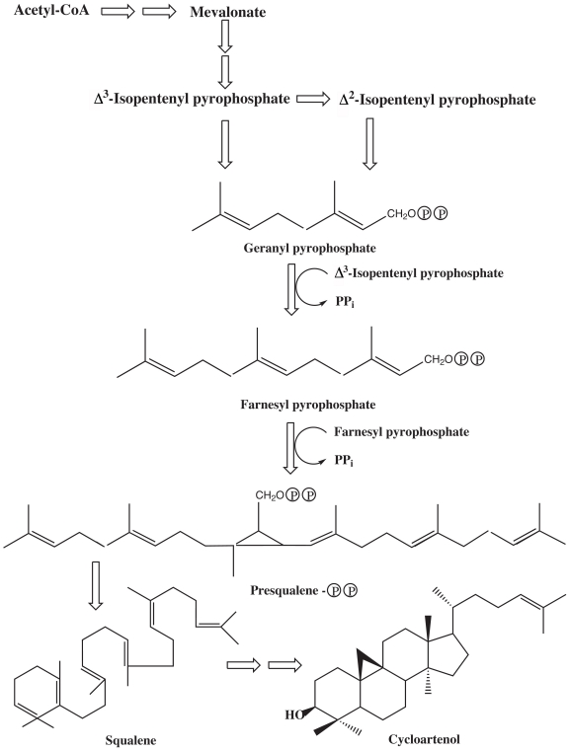

Slide 11
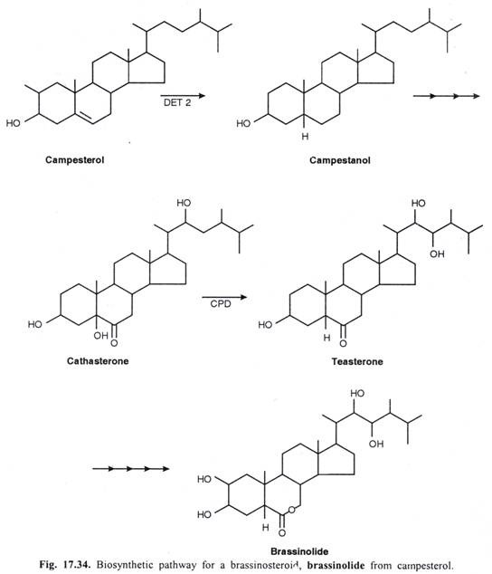

Slide 12
Brassinosteroids also have important agricultural implications in increasing productiv­ity of many crop plants.

