Slide 1
Hardy-Weinberg Equilibrium conditions

Slide 2
Hardy-Weinberg conditions
No mutation
No selection
No migration
No genetic drift
No non-random mating

Slide 3
If Hardy-Weinberg holds, then…
No allele frequency change
p = frequency of allele A q = frequency of allele a
Genotype frequencies follow from
p² + 2pq + q²

Slide 4
Migration
Not seasonal movement
  E.g. birds
Movement of alleles form one population to another
  Called ‘gene flow’
Makes populations more similar to each other

Slide 5
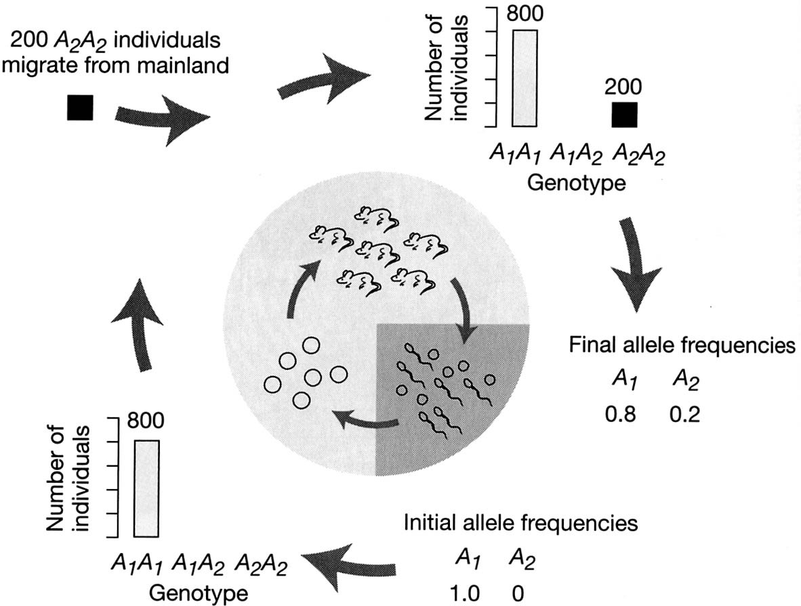
Migration

Slide 6
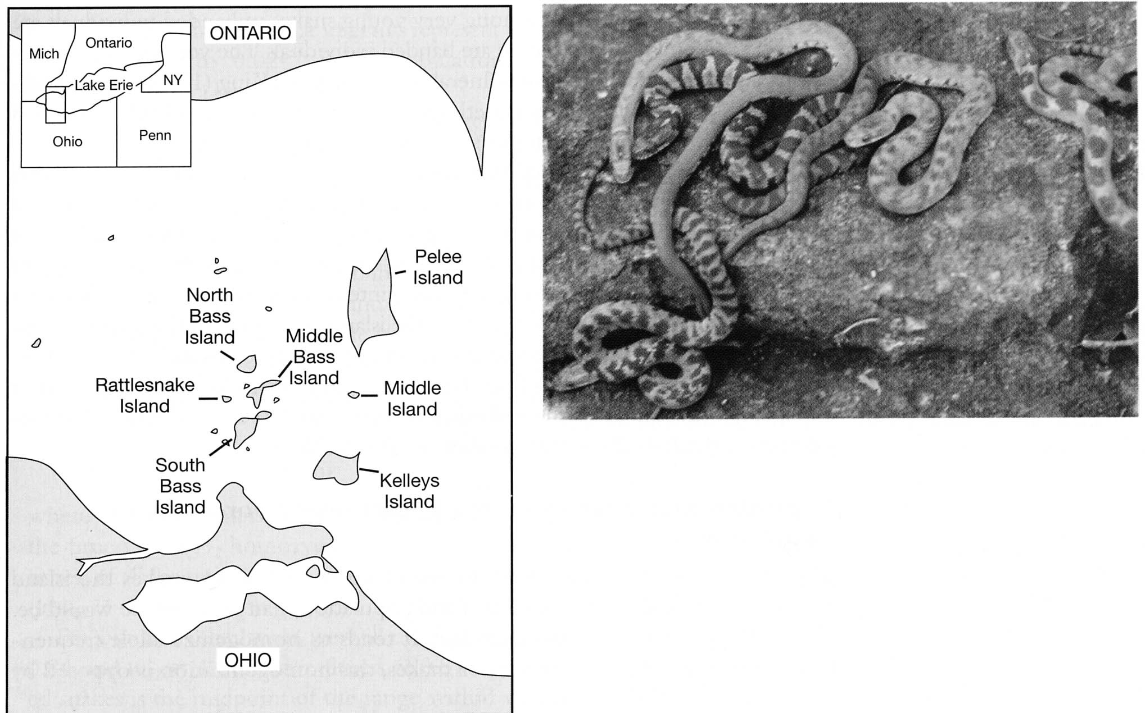
Nerodia sipedon

Slide 7
Selection on banding pattern
Mainland
  Banded snakes favored (dappled light)
Islands
  Unbanded snakes favored
    Barren limestone basking surfaces
Banded alleles on island persist due to migration from mainland

Slide 8
Migration of alleles
Changes allele frequencies
Can alter genotype frequencies
Makes populations more similar

Slide 9
Measuring genetic similarity of populations
Fst statistic ranges from 0 to 1
Measures variation among subpopulations relative to the total variation (s and t)
Fst high, then subpopulations pretty distinct
Fst low, subpopulations homogenous

Slide 10
Silene dioica Swedish islands
Colonize young island
  Genes that get to any specific island mostly a matter of chance
Pollination by insects
  Over time, genes get spread from island to island (migration of alleles)
Die off through ecological succession
  Old populations survivors stochastic

Slide 11
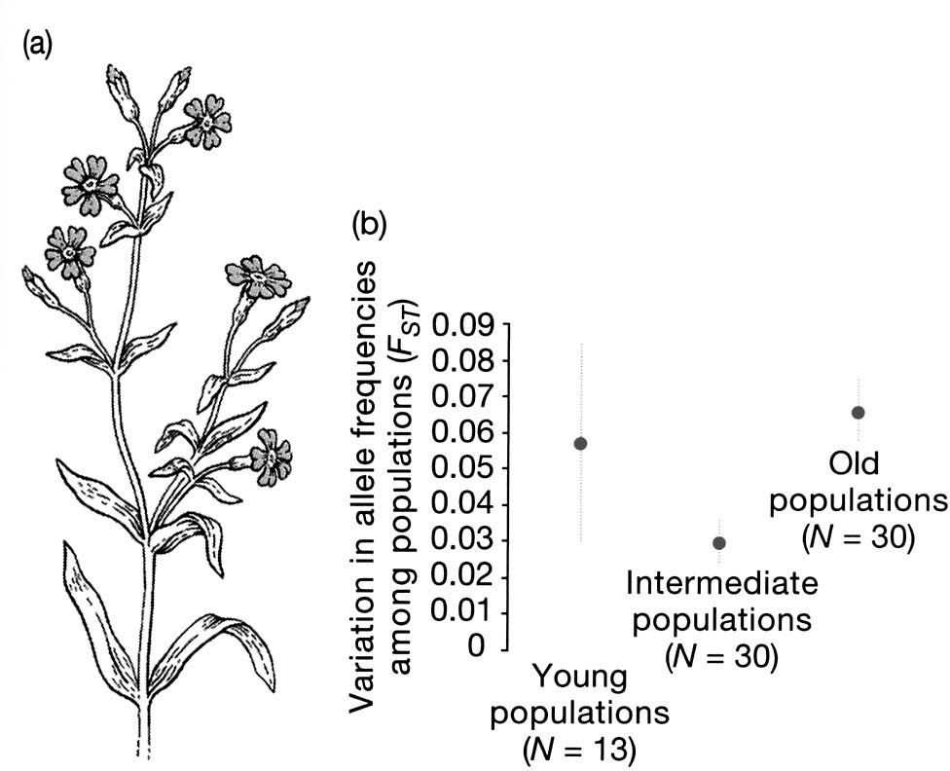
Giles and Goulet, 1997

Slide 12
Genetic drift
In Giles and Goulet’s study, what accounts for the high Fst values for young populations?
Chance founder events
– Populations drawn from small potential pool

Slide 13
Population size and genetic drift
Flip a coin, odds are even (50:50) heads or tails
If you flip the coin 10, 000, 000 times
– You’d better get really close to 50:50
If you flip the coin only 4 times, you have a good chance of getting either all heads or all tails
12.5% chance, even if the coin is a fair coin

Slide 14
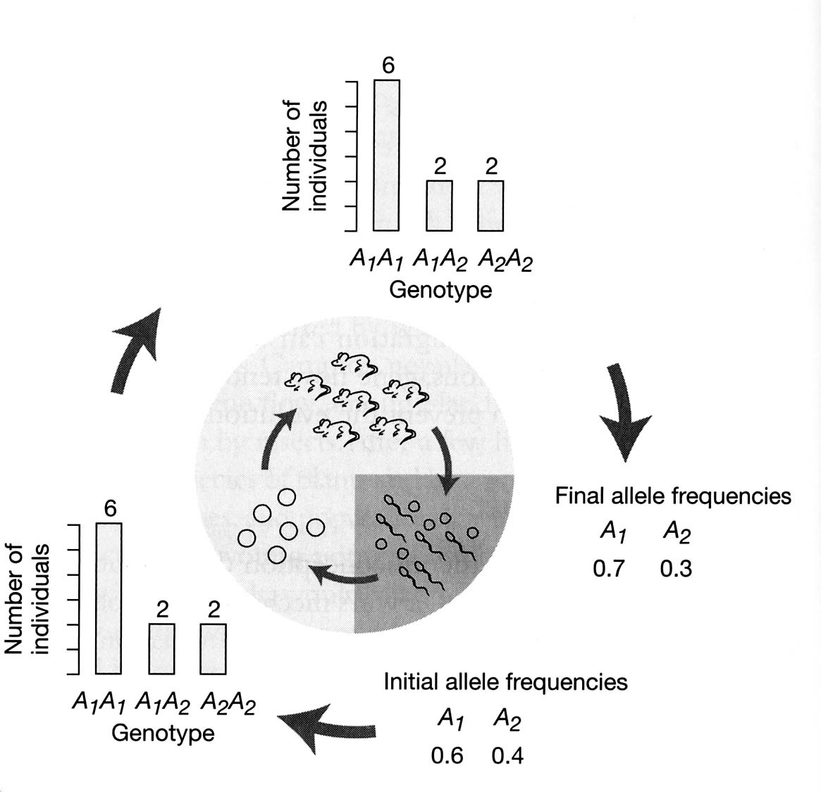
Sampling error in small populations

Slide 15
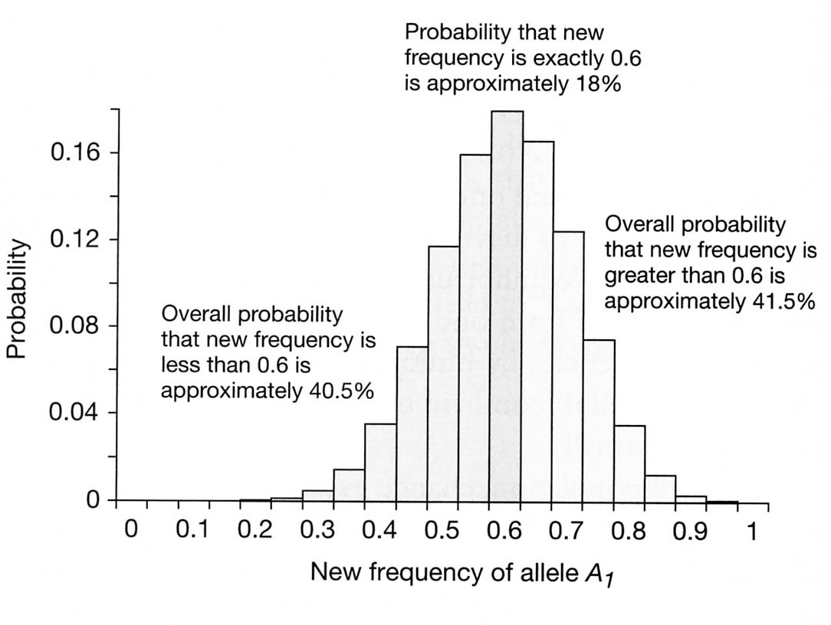
Chance of random allele frequency change, N = 10 zygotes

Slide 16
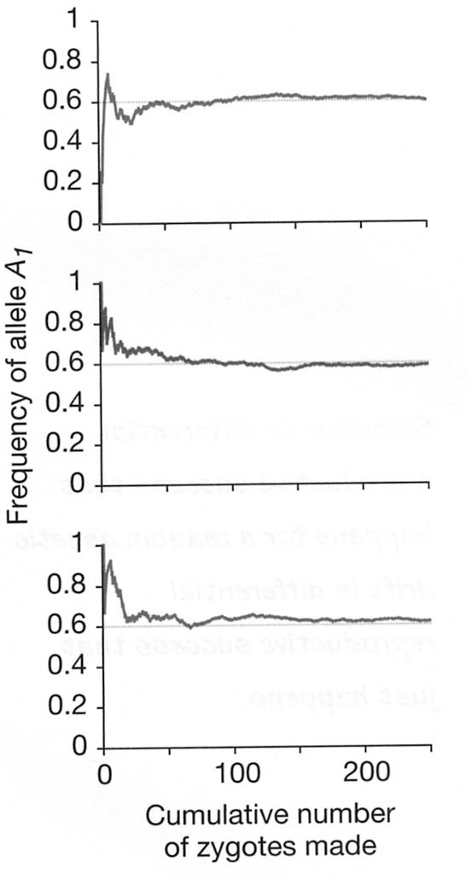
Drift versus sample size
3 runs of a simulation model
True allele frequency 60:40

Slide 17
Drift as an evolutionary force
Drift not an important evolutionary force in large populations
Can be important in small populations
  Founding of new populations
  Fixation of alleles, loss of heterozygosity

Slide 18
Founder effect
High Fst in Silene dioica young populations
In humans,
  Ellis-van-Creveld syndrome
    Rare form of Dwarfism
    Allele frequency around 0.001 in most populations
    But found at 0.07 in Pennsylvania Amish descended from 200 founding individuals

Slide 19
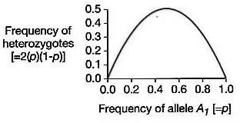
Drift and allele frequency change
small populations over many generations
Fixation: an allele is fix at a locus if it is at a frequency of 100%
Heterozygosity decreas
ed
es
as alleles becomes rarer
Note: 2(p)*(1-p)
= 2pq

Slide 21
Fixation of alleles
If allele frequency goes to 1 it is fixed
If it goes to 0 the allele is lost, and the alternative allele is fixed (if there are only two alleles)
Probability that an allele goes to fixation equal to its initial frequency
– With drift alone that is (no mutation, no selection, etc.)

Slide 22
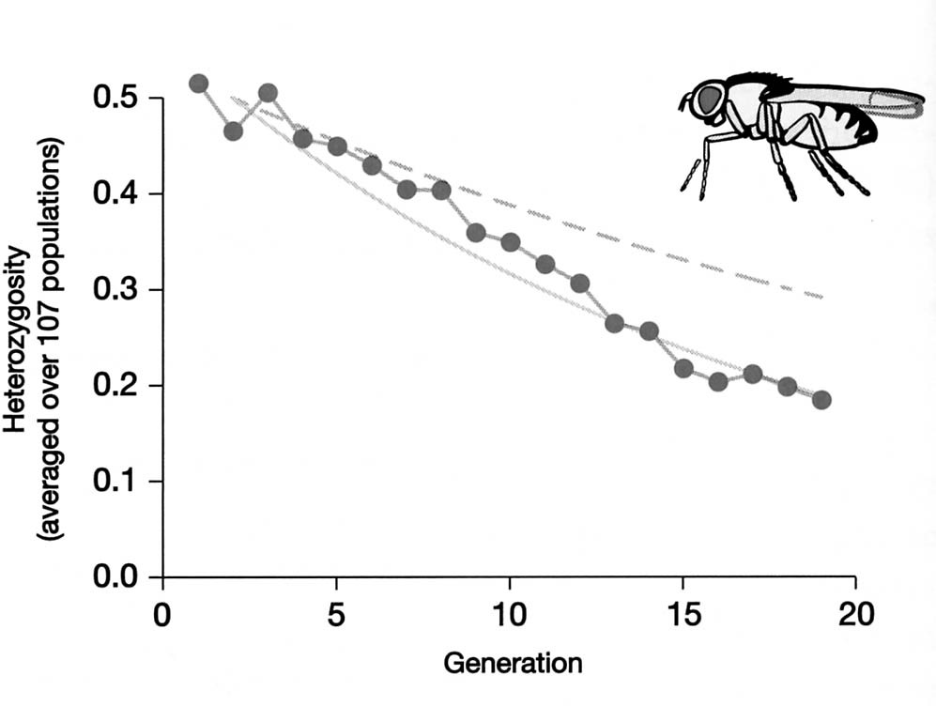
Loss of heterozygosity
Heterozygote frequency = 2 pq
  Alternatively 2p(1-p)
  At a maximum when p = 0.5
Buri Drosophila experiment
107 lines of 8 females 8 males
Start p = q = 0.5
Qualitative: heterozygosity decrease
Quantitative: for population with size 16, heterozygosity should follow dashed line; instead followed solid gray line - the prediction for n = 9

Slide 23
Effective population size
Buri’s fly populations lost heterozygosity as predicted IF the population size was 9 not 16
If some died, or failed to reproduce, then the effective population size can be smaller than the actual population size
Ne = (4 NmNf)/(Nm + Nf)
Nm = number of sexually reproductive males Nf = number of sexually reproducing females
5 males 5 females, Ne = 10
1 male 9 females, Ne = 3.6

Slide 24
Drift and the neutral theory
Alleles that have no fitness effect called neutral
Allelic substitution can be by drift or selection
If most mutations produce selectively neutral alleles, the fate of those alleles will be governed mostly by drift
– Basis of idea behind molecular clock

Slide 25
Genetic drift summary
Random effects
Importance highly dependent on population size
– Effective population size even smaller
Can allow a neutral allele to replace another simply by chance
Decreases allelic diversity and heterozygosity

Slide 26
Non-random mating
Obviously individuals do not mate randomly
  Really, would you want to mate randomly?
We are talking about random mating with respect to particular alleles
Not non-random mating with respect to money, sexiness, or ability to make your heart go pitter- patter
  That is sexual selection, a form of natural selection

Slide 27
Non-random mating with respect to alleles
Positive assortative mating
– Like mates with like
Mating among genetic relatives called
Inbreeding

Slide 28
Inbreeding and heterozygosity
Imagine extreme inbreeding
Self fertilization
Homozygotes produce all homozygotes
Heterozygotes produce 1/2 homozygotes and 1/2 heterozygotes
Proportion of heterozygotes decreases by 1/2 each generation

Slide 29
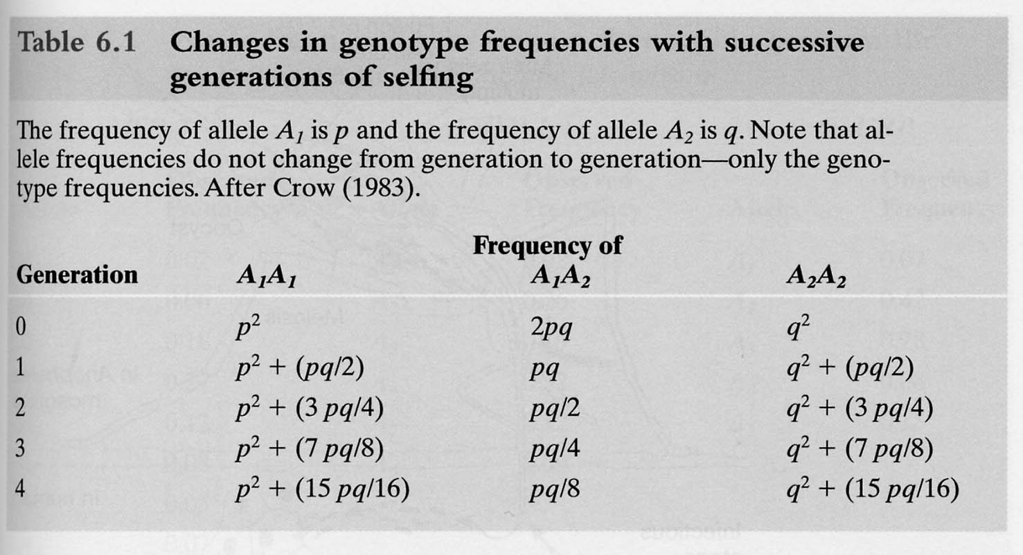
Selfing and heterozygosity

Slide 30
Inbreeding produces excess homozygotes
More homozygotes than predicted by Hardy-Weinberg suggests something, perhaps inbreeding is going on
One generation of random mating re- establishes Hardy-Weinberg genotype frequencies

Slide 31
Inbreeding depression
Does not mean you are sad you kissed your cousin
Inbreeding produces a deficit of heterozygotes and a surplus of homozygotes
What if those homozygotes are of deleterious recessive alleles?

Slide 32
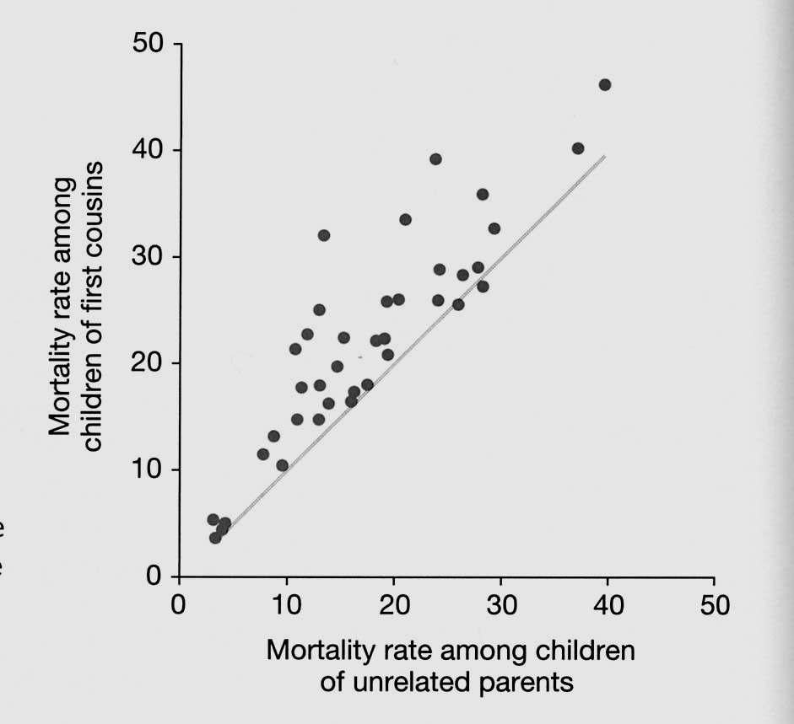
Inbreeding reduces fitness: humans

Slide 33
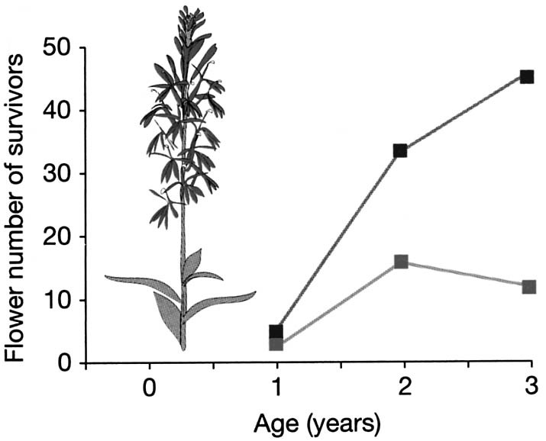
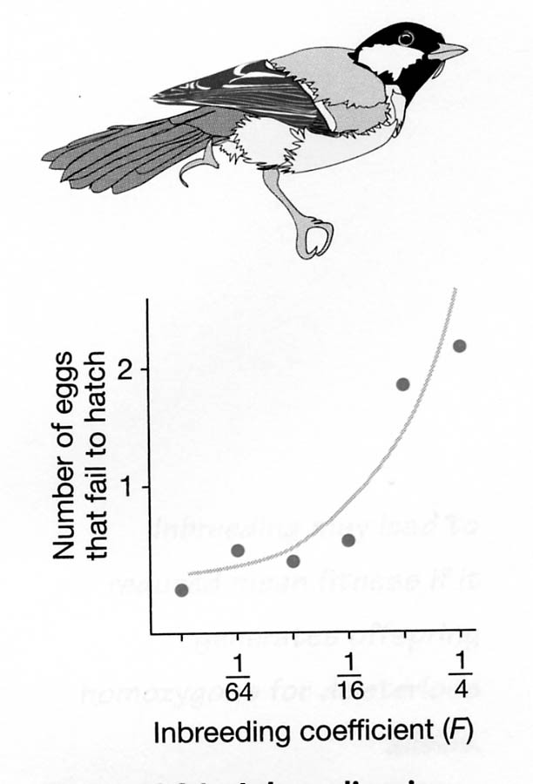
Also, plants, non-human animals
Blue outcrossed controls; red selfed

Slide 34
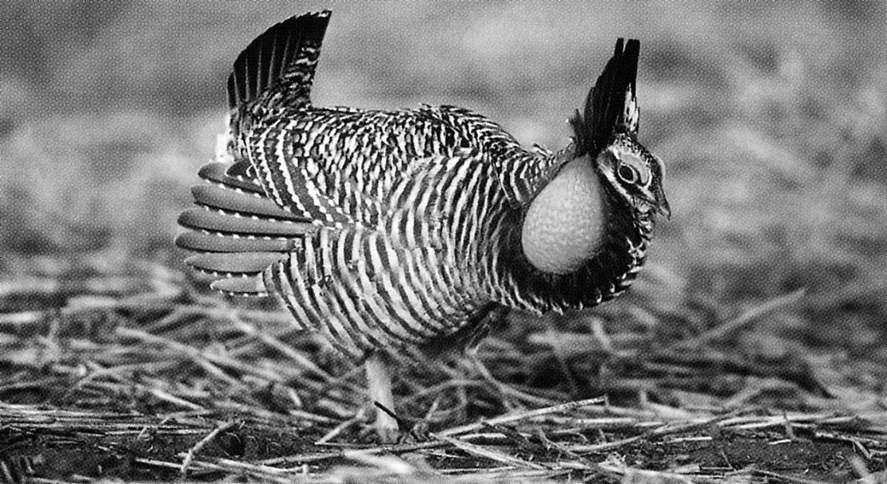
Conservation Genetics: the case of the greater prairie
chicken in Illinois

Slide 35
Movie time

Slide 36
Decline
Millions pre-1837 steel plow
25000 in 1933
2000 in 1962
500 in 1972
76 in 1990
50 or less 1994

Slide 37
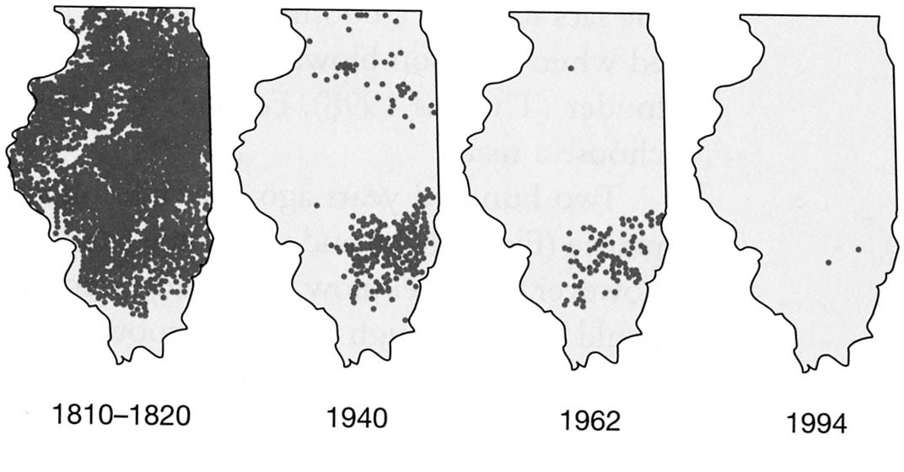
Habitat loss: steel plow 1837
Two remaining habitats protected in 1962 and 1967

Slide 38
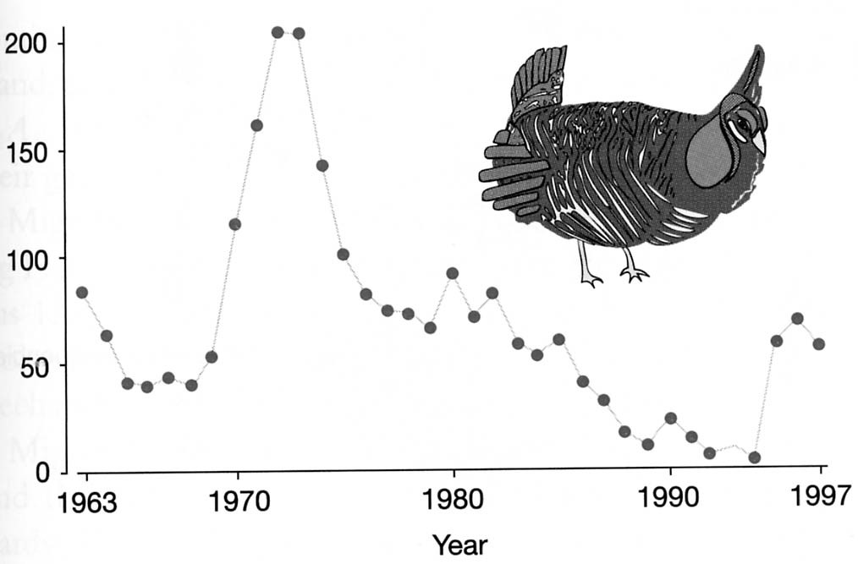
Protection and population decline

Slide 39
Why the post mid 1970’s decline?
Migration
Drift
Inbreeding

Slide 40
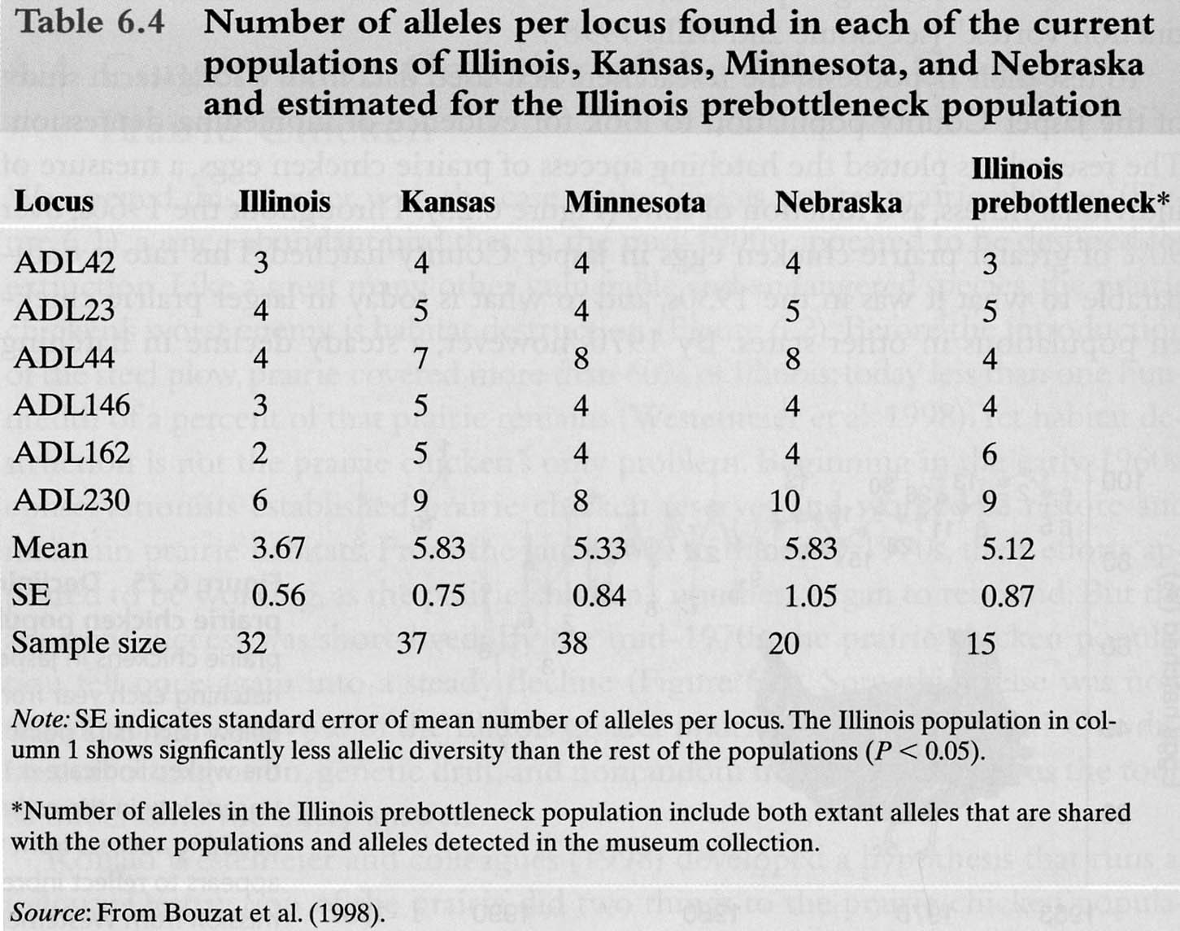
Allelic diversity

Slide 41
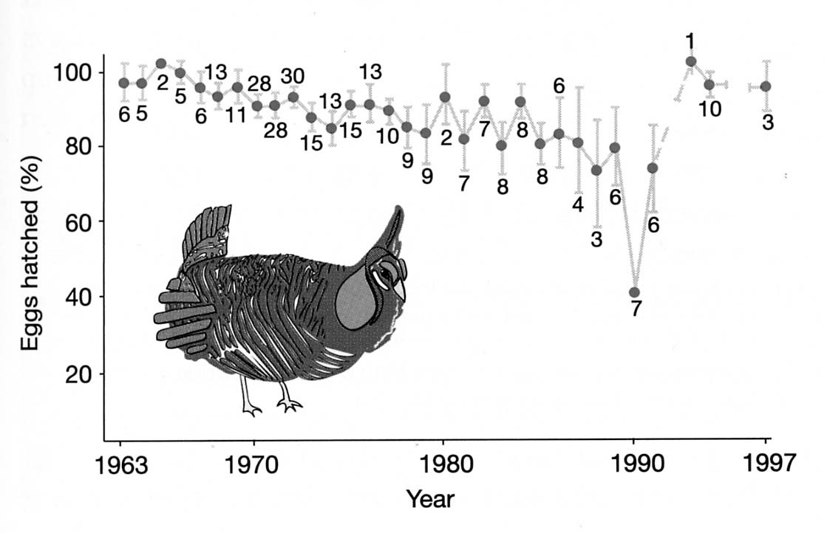
Egg viability

Slide 42
Evolutionary forces
Drift
  Small population
  Even smaller effective population size
    Lek mating system
Low allelic diversity, low heterozygosity
Migration reintroduces new alleles
  Gene flow

