Slide 1
Field Application of Mycorrhizae for healthy Plant health
1

Slide 2
Methods of Inoculation
13
Basidiospores, chopped sporocarp,pure mycelia culture, fragmented mycorrhizal roots or soil from mycorrhizosphere region in ecto mycorrhizal fungi.
VA mycorrhizal fungi can be isolated from soil by wet sieving AND by pot culture technique.

Slide 3
 Soil inoculum
Types of Inoculum
14
 Spore-based inoculum forms
Preparation of Fungal Spores
Inoculation Roots and Fungal Spores
Utilizing wet or dry spore
 Mycelium-based inoculums forms

Slide 4
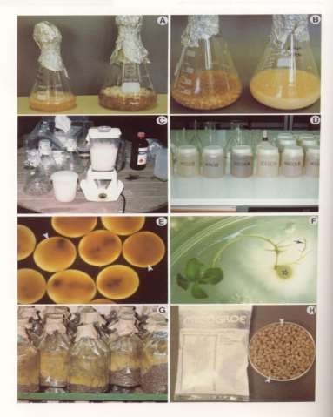
Inoculum production
A and B= mycelial culture C = homogenized mycelium
15
D = mycelium in liquid form E = mycelium in alginate
F = inoculation
G = large scale production H = spores granules

Slide 5
Soil inoculum
16
Easiest and inexpensive method
Successfully in the past
Well adapted to local condition
irregular and inconsistent
risk of introducing pathogens

Slide 6
Spore-based inoculum
17
most effective
Use of the puffballs pisolithus and Scleroderma
 Collecting Spores
Late Autumn
Larger sporocarps cut into smaller pieces
Dry spores are required 35˚C store in4 ̊C at refrigerator.

Slide 7
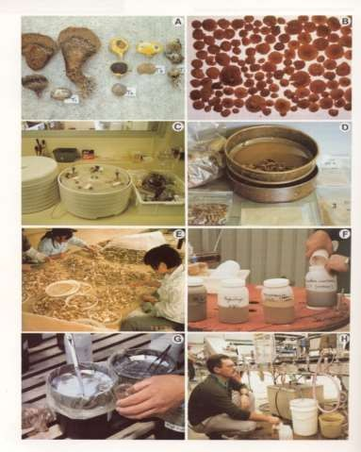
Spore ectomycorrhiza inoculum
18
A and B = fruiting body C = drying (35 C)
D = grinding and sieving E = fruit body selection F = spore inoculum
G = small scale inoculum production
H = large scale inoculum
production
(nursery)

Slide 8
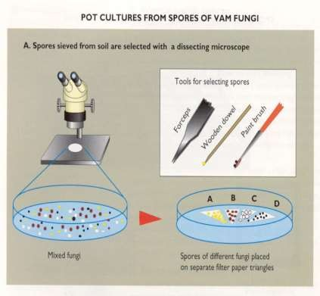
19
 Preparation of Fungal Spores
5-10 spores of
Gigaspora margarita
+ 0.5 ml per well of peptone-yeast extract solution for five to seven days

Slide 9
Inoculation of Roots and Fungal Spores
20
sterilized nutrient solution(pH 6.5 )+ l0g Difco Bacto-agar/liter+ vermiculite and peat, 95.5, v/v substrate prepared
spores of Gigaspora margarita + 30-50 Tips of cloned Trifolium root incubated in the dark at 28°C shaken continuously at 60 rpm
harvested after 4 weeks .

Slide 10
Mycelium-based inoculums
21
Directly Fungal mycelium, carrier materials hydrogels used as inocululm .
Peat-vermiculite mixture
Segments of agar containing mycelium
Standard nutrient solution partially solidified with 0.3% agar in flask
Fungal biomass as a inoculums slurry

Slide 11
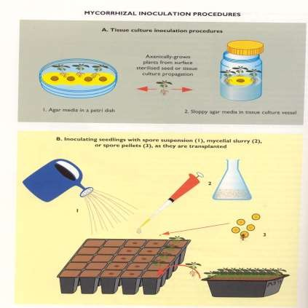
Mycorrhizal Inoculation procedure
22
Brundrett, M., Bougher, N., Dell, B., Grove, T and Malajczuk, N. Working with mycorrhizas in forestry and agriculture, 02/01/1995

Slide 12
Advanced form of this inoculum
23
Homogenized mycelium+ sodium alginate solution + solidified into beads by 0.7M calcium chloride solution result encapsulation 0.5 to 0.2 mm of hyphal fragment within beads.

Slide 13
The Effects of Mycorrhizal Fungi Inoculum on Vegetables
24
 Method:Seeds of plants in one inch cells in a green house ( golden chard, strawberry spinach, double red orach spinach,
epazote Japanese chrysanthemum) transplanted into four inch containers
after 12 days
after 10 days
seedlings planted On planting add inoculants and Both beds received 10 minutes of drip irrigation for 2 weeks
Results : vegetables with inoculum grew larger ,
more disease resistant, sweeter tasting
Without inoculum, suffered severe leaf damage.

Slide 14


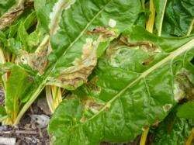
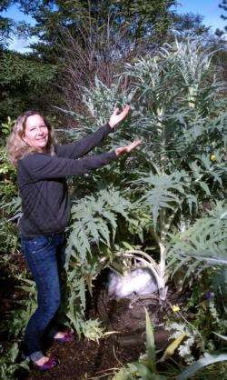
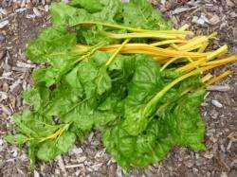
Results
25
The chard receiving inoculum at planting had no leaf damage
The cardoon plants in the inoculated beds grew height of over 8 feet

Slide 15
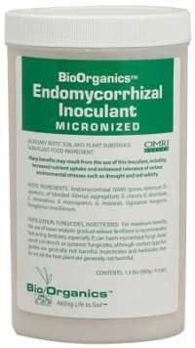
Tips to Choose a Quality Mycorrhizal Inoculant
26
Some researchers lucky enough to find an excellent manufacturer.
Spore count
The quality of the manufacturing process
The health of the spores
Cost price
Ectomycorrhizal inoculant are more plentiful
Don’t buy mycorrhizal inoculants with trichoderma

Slide 16
Amount to use inoculant
27
Use 1/2 pound per 1/3 acre if mixing it in with seed before sowing.
1/2 pound will be more than plenty. If seeding vegetables,
Nursery application: 100 g/one metre square.
20g of VAM inoculum is required per seedling
200g of VAM inoculum is required for inoculating one tree.

Slide 17
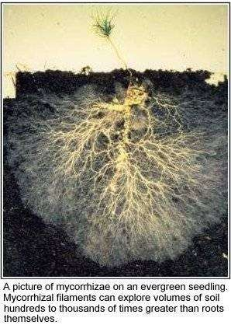
Conclusion
28

Slide 18
References
29
Bagyaraj, D.J. (1984). Biological interactions with VA mycorrhizal fungi. In: VA mycorrhizae (eds.). C.L. Bailey and J.W. Mansfield. CRC Press, Boca Raton, Florida,USA, pp.131-154.
Brundrett, M., Bougher, N., Dell, B., Grove, T and Malajczuk, N. (eds.) Working with mycorrhizas in forestry and agriculture, 02/01/1995, Publication
Code: MN032
Crush, J.R. (1974). Plant growth response to vesicular-arbuscular mycorrhizal. VII. Growth and nodulation of some herbage legumes. New Phytologists, 73: 743-749.
http://www.sciencedirect.com/science/article/pii/S0166248108702009
HTTP://WWW.JSTOR.ORG/DISCOVER/10.2307/2442619?UID=2&UID=4&S ID=21105407197063
HTTP://WWW.DAVIDMOORE.ORG.UK/ASSETS/MOSTLY_MYCOLOGY/DIANE
_HOWARTH/ERICOID.HTML
Native Plant Class Notes Las Pilitas native plant class (from Spring 1994, updated
2003, 2012)
HTTP://WWW.JSTOR.ORG/DISCOVER/10.2307/2442619?UID=2&UID=4&SID
=21105407197063

