Slide 1
Sources of Ectomycorrhizal Inoculum

Slide 2
Ectomycorrhizas may be initiated by several different kinds of inoculum
Naturally dispersed spores
Colonized soil
Mycorrhizal seedlings
Ascomata basidiomata spores or sclerotia collected for the purpose
Fungal Mycelium produced in axenic culture

Slide 3
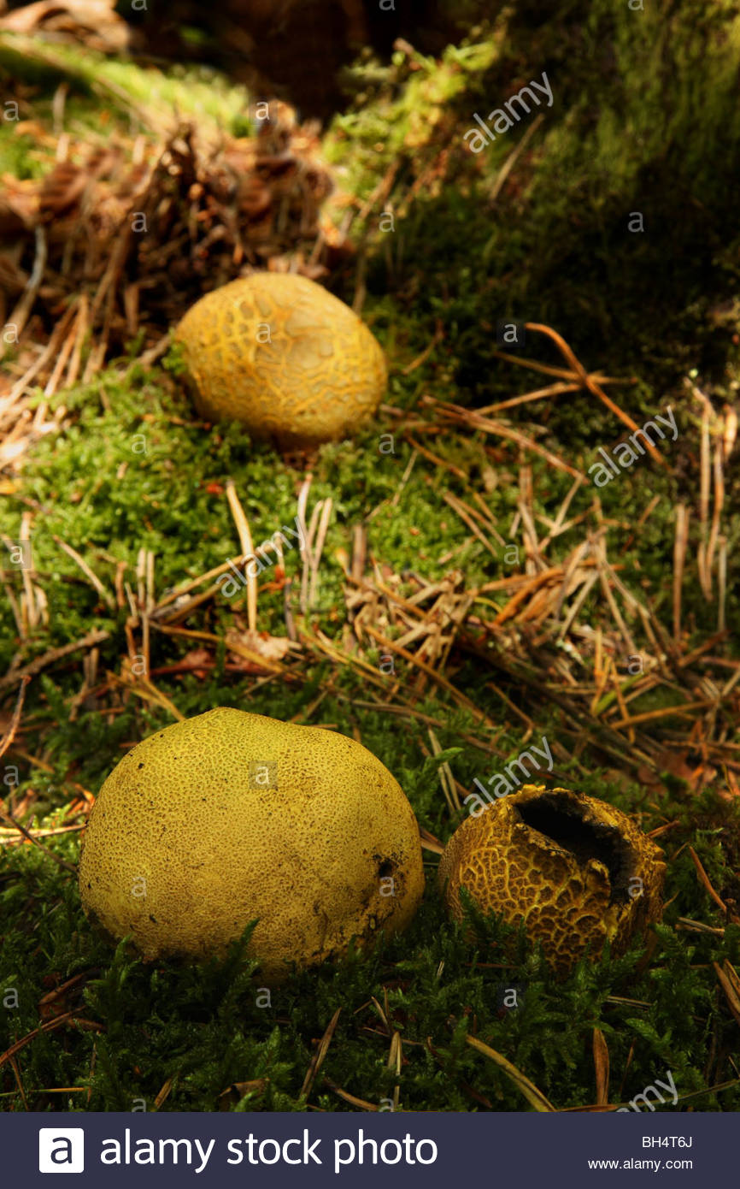
Natural spore inoculum
Prime dispersal mechanism
Cannot always be relied because
A)Availability during short season
B)Even when spores are being released, they may not reach the seedling in adequate numbers, especeially if the seedlings are long away from the nearest stand of ectomycorrhizal trees.
C)No control of the nature of fungal partners being introduced because they vary widely in their efficency

Slide 4
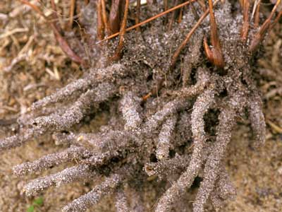
Colonized soil
In western austrailia, pine seeds planted at 14 new nurseries, only healthy seedlings were found to have developed ectomycorrhizas
Soil around the healthy seedling are used to inoculate other seedbeds because it is fairly reliable source for inoculum, if 10% by volume is added to the new nursery bed.
The mycobionts are often unknown and ther is sone risk of introducing pests or pathogens. It can be carefully checked in advance.
This method is used to establish exotic pines in southern hemisphere.

Slide 5
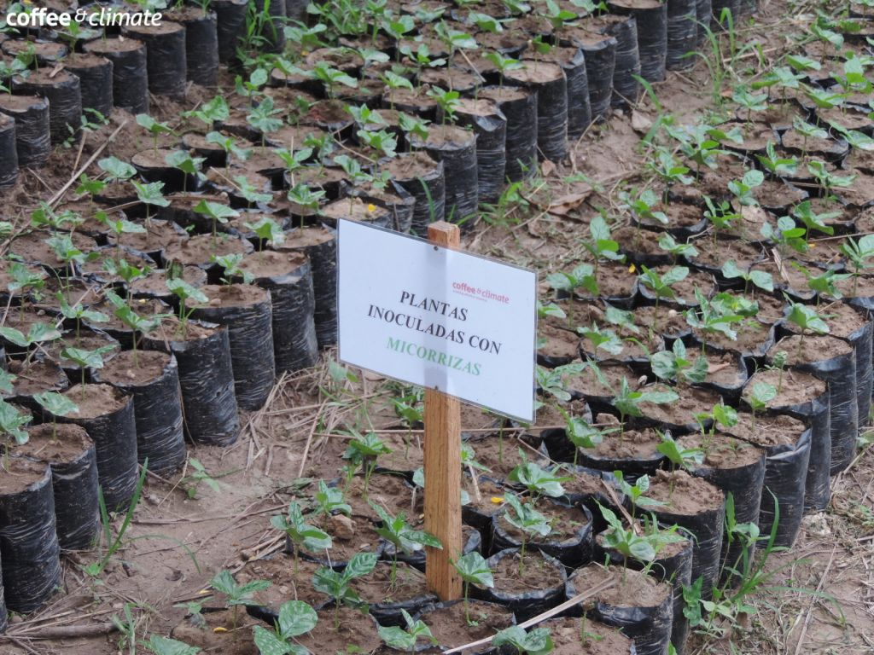
Mycorrhizal seedlings
This carry the same risk as (2) but relatively well.
This technique was firstly used on a large scale in Indonesia and still used there.
Mycorrhizal seedlings are planted in seed beds at 1-2 m intervals at out planting time, some seedling are left in onoculate the next crop.

Slide 6
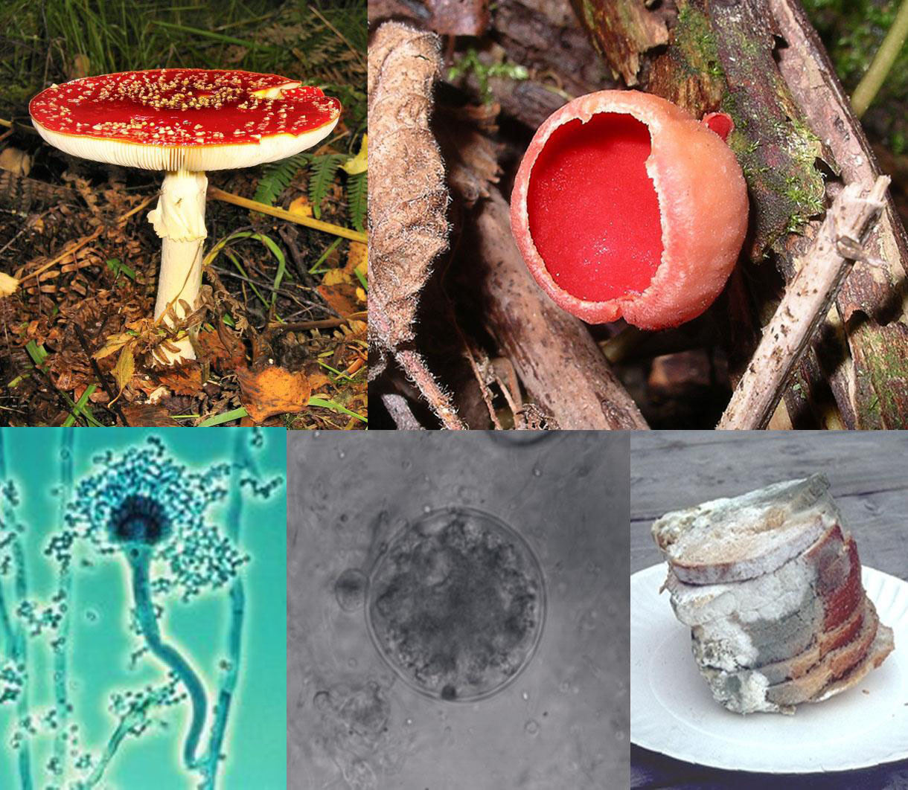
Ascomata basidiomata sclerotia
The delibrate collection and introduction of spores fruit bodies or sclerotia would seem to be an obvious way of improving upon nature but there are some problems
A) naturally occurring fruiting bodies of most EM fungi are available during a small part of year

Slide 7
B) the amount of available inoculum will be limited
Collection in the amount needed for large scale forestry appilication would be almost impossible
C)Storage of the eminently perishable basidiomata would be difficult
D) initiation of mycorrhizas by basidiospores inoculum takes 3-4 weeks than mycelium inoculum and it gives pathogens longer to attack on roots also provide the less growth stimulation during the crucial early stages of seedling developed

Slide 8
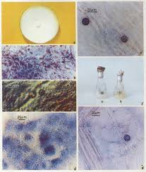
Exenic Culture
If the mycelial inoculum derived from pure culture of known mycobionts is uded, the identity of the fungus will be known, pests and pathogens will be absent, inoclum will be compact and easily transpoted and should be available in year around, it is by far the most expensive of the alternatives.
Some ectomycorrhizal fungi are difficult to isolate in pure culture.
Expensive to maintain and grow slowly

Slide 9
We still do not know how well such inoculum survives in the soil in face of predation and competition.
We have not yet defined the best possible fungus host combinations for many soil climate combinations
It is easy to grow enough mycelial inoculum for small scale research projects, but experience can be shown that is much more difficult to generate enough to inoculate the many millions od seedlings produced each year.
Various methods of producing mycelial inoculum of Pisolithus tinctorius. Thelephora terrestris and cenococcum geophilum have been tried.

Slide 10
Several methods of application have been tried.
A) Broadcast inoculation
A known quantity of inoculum is spread out over a given area of seedbed, and mixed into the 10 – 30 cm of soil before the bed is seeded. Inoculum of Pisolithus tinctorius, broadcast at a rate of 1 litre/square meter, gave the same results as those obtained with higher level of inoculum.
Inoculum incorporated in contained growth media at a rate of 6% by volume produced effective mycorrhization in many conifers. Here inoculation and contained filling process can be combined. Pinus taeda nursery beds have been successfully inoculated with cultures of Pisolithus tinctorius. Laboratory growth inoculum was leached under running tape water, cool dried to about 20% moisture and kept cold but not frozen until used.
Nursery beds previously fumigated with methyl bromide – chloropicrin were inoculated with the dried preparation, which was dug into the top 7 – 10 cm of soil, before seeding.

Slide 11
B) Banding of Inoculum below seeds
This concentrates inoculum in a zone that will be penetrated by the growing roots. Seeds and inoculum can be dispensed at the same time. This method need only about a third as much inoculum as broadcast technique.
C) Slurry Inoculum
This has advantage that bare root or containerized seedlings can be rapidly inoculated by dipping before transplanted.

