Slide 1
Subject: Plant Fungal Interactions
1
ECTOMYCORRHIZAL FUNGAL COMMUNITIES AND WORK DONE IN PAKISTAN

Slide 2
Introduction
3
It is a form of symbiotic relationship that occurs within a fungal partner called mycobiont with the roots of plant species also known as phytobiont.
Ectomycorrhizas composed at least 65 genera of
mycobiont. Mostly belongs to Basidiomycetes.
They form entirely intercellular structure and never penetrate inside the cell.

Slide 3
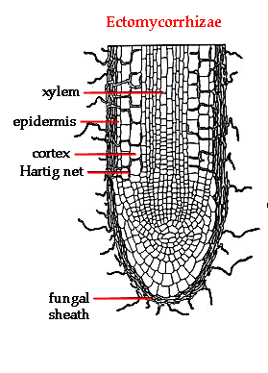
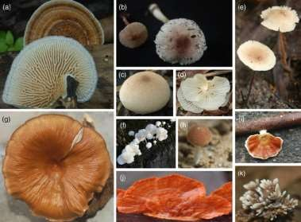
ECM structructures
4
Hartig’s net
Mantle
Extraradical hyphae
Sporocarp
ECM structures
Sporocarps

Slide 4
Community
5
According to Whittaker (1975)
“An assemblage of population of plants, animal bacteria, and fungi that live in an environment and interact with one another forming together a distinctive living system with its own composition, structure, environmental relations, development and function”.

Slide 5
Fungal community
6
The concept of a group of organisms growing in a
particular area and requiring similar conditions is easier to apply to some fungal habitats and groups of fungi than to others.
Fungal communities are inextricably related to communities and populations of plants and animals in ecosystem.

Slide 6
Ectomycorrhizal fungal communities
7
Fungi forming ectomicorrhizal association with plant roots.
These communities are present above ground and below ground.
Community structure may be different above and below ground

Slide 7
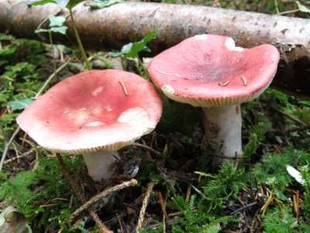
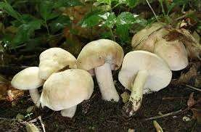
ECM communities above ground
8
Epigeous fruiting bodies i.e Russula, Cortinarius, Inocybe.
Different areas have different community structures in terms of richness and diversity.
Russula sp.
Inocybe sp.

Slide 8
ECM communities below ground
9
Due to some unfavorable conditions some fungi do not have chance to make fruiting bodies or they may be hypgeous (Tylospora, Tomentella etc.).
By this observation we cannot assume that ECM fungi are
totally absent in that area.
There can be 65-80 ECM species with roots of mixed coniferous forests in a single hectare.

Slide 9
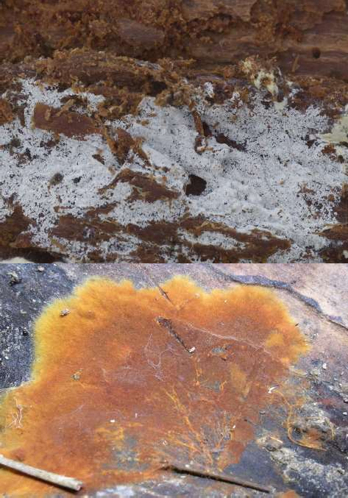
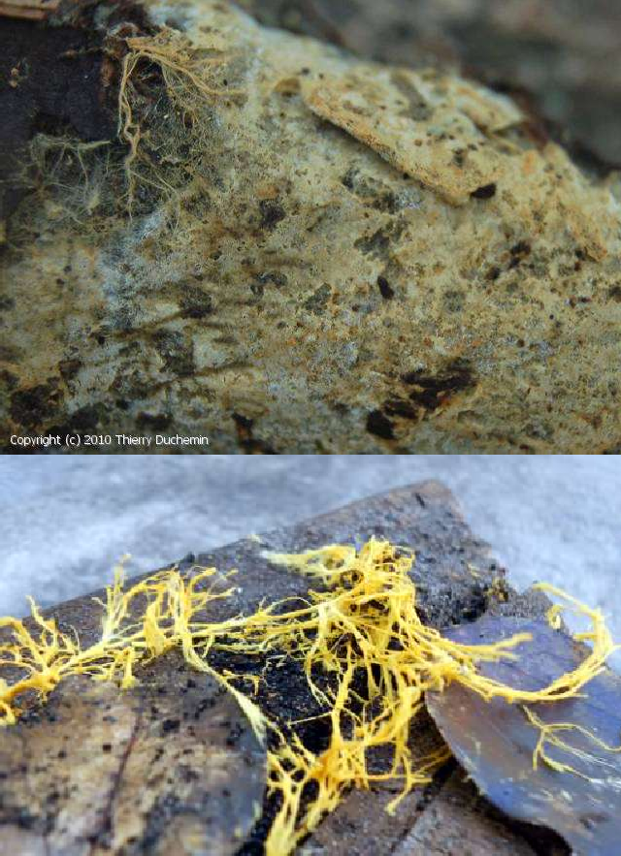
10
Tylospora sp.
Amphinema sp.
Tomentella sp.
Piloderma sp.

Slide 10
Identification and characterization of fungal community
11
Trace method
Morphotypes study
Culturing methods
Molecular/biochemical methods

Slide 11
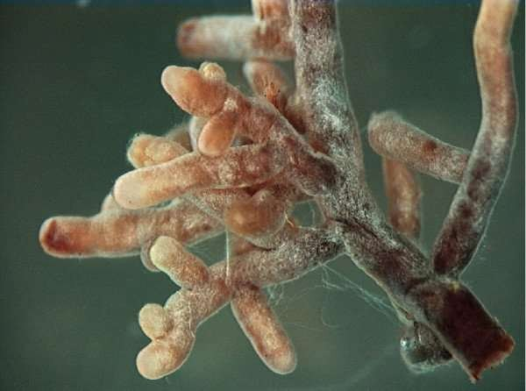
12
An example of an ectomycorrhizal symbiosis, showing root tip mycelia from the genus Amanita

Slide 12
Factors effecting ECM communities
13
Host effect on ectomycorrhizal fungal community.
Size of host plant and its distribution on landscape
Host specific mycobionts.
The EMF community structure is affected by a number of biotic and abiotic factors such as EMF succession, interspecific interaction of EMF, litter quality, climate, soil type and soil nutrient status.
Nitrogen availability may be a major factor structuring ectomycorrhizal fungal communities. Atmospheric nitrogen (N) deposition has been implicated in the decline of ectomycorrhizal fungal (EMF) sporocarp diversity.

Slide 13
Significance
14
Promote fine root development
Produce antibiotics, hormones, vitamins for plants
Protect plant root against pathogen
Moderating effect of heavy metal
Promote soil structure
Sustaining forest ecosystem
Critical in regeneration of canopy trees
Determine host plant community
Role in succession

Slide 14
Role in succession
15
Observation of plant colonization in successional seral environments have indicated that nonmycorrhizal or facultative mycorrhizal plants are often first to establish in severely disturbed sites.
There appear to be continuum mycorrhizal dependency along successional gradients.
These are replaced by obligately arbuscular mycorrhizal followed by ectomycorrhizal plants and ultimately ericoid plant species.

Slide 15
16
Plant establishment thus follow a predictable pattern
towards communities with a
greater dependency on
mycorrhizal fungi with different characteristics in their resources especially N and P.

Slide 16
ECM Fungal Communities: Study in Pakistan
17

Slide 17
18
In plains of Punjab with subtropical to semiarid climate, sub-tropical thorn forest of vegetation is represented by several species of deciduous and evergreen trees.
Among these, Populus euramericana, Salix babylonica, S. tetrasperma, Dalbergia sissoo, Eucalyptus comendulensis, Morus alba and Acacia nilotica are among the dominant tree species.

Slide 18
19
In temperate climate of Northern areas, Himalayan and Hindu-kush ranges are covered with dense forests of conifers along with scattered vegetation of deciduous trees.
The dominant tree species are Pinus wallichiana, Abies pindrow, Cedrus deodara, Picea smithiana, Juglans regia, Salix spp. and Populus spp.

Slide 19
Salix and Populus
20
Work done on ECM association in Salix and Populus from
two different ecological regions (KPK & LHR.)
Dominant specie associated with Populus in KPK was Populirhiza followed by Tomentella whereas in Lahore it was Quercirhiza.
Dominant species associated with Salix was Dermocybe in KPK and Salicirhiza lahorensis in Lahore folowed by Lactarius sp.

Slide 20
Himalayan Spruce (Picea smithiana)
21
First records of ECM with Picea from Pakistan was
described by Khan (1970)
He reported Lycoperdon in symbiotic association with Spruce.
Niazi et al,. (2009) described Amanita rubescens and three morphotypes based on morphoanatomical feature
Collection was done from Mukshpuri and Swat valley
Dominant community was of Sebacina epigea followed by
Tomentella sp.

Slide 21
ECM with Eucalyptus
22
An evaluation of the ectomycorrhizal status of Eucalyptus
plantations in different areas of the Punjab Province was done.
This study reveals a very low diversity of below-ground ectomycorrhizal fungi associated with Eucalyptus.
Scleroderma Eucalyptus.
Scleroderma
bovista was frequently associated with
aurantium and Pisolithus tinctorius were
infrequent associates with eucalypt roots.

Slide 22
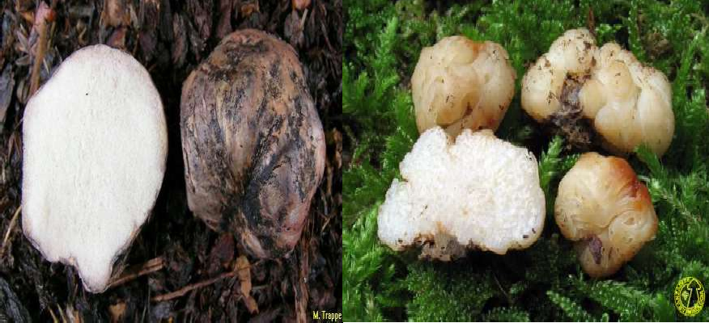
Pinus spp.
23
In Lahore dominant community was Rhizopogon followed by Hydnobolites.
Samples collected from KPK show dominant community was Pinirhiza sp.
Rhizopogon sp.
Hydnobolites sp.

Slide 23
Recent discoveries
24
Peziza succosella and its ectomycorrhiza associated with Cedrus deodara from Himalayan moist temperate forests of Pakistan (Jabeen et al,. 2015)
New reports of Inocybe from pine forests in Pakistan
(Saba et al,. 2015)
Inocybe kohistanensis, a new species from Swat, Pakistan (Jabeen et al,. 2016)

Slide 24
Some ectomycorrhizal fungi reported from Pakistan
25

Slide 25

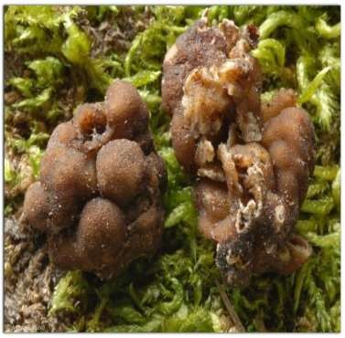
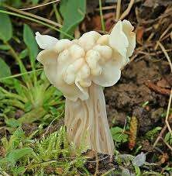
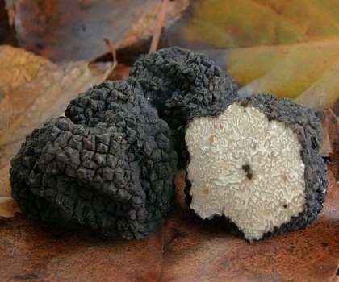
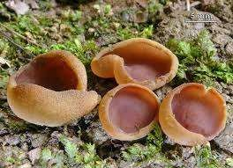
26
Genea
Helvella
Tuber
Peziza

Slide 26
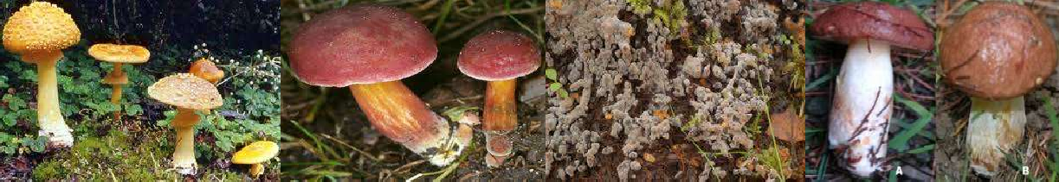
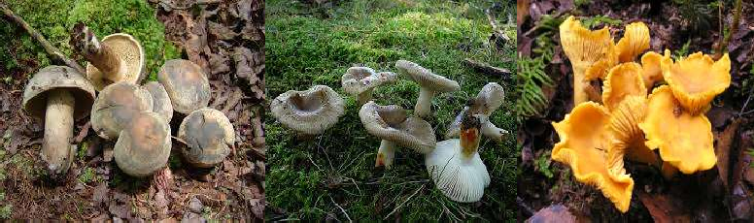
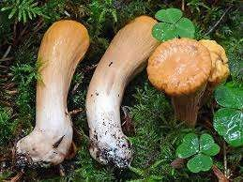
27
Amanita
Boletus
Tomentella
Suillus
Sarcodon
Russula
Cantharellus
Clavariadelphus

Slide 27
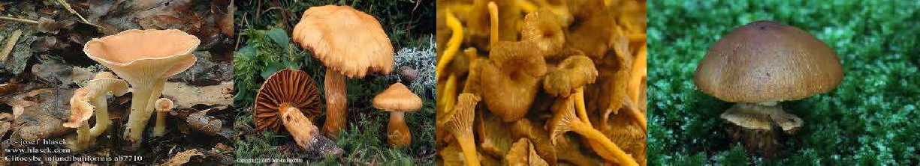
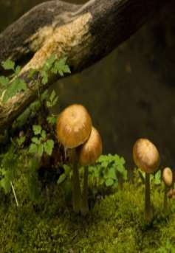
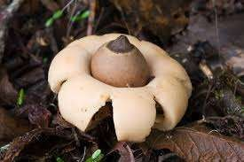
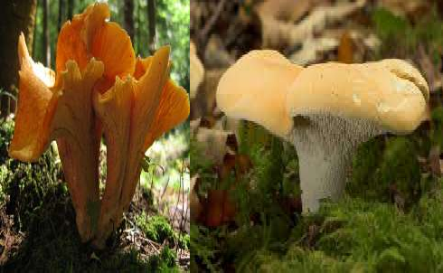
28
Clitocybe
Cortinarius
Craterellus
Descolea
Dermocybe
Geastrum
Gomphus
Hydnum

Slide 28
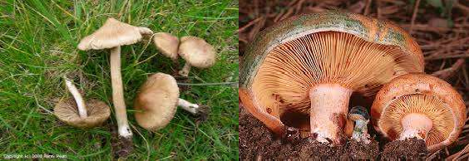
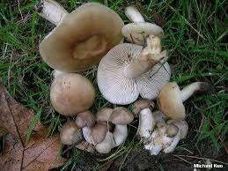
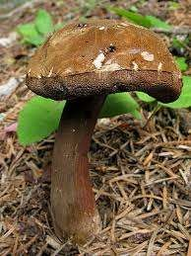
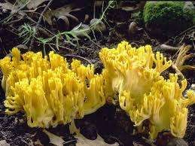
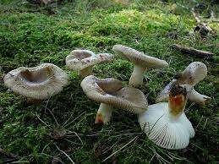
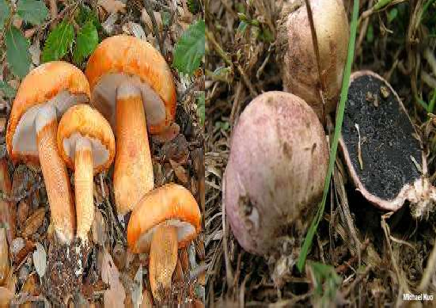
29
Inocybe
Lactarius
Lyophyllum
Porphyrellus
Ramaria
Russula
Tricholoma
Scleroderma

Slide 29
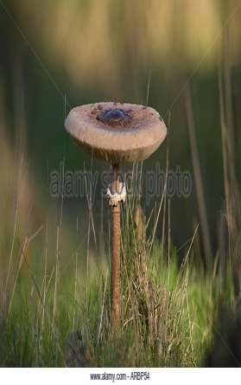
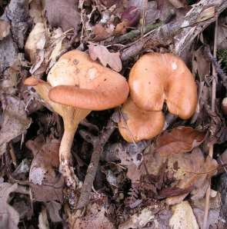
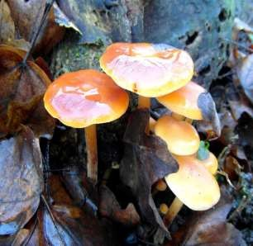
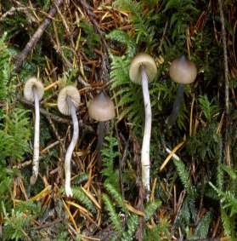
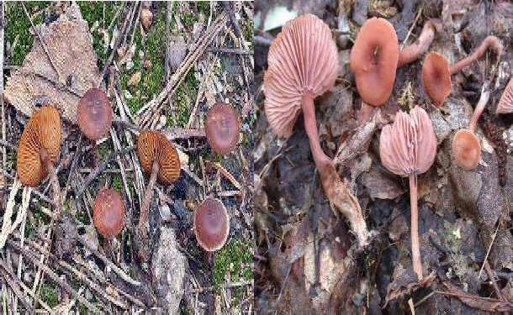
30
Lepiota .
Lepista
Flamullina
Rhodocybe
Crassisporium
Laccaria

Slide 30
Conclusion
31
ECM communities are very important for plant survival.
Different environment and different host plants supports different fungal communities.
Community richness and diversity is different below and above ground.
Due to its importance, role in sustaining forest ecosystems, there is need to study these communities.

Slide 31
References
32
John Dighton, James F. White, The Fungal Community: Its Organization and Role in the Ecosystem, Third Edition
Michael Allen, Mycorrhizal Functioning: An Integrative Plant-Fungal Process
Jabeen S., Ahmad I., Khalid A.N., Inocybe kohistanensis, a new species from Swat, PakistanTurkish Journal of Botany(2016) 40:
Jabeen S, Sarwar Ectomycorrhizae from 2014;1:R10-R20
S, Niazi Pakistan.
ARK, Khalid AN. Checklist of Annals
of Applied Bio Sciences.
Bashir H and Khalid AN. Morpho-anatomical and molecular characterisation of ectomycorrhizae associated with Eucalyptus species growing in different areas of the Punjab Province, Pakistan, Australian Journal of Botany, 2014, 62, 689–697.
Takahide A. Ishida,Kazuhide Nara,Taizo Hogetsu, Host effects on ectomycorrhizal fungal communities: insight from eight host species in mixed conifer–broadleaf forests New Phytologist (2007) 174: 430 –440.
Erik A. Lilleskov, Timothy J. Fahey, Thomas R. Horton, Gary M. Lovett, belowground ectomycorrhizal fungal community change over a nitrogen deposition gradient in alaska, ecological society of america, 2002.

