Slide 1
MYCOHERBICIDES

Slide 2
MYCO-HERBICIDE
From Greek, Mukes Any weed killing pesticide
- Can be synthetic OR
Meaning ‘Fungus’ - Derived from some biological
source

Slide 3
BIOHERBICIDES
Biologically based control agent for weed
Consists of any naturally occurring PATHOGEN
Is indigenous in a population of target plant
Use of fungal pathogens as controlling agent for weeds….MYCOHERBICIDES

Slide 4
Fungi which can be used as Mycoherbicide usually are:
Obligate parasite
Native to the area
Host specific

Slide 5
Mycoherbicide should be
Low in cost
Culturable in artificial media.
Capable of abundant spore production.
Stable in storage
Genetically stable
Effective under field condition
Tolerant to variation in Temperature
Compatible with other chemical cultural practices.

Slide 6
HISTORY OF MYCOHERBICIDES
First attempt was done in Hawaii in 1940 and was unsuccessful
Used Fusarium oxysporum to control white form of Pricky pear (Opuntia megacantha)

Slide 7
Contd…
Successful experiment was done in US in 1960s
Used Acremonium diospyri to control weedy persimmon (Diospyros virginiana)
DeVine,
first mycoherbicide to be registered in 1981
In US by U.S environmental protection agency (EPA)
Composed of Phytophthora palmivora strain MWV

Slide 8
Was developed by researchers in 1960s & 1970s to control Milkweed vine/ stranglervine (Morrenia odorata)… citrus groves
Collego, Colletotrichum gloeosporioides f.sp. aeschynomene, Ecogen, University of Arkansas.
Anthracnose on northern jointvetch, a leguminous weed in rice and soybeans
Wet able powder applied with conventional herbicide sprayers
English pea and broadbean are susceptible

Slide 9
How mycoherbicides work?
Spore germination
Phytotoxins release
PHYTOTOXINS RELEASE
(Misra, 2005)
Mycoherbicides release phytopathogens when sprayed on target plant
Phytopathgens release phytotoxins
Phytotoxins kill the target plant up to 5 weeks

Slide 10
Spore production/physical infection
(Batron, 2004)
Application of mycoherbicide to target plant
Production of stable and temperature tolerant spores
Germination of spores
Infection spread outwards
GERM TUBE to infect upper layers of leaf
Appressoria is created

Slide 11
PURPOSE OF MYCOHERBICIDES

Slide 12
Growth of weeds in a crop compete with the plants in terms of nutrients, water and survival
May result in the loss of grower’s expected yield
The lost yield results in economic losses
A problem in the agriculture industry
SOLUTION?

Slide 13
Bioherbicides can constitute an alternative to mechanical methods & chemical herbicides
Mycoherbicide is created with the fungi as its active ingredient
The MYCOHERBICIDE inhibit the weed growth without harming the crop or the living organisms surrounding it

Slide 14
SCOPE OF MYCOHERBICIDES
Host specific & will reside on the soil or weed host
Don’t disturb other plants or living organisms present there
Long lasting
Survive in soil for extending period of time
Cause disease in succeeding crops of target plant sp
Help to mitigate the adverse effects of chemical herbicides
Such as, ground and water contamination
Non-target effects
Development of herbicide resistance

Slide 15
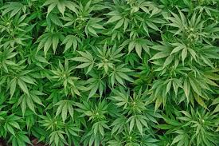
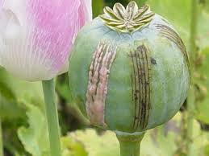
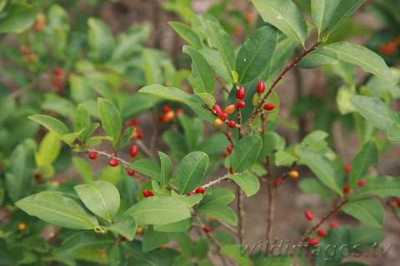
contd….
Cheaper alternative to expensive mechanical controls
Used to control illicit drug crops
Fusarium oxysporum & Crivellia papveracea controls coca, cannabis, opium etc.
Coca Cannabis Opium

Slide 16
CHALLENGES
Anti-herb capacity is generally less than that of a chemical herbicide
Success rate is dependent up on environmental conditions & are host specific
For foliar biocontrol agents some factors influencing plant infection are:
Temperature
Free moisture/dew period
Protection against UV irradiation

Slide 17
Contd….
Necessary to include:
Good market potential
Ease of production & application
Adequate product stability
Sufficient shelf life during transportation & storage

Slide 18
CASE STUDY
“Mycoherbicidal potential of Alternaria alternata ITCC4896 for the control of Parthenium hysterophorus”

Slide 19
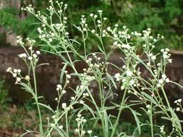
Parthenium hysterophorus
Ragweed Parthenium; Carrot weed; Congress grass; White tops
Accidently introduced in India in 1950s
Among worst top 10 weeds of the world (Holm et. Al. 1977)
Hazard to livestock & humans
Responsible for allergic rhinitis,
nasobronchial allergies etc. in
humans eventually leading to
deaths
Become resistant to chemical
pesticides like Trifluralin,
Atrazine 2,4-D etc.

Slide 20
A. alternata mycoherbicidal potential was observed
in vitro Detached leaf bioassay
In vivo whole plant bioassay

Slide 21
INOCULUM PREPARATION
4 spore conc. Were tested
A. alternata was grown on PDA (26±2º C) for 7 days
Conidia was harvested by flooding the petri dishes with sterile distilled water
The conidial suspension was filtered to remove mycelial bits
Resulted suspension was centrifuged (8000 rpm for 10mins)
Resulted pellet was resuspended using SDW & different conidial conc. Were prepared

Slide 22
Detached leaf bioassay
Leaves were excised from shoots at preflowering stage
9 replicates comprising of 3 leaves each were tested
Fungal inoculum was sprayed evenly
3 replicates (3 leaves each) served as control(received only SDW)
All treatments were kept in a growth chamber (26±2º C; 75±15 %) relative humidity and 15 h illumination period) for one week
Leaves were rated for disease severity every 12 h on a 5-point scale

Slide 23
Resuts
Concentration of 1x10^6 spores/mL was found to be most effective
Caused 89.2 % of average leaf damage
Therefore used for whole plant bioassay

Slide 24
WHOLE PLANT BIOASSAY
4-6 week old plants having 4-8 leaves were grown in pots in a growth chamber with illumination of 12 h daily for a week
Sprayed with fungal inoculum of a spore conc. Of 1x10-6 spores/mL
Experimental set had 10 replicates
The control set received only SDW
Covered with plastic bags and kept in controlled conditions
Plants were observed daily for disease severity until all plants were dead
The experiment was repeated thrice

Slide 25
Results
Onset of disease after 24 h of treatment
Complete death after 7 days
50% damage of weed was recorded on 4th day
60% mortality was observed in detached leaf bioassay on 4th day

