Slide 1
EPISTASIS
“STAND ABOVE”

Slide 2
EPISTASIS
When two or more genes influence a trait, an allele of one of them may have an overriding effect on the phenotype.
When an allele has such an overriding effect, it is said to be epistatic to the other genes that are involved.

Slide 3
OR
Epistasis is a form of gene interaction in which one pair of alleles (gene) masks the phenotypic expression of another.

Slide 4
Epistatic versus Hypostatic
The alleles that are interfering or masking the effect are called epistatic alleles.
The alleles whose effect is being interfered with or masked are called the hypostatic alleles.

Slide 5
Epistasis changes the typical phenotypic ratio observed, and also reduces phenotypic variation.

Slide 6
KINDS OF EPISTATIC INTERACTION
DOMINANT EPISTASIS (12:3:1)
RECESSIVE EPISTASIS (9:3:4)
DUPLICATE GENES WITH CUMULATIVE EFFECT (9:6:1)
DUPLICATE RECESSIVE GENES (9:7)
DUPLICATE DOMINANT GENES (15:1)
DOMINANT & RECESSIVE INTERACTIONS (13:3)

Slide 7
1. DUPLICATE RECESSIVE GENES
Bateson and Punette studied the genetic control study of the corn color.
The corns are either purple or white--- purple if they contain anthocyanin pigment and white if they do not.
Bateson and Punnett crossed two different varieties with white corns to obtain hybrids, which all had purple corns.

Slide 8
When these hybrids were intercrossed, B&P obtained a ratio of 9 purple: 7 white corns in the F2.
They explained the results by proposing that two independently assorting genes, A&B are involved in anthocyanin synthesis and that each gene has a recessive allele that abolishes pigment production.

Slide 9
Given this hypothesis, the parental varieties must have had complementary genotypes: AAbb & aaBB.
When the two varieties were crossed, they produced AaBb.
In this system, a dominant allele from each gene is necessary for the synthesis of anthocyanin pigment.

Slide 10
In the F2, 9/16 of the plants are A-B- and have purple corns; the remaining 7/16 are homozygous for at least one of the recessive alleles and have white corns.
Notice that the double recessive homozygotes, aabb, are not phenotypically different from either of the single recessive homozygotes.

Slide 11
B&P work established that each of the recessive alleles is epistatic over the dominant allele of the other gene.
Each dominant allele produces an enzyme that controls a step in the synthesis of anthocyanin from a biochemical precursor.
If a dominant allele is not present, its step in the biosynthetic pathway is blocked and anthocyanin is not produced.

Slide 12
All the above result tells us that the white strains were homozygous for mutations in different genes involved in the synthesis of purple pigment.
Substrate A Substrate B Anthocyanin
Therefore, if a plant has ccPP, ccPp, CCpp or Ccpp genotypes, it bears only white flowers.
Purple flowers are formed in plants having genotype CCPP or CCPp or CcPP or CcPp.

Slide 13
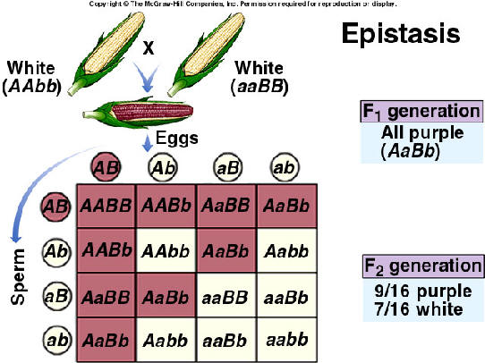

Slide 14
Complementary genes
The complementary genes are two genes present on separate gene loci that interact together to produce dominant phenotypic character, neither of them if present alone, can expresses itself. It means that these genes are complementary to each other.
From checker board, it is clear that 9 : 7 ratio between purple and white is a modification of 9 : 3 : 3 : 1 ratio.

Slide 15
Duplicate Dominant genes
If the dominant alleles of two gene loci produce the same phenotype, whether inherit together or separately, the 9 : 3 : 3 : 1 ratio is modified into a 15 : 1 ratio.

Slide 16
EXAMPLE
The capsules of shepherd's purse (Capsella) occur in two different shapes, i.e., triangular and top-shaped.
When a plant with triangular capsule is crossed with one having top-shaped capsule, in F₁ only triangular character appears.
The F₁ offspring by self crossing produced the F₂ generation with the triangular and top-shaped capsules in the ratio of 15 : 1.

Slide 17
Two independently segregating dominant genes (A and B) have been found to influence the shape of capsule in the same way.
All genotypes having dominant alleles of both or either of these genes (A and B) would produce plants with triangular-shaped capsules.
Only those with the genotype aabb would produce plants with top - shaped capsules.

Slide 18
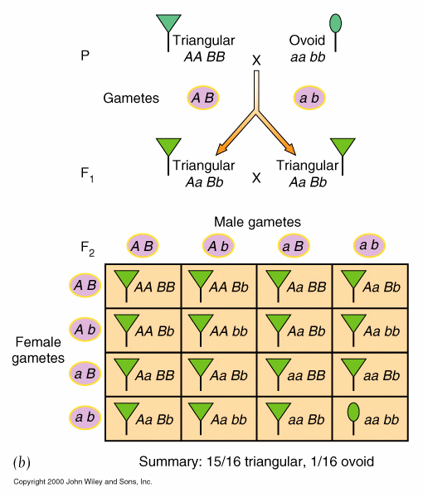

Slide 19
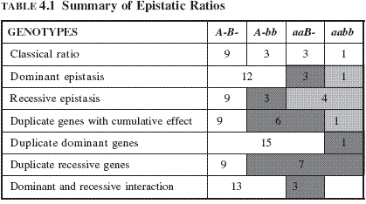
SUMMARY OF EPISTATIC RATIOS

