Slide 1
TRIHYBRID CROSS

Slide 2
A trihybrid cross is between two individuals that are heterozygous for three different traits.
We will build on previous examples and again examine pea shape and pea color and then a new trait: pod shape.
The same rules as before apply for shape and color (round is completely dominant to wrinkled, and green is completely dominant to yellow).
Pea pod shape follows similar rules, with smooth pods being completely dominant to constricted pods.
Therefore, homozygous-dominant and heterozygous individuals will have smooth pods, while homozygous-recessive individuals will have constricted pea pods.

Slide 3
Our trihybrid cross example: RrYyCc x RrYyCc is a trihybrid cross.
The shape of the pea is controlled by one set of alleles, where round is completely dominant to wrinkled:
RR = round
Rr = round
rr = wrinkled
The second set of alleles in this example controls the color of the peas. Green is dominant to yellow:
YY = green
Yy = green
yy = yellow
The third set of alleles in this example controls the shape of the pea pod. Smooth is completely dominant to constricted:
CC = smooth
Cc = smooth
cc = constricted

Slide 4
The gametes for each parent in a trihybrid cross would be RYC, RYc, RyC, Ryc, rYC, rYc, ryC, ryc, with one-eighth of a chance for any of them.

Slide 5
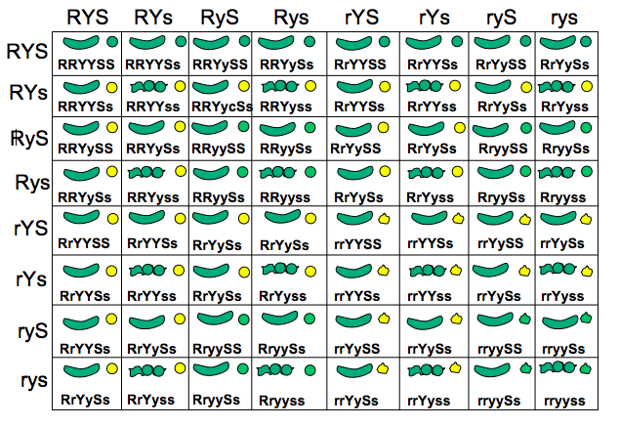

Slide 6
Phenotypic ratio
27: round, green, smooth pod
9: round, green, constricted pod
9: round, yellow, smooth pod
3: round, yellow, constricted pod
9: wrinkled, green, smooth pod
3: wrinkled, green, constricted pod
3: wrinkled, yellow, smooth pod
1: wrinkled, yellow, constricted pod

Slide 7
Genotypic ratio
1: RRYYCC
2: RRYYCc
1: RRYYcc
2: RRYyCC
4: RRYyCc
2: RRYycc
1: RRyyCC
2: RRyyCc
1: RRyycc
2: RrYYCC
4: RrYYCc
2: RrYYcc
4: RrYyCC
8: RrYyCc
4: RrYycc
2: RryyCC
4: RryyCc
2: Rryycc
1: rrYYCC
2: rrYYCc
1: rrYYcc
2: rrYyCC
4: rrYyCc
2: rrYycc
1: rryyCC
2: rryyCc
1: rryycc

Slide 8
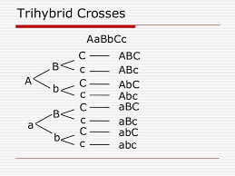

Slide 9
