Slide 1
Bioethics and Biosafety
M.Sc/Biotech-409

Slide 2
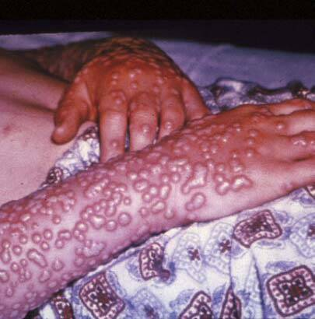
What is Biosafety?
the containment conditions under which infectious agents can be safely manipulated.
the mechanism developed through policy and procedure to ensure environmentally safe application of biotechnology.
Safety from exposure to Infectious Agents

Slide 3
Biosafety Practices
Treat all unknown chemicals as hazardous materials.
Containers are NOT to be used for food preparation or consumption.
Use proper containment when transporting through work area.
Implement corrective action to correct identified concerns.
Examples
Revising policies/procedures
Retraining employees
Re-organizing the workplace
No smoking while handling.
Always use proper personal protective equipment (PPE)

Slide 4
Personal protective equipment (PPE)
PPE refers to protective clothing, helmets, goggles, or other garment or equipment designed ------------- to protect the worker's body from injury.
Use fume hoods whenever possible.
Splash proof safety goggles ------- all times in the laboratory.
Laboratory coat/apron ---------------- in the laboratory.
Appropriate gloves ------------------------- as needed.
Appropriate closed-toed shoes --------------- in the laboratory.
Respirators may only be used by individuals that have completed respirator training

Slide 5
Wash hands before leaving laboratory.
Launder clothing worn in laboratory separately from other clothing.
Never mouth pipettes anything in the lab.
Never eat, drink or apply cosmetics in a laboratory or areas where chemicals/hazardous agents are stored. (Smoking is prohibited in all areas of University buildings, including laboratories.)
Never store food in a refrigerator where hazardous materials are stored.
Never eat or drink from laboratory glassware.
Avoid contact lenses in the laboratory.
Avoid situating long hair, loose sleeves/cuffs, rings, bracelets, etc. in close proximity to open flames or operating machinery.
Keep exposed skin covered. Shorts, sleeveless or short sleeve shirts, skirts or open-toed shoes should not be worn in the laboratory

Slide 6
Routes of exposure
Ingestion = Eat/swallow
Inhalation = Breath
Perenteral = Mother to child/before born
Cutaneous = Skin/Absorption

Slide 7
Devices and equipment that provide a barrier between an employee and a hazardous environment are :
Disposable = Must be properly discarded after use
Reusable = Must be disinfected after each & every use

Slide 8
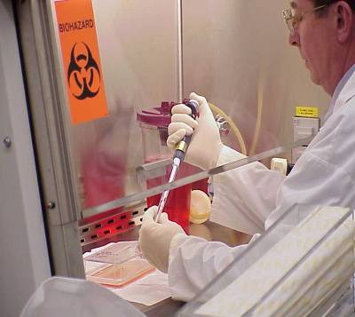
Biosafety in Academic Research
Research Universities:
Promoting safe laboratory practices, and procedures; proper use of containment equipment and facilities; provides advice on laboratory design and risk assessment of experiments involving infectious agents, rDNA in-vitro and in-vivo.

Slide 9
Good Laboratory Practices
Be familiar with the materials you are working with (e.g., chemical, biological, radioactive).
Written laboratory protocols and review the MSDS (Material Safety Data Sheets) for chemicals.
Consider the toxicity of the materials and the health and safety hazards of each procedure.
Know the location of safety equipment and emergency procedures in your area.
Always use appropriate clothing (e.g., pants, shirts, shoes) in the laboratory. Open sandals are prohibited; shorts and skirts are not recommended.

Slide 10
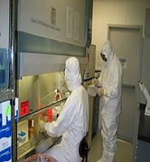
Do not work alone in the laboratory. When hazardous operations are conducted, arrangements should be made to have another person present in the lab.
Keep the laboratory and work area clean and uncluttered.
Work with all hazardous chemicals inside a fume hood.
Never eat, smoke, drink, prepare food or apply cosmetics in the laboratory.
Do not leave reactions unattended.
Prohibit unauthorized individuals from
entering the laboratory.

Slide 11
Biosafety in Pakistan

Slide 15
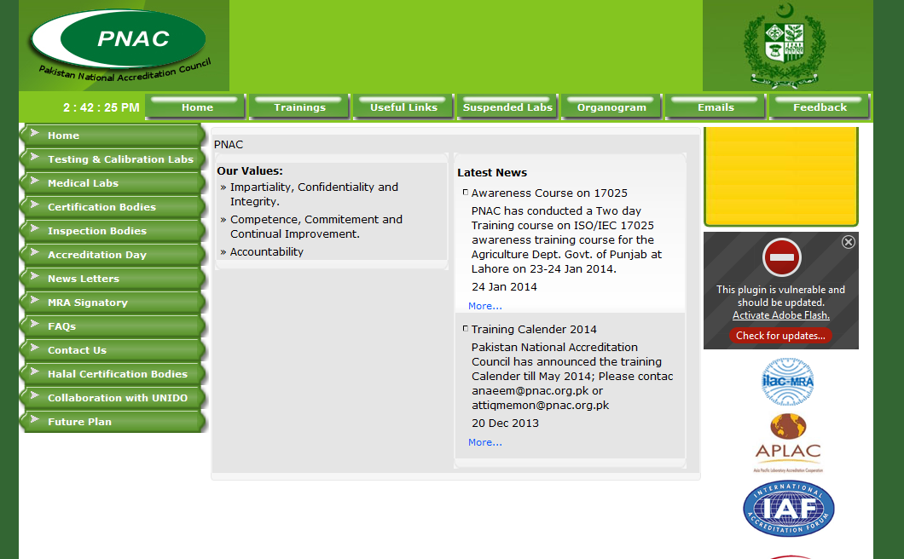

Slide 16
Questions?
Dr. Saiqa Ilyas
saiqailyas@gmail.com

