Slide 1
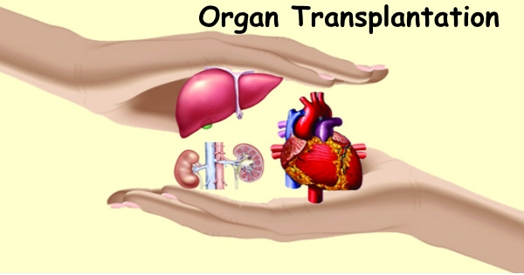
ETHICAL ISSUES INVOLVED IN ORGAN TRANSPLANTS

Slide 2
DEFINITION:
Organ transplantation is the moving of an organ from one body to another or from a donor site to another location in the person's own body, to replace the recipient's damaged or absent organ.
The donated organ may be from a deceased donor, a living donor, or an animal. In some cases an artificial organ is used.
Organ donors may be living, brain dead, or dead via circulatory death. Tissue may be recovered from donors who die of circulatory death, as well as of brain death – up to 24 hours past the cessation of heartbeat.

Slide 3
INTRODUCTION
An organ transplant is a surgical operation in which the damaged organ in the human body is removed and replaced with a functioning one.
Cadaveric organ donation involves removing organs from a recently deceased donor.
Living organ donation involves the donation of one of a paired organ (such as kidneys) or a portion of an organ (such as a lobe of the liver or lung). The donor's organ system is still able to function after the donation.

Slide 4
Which organs can be transplanted?
Solid transplantable organs:
Lungs
Kidney
Pancreas
Heart
Intestine
Thymus
Liver
Other organs
Gall bladder
Stomach
Eyes, ear, nose, skin

Slide 5
The critical donation pathway Donation after brain death
Severe brain damage Donor detection Identify potential donor Donor referral Diagnose brain death Familycommunication
Refer potential donor Donor maintainance
Approach to family Organ retrieval Maintain viability of organs Retrieve organs Provide feedback

Slide 6
PROCESS
Organ Transplantation Process
Organ Transplantation process
Steps for getting on the Organ Transplant waiting list
Planning your finances
How organs are matched i-e blood type
After the transplant (eating & exercise)
Contacting your donar family

Slide 7
ETHICAL ISSUES REGARDING THE DONOR
A problem or situation that requires a person or organization to choose between alternatives that must be evaluated as right (ethical) or wrong (unethical).
The decision whether or not to donate organs and/or tissues for transplantation is an ethical (or ‘moral’) decision.
The discussion here aims to ensure that whatever decision the person makes, whether to donate or not to donate, that
decision will be a well-informed one

Slide 8
ISSUES
Why think about the ethics of donating organs after death?
What actually happens?
Reasons why some
Decide and others decide
not to donate organs after
death.
Making a decision when the relative has died
The procedures involved
Brain death
What happens to the organs and tissues?
How will the family feel outwards?

Slide 9
DONATION AFTER DEATH
Organ and tissue donation involves making a decision about how someone’s body is to be treated after death.
Organ and tissue donation may be seen as one of the last acts of the person who donates. It is a decision about how that person wanted to live his or her life and be remembered in death.
It is also an ethical decision because it is intended to benefit others, the recipients of organs or tissues by transplantation
Organ and tissue donation is a decision which will affect those who are left behind after someone has died. Since the issue of organ donation often arises after a sudden and traumatic death, the feelings of the bereaved family are very important.

Slide 10
LIVING ORGAN DONATION
Benefits:
The donation can be pre-arranged, allowing the patient to begin taking antirejection drugs in advance, thereby increasing the chances of success
·There are often better matches between donors and recipients with living donation, because many donors are genetically related to the recipient
Psychological benefits for both the donors and recipients

Slide 11
DRAWBACKS
Health consequences: Pain, discomfort, infection, bleeding and potential future health complications are all possible
Psychological consequences: Family pressure, guilt or resentment
Pressure: Family members may feel pressured to donate when they have a sick family member or loved one
·

Slide 12
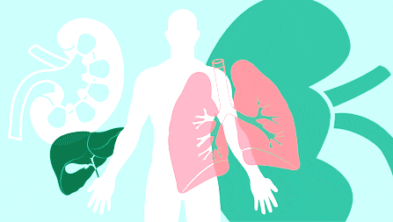
ETHICAL ISSUES REGARDING THE RCIPIENT
A competent person who could benefit from receiving a transplant should be informed regarding the benefits, risks, burdens and costs of the transplant and aftercare.
No unfair influence should be put on someone to be a transplant recipient.
Recipients and their families can be tempted to pressure, blackmail or bribe a potential living donor to donate or a health care professional to give them a privileged position on the waiting list.
Such practices are unethical because they fail to respect the freedom of the donor or they violate other potential recipients' rights regarding access.

Slide 13
ETHICAL ISSUES REGARDING THE ALLOCATION OF LIMITED RESOURCES
1. Criteria for Selection
Human organs demand usually exceed. Ethical questions regarding efficiency and fairness arise as to how best to distribute these limited resources.
On what basis should this person rather than that person be chosen to receive a given organ?
Who should choose?
These decisions are serious as they can involve who will live and who will die. A widely used and approved criteria of selection is to give priority to those who have great need and who are expected to benefit greatly.

Slide 14
2. Artificial Substitutes for Organs
The shortage of various human parts for transplant purposes has also in motivated research in the development of artificial and synthetic substitutes for tissues and organs.
Artificial replacement technologies are generally very costly to develop. If they prove to be successful and are mass produced, their long-term costs can be significantly reduced.
A number of routinely used replacement technologies such as long-term renal dialysis, however, remain expensive.

Slide 15
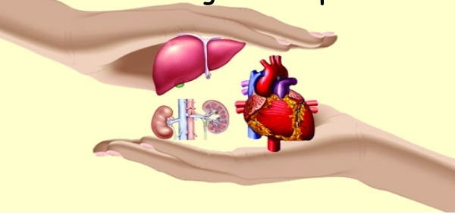
3. USING ANIMALS
The use of animal parts such as insulin extracted from animal pancreases, and pig heart valves, are already "accepted" medical treatments.
Some argue that the transplants between species does not justify such experiments which so far do not offer hope of therapeutic benefit to the human recipients. Defenders of such experiments argue that they can be justified if no other alternatives are available and for the knowledge gained.
Some have questioned whether such transplants involve irresponsible meddling with nature. Various animal rights groups have protested the sacrifice of animals involved in this and other research, which uses them as "mere means" to human welfare.

Slide 16
thanks

