Slide 1
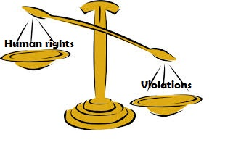
Introduction to Bioethics

Slide 2
ethics
The term comes from the Greek word
Ethos, which means "character in philosophy”
It is a branch of philosophy dealing with values relating to human conduct, with respect to the rightness and wrongness of certain actions and to the goodness and badness of the motives and ends of such actions
study of moral behaviors in humans
a system of moral principles
involves defending and recommending concepts of right and wrong conduct.

Slide 3
What is bio-ethics?
Bioethics ------ a combination of two words
Bios = life
Ethos = Ethics/behavior/character/
literally means the ethics of life.
Study of the typically controversial ethical issues emerging from new situations and possibilities brought about by advances in biology and medicine
OR
The discipline dealing with the ethical implications of biological research and applications especially in medicine, organ transplantation, genetic engineering.
Ethical discussion ---------Biological research

Slide 4
The Origin of Bioethics
Albert Jonsen started history of bioethics
“The Birth of Bioethics”
The ancient ethical codes were often expressed in the form of oaths.
The best known medical oath in the Western tradition is the Oath of Hippocrates, commonly assumed to be from the fifth century BC, and often regarded as the very foundation of Western medical ethics.
Hippocratic oath to "do no harm" remains at the core of modern medical ethics.

Slide 5
The American Medical Association (AMA) established a code of ethics in 1846 to regulate medical practice.
In the 1960s the introduction of dialysis machines, and the resulting "God committees" to decide who would receive the life-saving treatments
At the same time, a cultural emphasis on individual rights merged with growing concerns over medical and biological advances to require government intervention.
For example,
brain death
the ethics of organ transplantation,
potential for prenatal genetic discrimination ----- led to the first Senate hearings on bioethics in 1968.

Slide 6
national bioethics commission
The National Commission for the Protection of Human Subjects of Biomedical and Behavioral Research (1974-78) is generally viewed as the first national bioethics commission.
Established as part of the 1974 National Research Act.

Slide 7
INSTITUTIONS OF BIOETHICS
In 1969, Willard Gaylin and Daniel founded the Hastings Center, funded primarily by the individuals John D. Rockefeller III and Elizabeth Dollard, as well as by the National Endowment for the Humanities.
Since 1974 the KIE (Kennedy Institute of Ethics) at Georgetown University has sponsored very popular "intensive summer courses" in bioethics.
Journals emerged that were designed for works in the field of bioethics,
Hastings Center Report,
the Kennedy Institute of Ethics Journal,
the American Journal of Bioethics.

Slide 8
International bioethics committee (IBC)
The International Bioethics Committee (IBC) was created in 1998, under Article 11 of the Statutes of the International Bioethics Committee (IBC).
It is comprised of 36 Member States whose representatives meet at least once every two years to examine the advice and recommendations of the IBC.

Slide 10
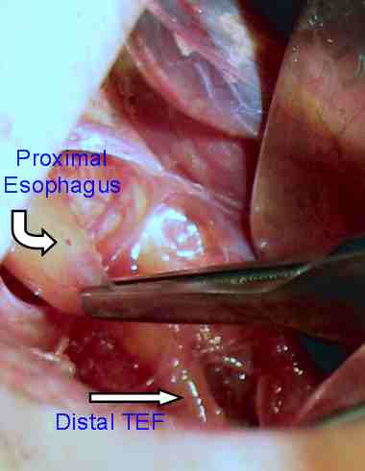
Surgical treatment of condition

Slide 11
Bioethics in Pakistan
bioethics was imported to Pakistan in the mid-1980s by members of the medical community, many of whom had trained in America.
imparting thought and knowledge in different aspects of ethics to medical students, junior doctors and patients.
Centre of Bioethics and Culture (CBEC) in Karachi, the only public sector institute providing training for award of diploma and masters in Bioethics in Pakistan.
In Pakistan, even the uneducated, poor, and presumably "powerless" patients have now begun to question
their physicians for their right to know their options
their planned treatment and possible complications

Slide 12
National Bioethics committee (NBC) Pakistan
The Ministry of Health, Government of Pakistan constituted a National Bioethics Committee (NBC) according to International guidelines.
This committee was notified in the Gazette of Pakistan on January 28, 2004.
In Pakistan no system for ethical clearance was in place and as a result researchers from within country seeking international funding and researchers from abroad linking with researchers and institutions, were facing lot of problems in getting the required ethical clearance for their projects.

Slide 13
Bioethics & its relationships
Bioethicists are concerned with the ethical questions that arise in the relationships among
Life sciences
Biotechnology
Politics
Law
Medicine
Philosophy

Slide 14
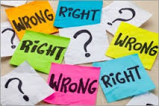
Ethical issues
Abortion
Euthanasia
Suicide
Determination of death
Cloning
Human experimentation
Birth control
In vitro fertilizations
Stem cell technology
Homosexuality
Genetically modified food
Genetically modified organisms
Organ transplant
Surrogacy

Slide 16
Principle of bioethics
Some of the early founders of bioethics put four principles which form this framework for moral reasoning. These four principles are:
Autonomy
(respect the right of individuals to make their own decisions)
Non maleficence
(avoid causing harm)
Beneficence
(take positive steps to help others)
Justice
(benefits and risks should be fairly distributed)

Slide 17
Autonomy
Medical treatment should be practiced under the consent of the patient
In order to respect their will, we must KNOW what their will is BUT here comes the problem……
Medical treatment requires high medical knowledge but the patient doesn’t usually have that, and is it right to respect their choices fully just because we are living in a free and democratic society?
Doctor tells the patient about all the information related to his /her disease, is this morally right?
What if telling the truth can weaken the patient’s health and have a bad influence on them?
What if the patient is unable to express their will e.g. they are in the state of coma or etc?
Can the doctor use placebo effect to enhance the condition of the patient?

Slide 18
Non maleficence
Maleficence = harmful influence in mental and physical ways to the patient
There are different cases when the doctors have to practice “maleficence” e.g.
organ donation causes physical harm to one person but is necessary to save the life of the other patient
Act of murder-active or passive is also a question worth thinking about….e.g.
your cat starved to death because you didn’t give it any food…..did we kill it or leave it to die?

Slide 19
Beneficence
Doctor can interfere with patients considering the increase of the quality of their lives
e.g. euthanasia
Principle of beneficence goes against the principle of autonomy – have to know WHAT IS GOOD for patient (which we call quality of life)
What is the quality of life?
Does the doctor have the moral duty of good deeds?

Slide 20
Justice
The distribution of medical resources- microscopic level and macroscopic level
Micro--Decisions of the real beneficiary/ to whom and how should the medical resources be distributed?
Macro—how much budget for ministry of health & welfare / who is going to pay for this?/ what kind of medical insurance system should the government implement?
Does human have right to a decent minimum of health care? And if humans do, what is the standard?

