Slide 1
Preparation of blood components and their use

Slide 2
Introduction
• Blood components are those derived from whole blood collected from normal donors by phlebotomy –using the technique of differential centrifugation
• These products are prepared in blood centres or hospital labs

Slide 3
1. BLOOD COMPONENTS - Preparation and usage
Also known as BLOOD COMPONENT THERAPY
Blood component therapy
Various blood components are prepared from whole blood by using multiple blood bags and separating blood components in large refrigerated centrifuges
• This should be done within 2-6hrs of blood collection

Slide 4
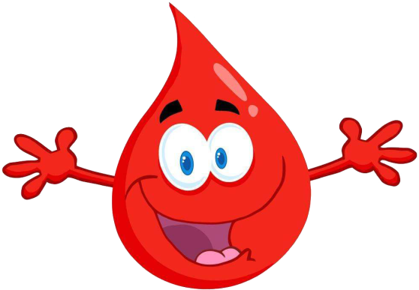
Introduction
• Human blood is covered under the definition of ‘Drug’ under Sec. 3(b) of Drugs & Cosmetics Act
• ‘Blood’ means and includes whole human blood, drawn from a donor and mixed with an anti-coagulant

Slide 5
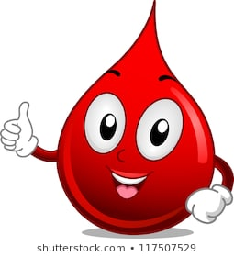
Introduction
• Blood component’ means: a drug prepared, obtained, derived or separated from a unit of blood drawn from a donor.

Slide 6
Collection of blood
• Blood is collected in the primary bag that contains anti-coagulant preservative
• Anticoagulant preservatives minimize biochemical changes and increase shelf life

Slide 7
Collection of blood
Blood bag collection set is packed in polythene bag and sterilized by gamma radiation or formalin fumes.
Blood collection set consist of disposable blood bag with sterile polythene tube fixed with 16 or 18 gauge needle

Slide 8
Procedure for collection PHLEBOTOMY
Phlebotomy the surgical opening or puncture of a vein in order to withdraw blood, to introduce a fluid, or (historically) when letting blood
Venepunture is performed by introducing 16 or 18 gauge needle of the bleeding set into a prominent vein.
Blood flows into the blood bag containing anti coagulant • Blood is collected upto particular weight about 500ml

Slide 9
Storage of blood
Storage
The whole blood should be stored at 4-60C in a suitable refrigerator
Different anticoagulants have different shelf life for the stored blood

Slide 10
Anticogulants
Maintain pH of blood
Prevent coagulation by precipitating calcium
Dextrose present provide necessary nutrition

Slide 11
Anticoagulants
Types
Acid citrate dextrose-ACD
Citrate Phosphate Dextrose-CPD
Citrate phosphae dextrose adenine - CPDA

Slide 12
Components of Blood

Slide 14
Blood component preparation was developed in 1960 to separate blood products from one unit whole blood by a specialised equipment called as refrigerated centrifuge.
Preparing only packed red blood cells PRBC and fresh frozen plasma (FFP) is by single-step heavy spin centrifugation; however preparing platelet concentrates (PLTCs), PRBC concentrates and FFP is by two step centrifugation

Slide 16
Blood components are
plasma,
platelets
leucocytes (Buffy Coat [BC])
packed red blood cells (PRBCs)

Slide 17
Methods of Separation of Blood Components
There are various methods to separate these components and the yield and quality of component depends upon the methods applied.
Various methods used are:
a)Gravity separation
b)Low and high speed centrifugation
c)Apheresis by cell separator

