Slide 1
Mendelian Genetics

Slide 2
Introduction
The life of Gregor Johann Mendel (1822-1884) spanned the middle of the 19th century.
He is known as the “Founder of Genetics”.

Slide 3
Mendel performed experiments with several species of garden plants.
Even tried some experiments with honeybees.
His greatest success was with peas.
He worked 11 years on pea plant (Pisum sativum L.) and completed his work in 1864, published in 1865.

Slide 4
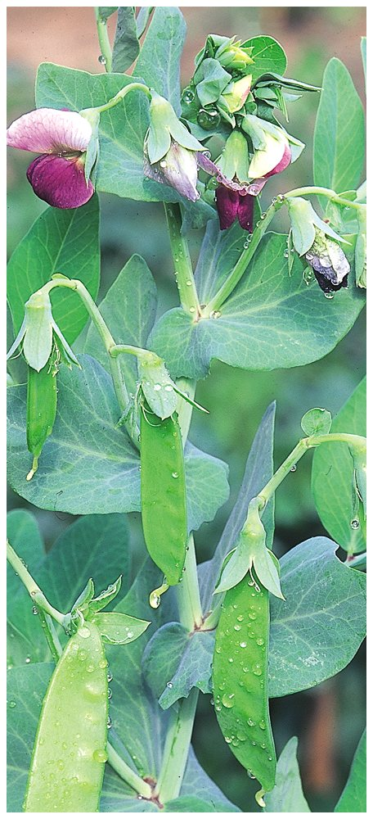
Why the Garden Pea…?
Short sowing season.
Easy to grow & interbreed.
Mature in single season.
True breeding strains.

Slide 5
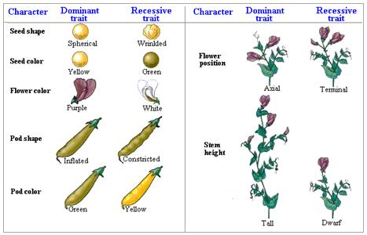
7 traits Mendel looked at
Notes:
5

Slide 6
In addition to all this, he kept careful records (quantitative) of the experiments that he performed.

Slide 7
Important TERMINOLOGIES
Dominance:
A condition in which one member of an allele pair is expressed to the exclusion of the other.
Recessive:
A condition in which one member of an allele pair lacks the ability to manifest itself when the other or dominant member is present.

Slide 8
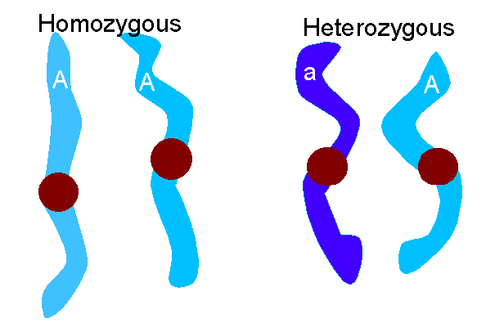
Genes:
These are heritable factors (unit of inheritance) located on chromosomes.
Alleles:
One of a pair or series of alternative forms of a gene that occur at a given locus in a chromosome. (D for tall and d for dwarf)

Slide 9
Homozygote:
An individual in which the two copies of a gene are the same allele (e.g., Tall: DD).
Heterozygote:
An individual in which unlike members of any given pair or series of alleles are present that consequently produces unlike gametes (e.g., Tall: Dd).

Slide 10
Parental generation:
Pertaining to the founding strains used in a cross; having the characteristics of these strains. P-generation.
Filial generation:
F1 is the first filial generation which is the first generation of descent from a given mating.
F2 is the second filial generation which is achieved by self-fertilizing F1.

Slide 11
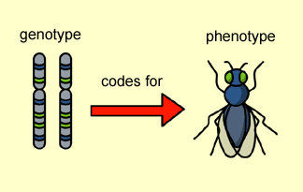
Genotype:
The genetic constitution (gene makeup) of an organism.
Phenotype:
The physical appearance or observable characteristics of an organism.

Slide 12
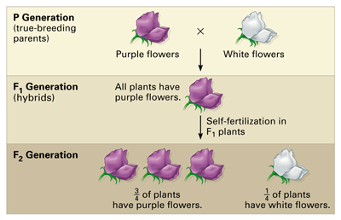

Slide 13
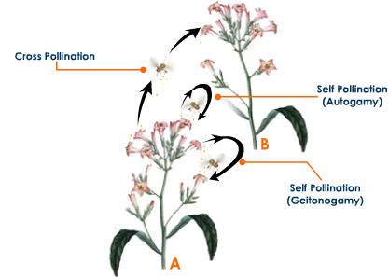
Self-fertilization:
Mating with the same.
Cross-fertilization:
Mating with the different.

