Slide 1
Introduction To
Biostatistics

Slide 18
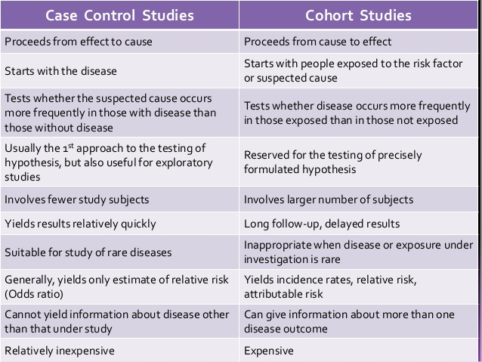

Slide 20
Cross-Sectional Studies

Slide 21
Features of C-S Studies
Snapshot in time
e.g. - cholesterol measurement and ECG measured at same time
Determines prevalence at a point in time
Therefore, C-S is a prevalence study

Slide 22
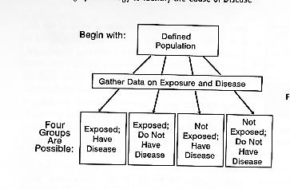
Design of a C-S Study

Slide 23
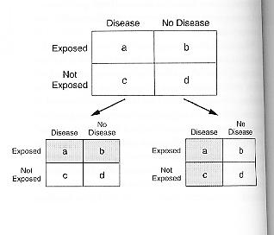
Design of a C-S study (Cont.)

Slide 24
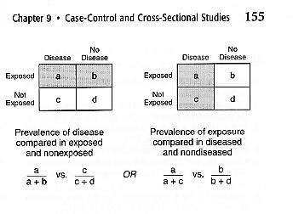
Fig 9-11
p. 155

Slide 25
Advantages of C-S Studies
Short term
Fewer resources required
Less statistical analysis
More easily controlled
Design less complex
Provide relationship between attributes of disease and characteristics of various groups, e.g. elderly group
Data is useful for planning of health services and medical programs

Slide 26
Disadvantages of C-S Studies
Represent only those who are surveyed
Identify prevalence, not incidence necessarily excludes cases that died before study was done
Show association with survival - not risk of development
People who are ill may not show up for survey -*Healthy Person Effect
Often, not possible to establish temporal relationship between exposure and onset e.g. does high cholesterol precede CHD?
Not too effective if disease levels are low
Therefore, difficult to establish a causal relationship
Data can be only suggestive of causation

