Slide 1
CULTIVATION & GROWTH OF MICROORGANISMS

Slide 2
CULTIVATION OF MICROORGANISMS
To determine the precise nutritional requirements of a microorganism, chemically defined media are used, because the exact composition of such media is known.
Culture medium: A nutritive substance, such as an agar gel or liquid medium, in which cultures of bacteria, fungi, animal cells, or plant cells are grown.
Two major types of growth media.
cell culture
microbiological culture

Slide 3
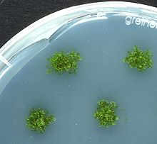
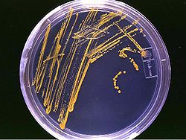

Slide 4
TYPES OF MEDIA
Nutrient Media
Minimal Media
Differential Media
Selective Media
Selective+Diffrential Media
Enrichment Media
Transport Media

Slide 5
1. Nutrient Media
Nutrient media contain all the elements that most bacteria, fungi, protozoan and algae need for growth and are non-selective, so they are used for the general cultivation and maintenance of microorganisms kept in laboratory culture collections.
An undefined medium (also known as a basal or complex medium).
A defined medium (also known as chemically defined medium or synthetic medium).

Slide 6
MEDIA FOR THE GROWTH OF BACTERIA
Media chosen to cultivate specific bacteria normally imitate the normal habitat of those bacteria.
Autotrophic (Photo/ Chemo)
Heterotrophic (Photo/ Chemo)

Slide 7
Example nutrient agar medium composition (HETEROTROPHIC)
Beef extract: 0.3 g (minerals and carbohydrates)
Peptone: 0.5 g (protein and nitrogen source)
NaCl: 0.5 g (electrolyte)
Agar: 1.5 g (solidifying agent)
Distilled water: 100 ml
pH: 7

Slide 8
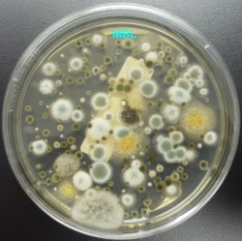

Slide 9
MEDIA FOR THE GROWTH OF FUNGI
Like, bacteria, fungi absorb nutrients and do not ingest them. Absorption aided by enzymes.
In general, media for fungal growth have a higher sugar concentration and low pH.

Slide 10
Composition of fungal media
Peptone
Glucose
Agar
Water
pH

Slide 11
MEDIA FOR THE GROWTH OF PROTOZOA
Most protozoa require a pH range of 6-8 for optimal growth.
Protozoa are aerobic heterotrophs with complex nutritional requirements.
Not easily grown in vitro.
Require a variety of amino acids, vitamins, carbohydrates etc.
Amoeba can grow in a simple peptone media while others require brain tissue emulsion, fetal calf serum, liver infusion etc.
They ingest nutrients rather than absorption.

Slide 12
MEDIA FOR THE GROWTH OF ALGAE
Algae use light for energy and require only CO₂, water and soluble inorganic salts for growth.
Mostly are photoautotrophs.
Few are heterotrophs.
Media used is soil extract and specially defined media.

Slide 13
2. Minimal Media
Minimal media are those that contain the minimum nutrients possible for a colony growth, generally without the presence of amino acids and are often used by microbiologists and geneticists to grow "wild type" microorganisms.
A minimal medium contains only inorganic salts, a carbon source, and water.

Slide 14
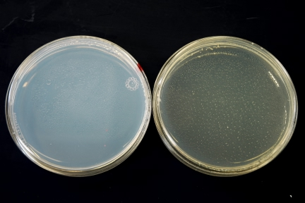

Slide 15
3. Selective Media
Selective media are used to enhance the growth of only selected microorganism or suppress the growth of other kinds of microorganisms.
For example, if a microorganism is resistant to a certain antibiotic, such as ampicillin or tetracycline, then that antibiotic can be added to the medium in order to prevent other cells, which do not possess the resistance, from growing.

Slide 16
YM (yeast and mold) which has a low pH, deterring bacterial growth.
MacConkey agar for Gram-negative bacteria.
Mannitol salt agar (MSA) which is selective for Gram-positive bacteria and differential for mannitol.

Slide 17
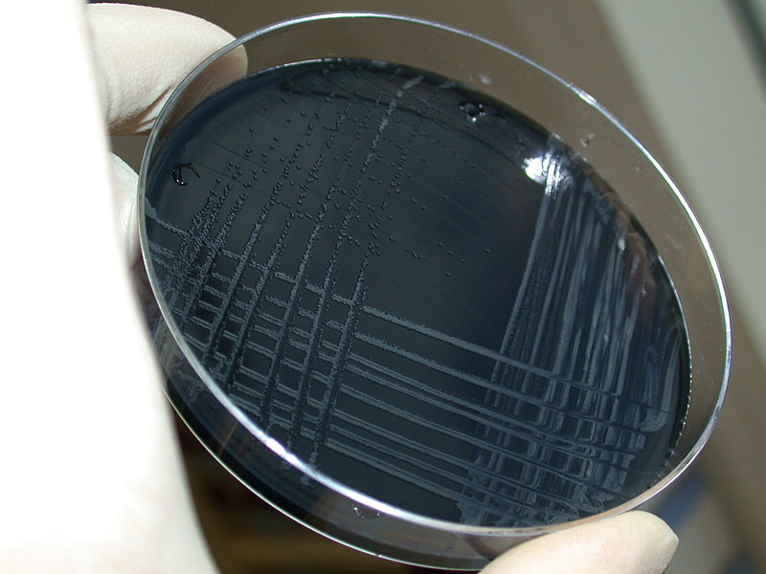

Slide 18
4. Differential Media
Differential media or Indicator media distinguish one microorganism type from another growing on the same media.
Microbiologists use differential media when they want to differentiate among various kinds of microorganisms on an agar plate.
This type of media is used for the detection of microorganisms and by molecular biologists to detect recombinant strains of bacteria.

Slide 19
Examples
eosin methylene blue (EMB), which is differential for lactose fermentation.
Blood agar medium to differentiate b/w hemolytic vs nonhemolytic.

Slide 20
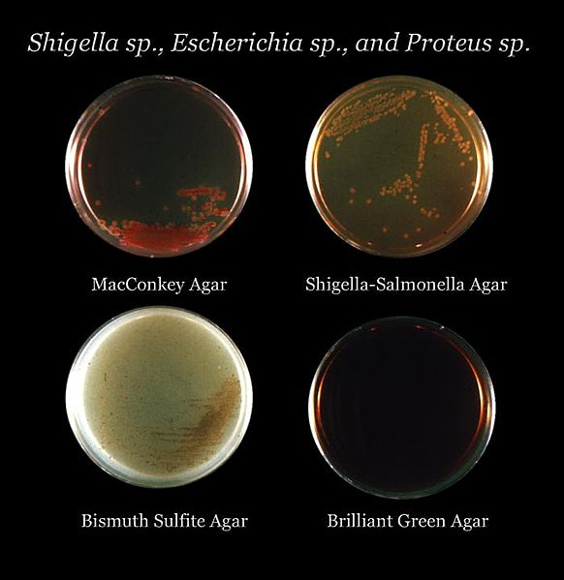

Slide 21
5. Selective/ Differential Media
Some culture media are both selective and differential.
For example: MacConkey Agar.
Inhibit the growth of gram positive and favors gram negative only.
Lactose fermenting gram negative.

Slide 22
6. Enrichment Media
An enrichment culture is a medium with specific and known qualities that favors the growth of a particular microorganism. The enrichment culture's environment will support the growth of a selected microorganism, while inhibiting the growth of others.
Examples:
High salt concentration will select for halophiles. High temperatures will select for thermophiles.
Selenite broth is used to selectively isolate Salmonella species. Alkaline Peptone Water is used for the cultivation of vibrio. Both these examples are clinically relevant for clinical microbiology relating to stool samples.

Slide 23
7. Transport Media
Transport media should fulfill the following criteria:
temporary storage of specimens being transported to the laboratory for cultivation.
maintain the viability of all organisms in the specimen without altering their concentration.
contain only buffers and salt.
lack of carbon, nitrogen, and organic growth factors so as to prevent microbial multiplication.
transport media used in the isolation of anaerobes must be free of molecular oxygen.

Slide 24
Examples
Thioglycolate broth for strict anaerobes.
Stuart transport medium - a non-nutrient soft agar gel containing a reducing agent to prevent oxidation and charcoal to neutralize
Certain bacterial inhibitors - for gonococci and buffered glycerol saline for enteric bacilli.
Venkat-Ramakrishnan(VR) medium for V. cholerae.

Slide 25
PURE CULTURE
Often microbes exist in mixed population and need to be purified or isolated by single colony formation (colony members are all descendant of a single cell).
Pure cultures are often obtained by streaking or spreading procedures using agar plates.
Pure cultures are often frozen or lyophilized and saved.
Contaminants: unwanted organisms in a culture.
Cells can be grown in liquid or solid culture media.

Slide 26
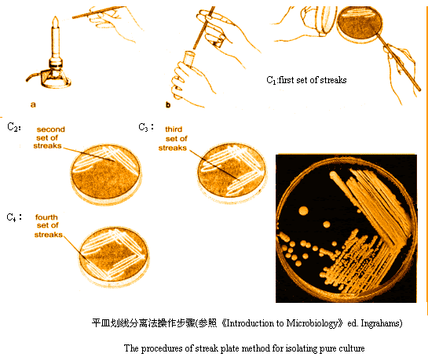

Slide 27
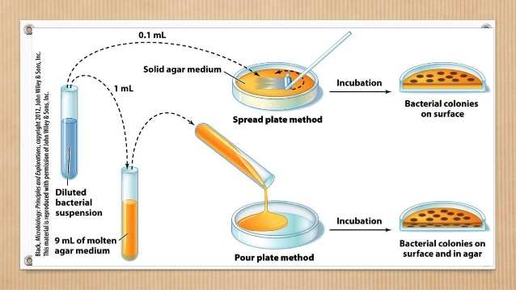

Slide 28
MICROBIAL GROWTH
Refers to growth of the microbial population and not to the growth of individual cells in the population.
During microbial growth each individual cell grows and divides, thus their number increases as well.

Slide 29
GROWTH CURVE
Bacterial growth has a
Lag Phase (no increase in cell number, period for preparing a balanced growth)
an Exponential Growth Phase ( period during which the rate of growth is constant, linear part of the curve)
a Stationary Phase (end of growth due to some limitation or change of some factors rendering growth impossible, during which cell number stays the same)
finally a Decline or Death Phase (beyond a certain period at stationary phase, cells start to die, so their viability decline).

Slide 30
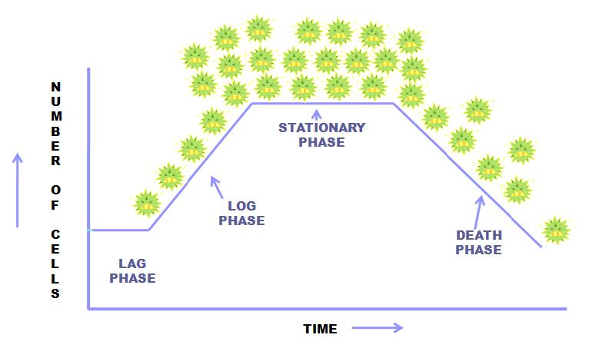

Slide 31
GROWTH MEASUREMENT
Usually by monitoring the mass increase either by
measuring total weight of cells periodically
or by monitoring the increase of a chemical as cell constituent
or by directly counting the number of cells using a counting chamber or a coulter counter
or monitoring indirectly the turbidity of cell cultures.

Slide 32
Effect of Environmental Conditions of Growth
Acidophiles
Alkalophiles
Aerobic
Anaerobic
Psychrophiles
Mesophiles
Thermophiles

