Slide 1
DNA INTRODUCTION

Slide 2
Friedrich Miescher in Germany, 1869
Isolated nuclei from pus cells (white blood cells) in waste surgical bandages
The nuclei contained a novel phosphorus bearing substance that he named nuclein
It is mostly chromatin which is a complex of DNA and chromosomal proteins

Slide 3
Genome
The heriditary basis of every living organism is its genome, a long sequence of DNA that provides the complete set of heriditary information carried by the organism.
It includes
Chromosomal DNA
DNA in Plasmids
Organellar DNA as found in mitochondria and chloroplasts (in Eukaryotes)
By a complex series of interactions the DNA sequence produces all of the proteins of the organism at the appropriate time and place.

Slide 4
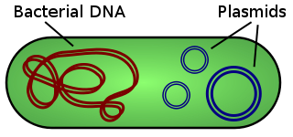
A plasmid is a DNA molecule that is separate from, and can replicate independently of, the chromosomal DNA
They are double stranded and, in many cases, circular. Plasmids usually occur naturally in bacteria, but are sometimes found in eukaryotic organisms (e.g., the 2-micrometre-ring in Saccharomyces cerevisiae).

Slide 5
Physically the genome may be divided into a number of different DNA molecules, or CHROMOSOMES.
So genome is the sequence of DNA of each chromosome
Functionally a genome is divided into genes

Slide 6
The amino acid sequence of every protein in a cell, and the nucleotide
sequence of every RNA, is specified by a nucleotide sequence in the cell’s DNA.
A segment of a DNA molecule that contains the information required for the synthesis of a functional biological product, whether protein or RNA, is referred to as a gene.
or
Each gene is a sequence of DNA that encodes a single type of RNA or polypeptide
A cell typically has many thousands of genes, and DNA molecules, not surprisingly,
tend to be very large.
500 genes (mycoplasma, a type of bacterium)
20,000-25,000 (humans)
50,000-60,000 (for rice)
Functions:
The storage and transmission
of biological information are the only known functions
of DNA.

Slide 7
RNAs have a broader range of functions, and several classes are found in cells.
Ribosomal RNAs (rRNAs)
are components of ribosomes, the complexes that carry out the synthesis of proteins.
Messenger RNAs (mRNAs)
are intermediaries, carrying genetic information from one or a few genes to a ribosome, where the corresponding proteins can be synthesized.
Transfer RNAs (tRNAs)
are adapter molecules that faithfully translate the information in mRNA into a specific sequence of amino acids.

Slide 8
DNA is the Genetic Material
Transformation
Fredrick Griffith
1928
The bacterium Streptococus (formerly Pneumococcus)
Pneumonia kills mice by causing Pneumonia
Virulence is determined by capsular polysaccharide of bacterium which allows bacterium to escape destruction by its host
Several types of S. pneumoniae have different polysaccharides but they all have a smooth appearance
Each of the S type can give rise to variant that fail to produce the capsular polysaccharide and therefore have a rough surface(R)
R types are avirulent and do not kill the mose
Heat killed S type bacteria are also avirulent
Heat killed S type bacteria and R type avirulent bacteria when injected jointly cause pneumonia and mouse died
S type virulant bacteria were recovered from the blood
Some property of dead bacteria has transformed the avirulent bacteria and make them virulent

Slide 10
Oswarld Avery, Maclyn McCarty, and Colin MacLeod (1944)
Performed the same experiment, only they used tissue cultures growing in petri dishes

Slide 11
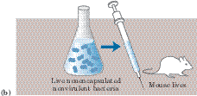
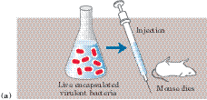
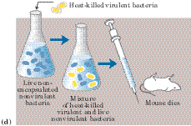
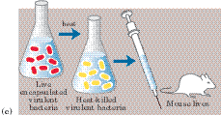
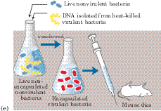
FIGURE The Avery-MacLeod-McCarty experiment. (a) When injected into mice, the encapsulated strain of pneumococcus is lethal,(b) whereas the nonencapsulated strain, (c) like the heat-killed encapsulated strain, is harmless. (d) Earlier research by the bacteriologist Frederick Griffith had shown that adding heat-killed virulent bacteria (harmless to mice) to a live nonvirulent strain permanently transformed the latter into lethal, virulent, encapsulated bacteria. (e) Avery and his colleagues extracted the DNA from heat-killed virulent pneumococci, removing the protein as completely as possible, and added this DNA to nonvirulent bacteria. The DNA gained entrance into the nonvirulent bacteria, which were permanently transformed into a virulent strain.

Slide 12
Avery and his colleagues concluded that the DNA extracted from the virulent strain carried the inheritable genetic message for virulence.
Not everyone accepted these conclusions, because protein impurities present in the DNA could have been the carrier of the genetic information.
This possibility was soon eliminated by the finding
that treatment of the DNA with proteolytic enzymes did not destroy the transforming activity, but treatment with deoxyribonucleases (DNA-hydrolyzing enzymes) did.

Slide 13
. Hershey and Chase Experiment
A second important experiment provided independent evidence that DNA carries genetic information.
In 1952 Alfred D. Hershey and Martha Chase used radioactive phosphorus (32P) and radioactive sulfur (35S) tracers to show that when the bacterial virus (bacteriophage)
T2 infects its host cell, Escherichia coli, it is the phosphorus-containing DNA of the viral particle, not the sulfur-containing protein of the viral coat, that enters the host cell and furnishes the genetic information for viral replication (Fig. 8–13).
These important early experiments and many other lines of evidence have shown that DNA is the exclusive chromosomal component bearing the genetic information of living cells

Slide 16
DNA is the genetic material

Slide 17
When DNA is entered in cells growing in culture, it enters the cells, and in some of them it results in the production of new proteins
The DNA that is introduced into the recepient cell becomes the part of its genome and is inherited with it
Expression of the new DNA results in a new trait
Indicate that DNA is the genetic material in eukaryotes
All known organisms and some viruses has DNA as genetic material
Some viruses use RNA as genetic material

